Slide 1
Notes:
Presentation for 2015 ERM Summit.

Slide 2
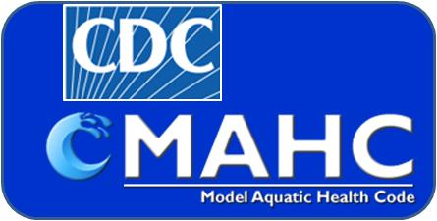
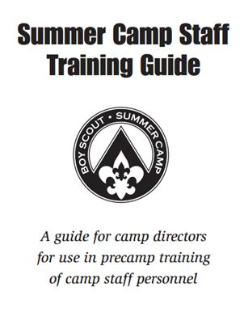
Notes:
Our focus is on how new government regulations, particularly the CDC Model Aquatic Health Code, are likely to affect council operated swimming programs, such as summer camps.
The new codes mandate training programs beyond basic pre-camp certifications.
That in turn needs to be reflected in the NCAP standards,
and also what is taught at National Camping Schools.

Slide 3
Minimum staff training duration:
Day camp = 8 hrs
Resident camp = 28 hrs
Mostly campwide
Mostly area specific
Notes:
Currently, camp standards require a minimal amount of pre-camp training. However, the NCS lesson plan for camp directors and program directors suggests that most of that time is needed for campwide training sessions. There is nothing specific in the admin lesson plan about code training requirements. On the other hand, the NCS aquatics lesson plan, which takes state codes into account, notes that much of the training time will be needed for aquatics specialty training. Making folks aware of that gap, and closing it (next slide), is a goal of this presentation.

Slide 4
Minimum staff training duration:
Day camp = 8 hrs
Resident camp = 28 hrs
campwide
area specific
balanced

Slide 5
Model Aquatics Health Code
what ?
Notes:
So, what exactly is the CDC Model Aquatics Health Code, or MAHC?

Slide 6
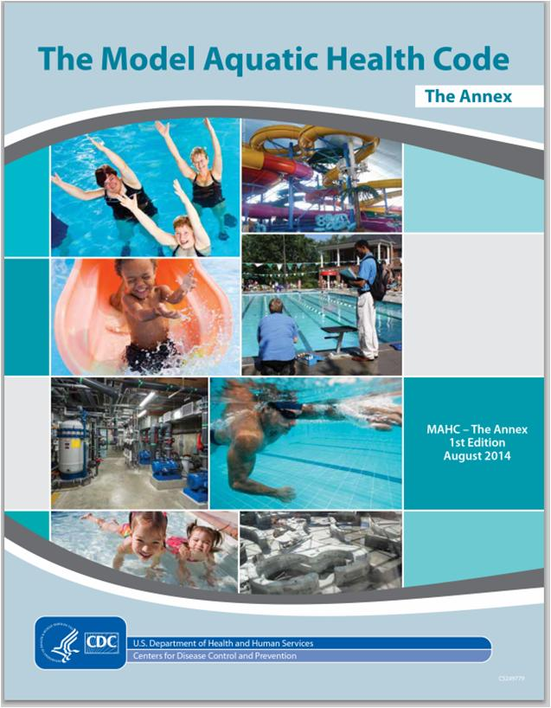
http://www.cdc.gov/healthywater/swimming/pools/mahc/
Notes:
The MAHC is a 316 page document by the CDC meant to serve as a standard for state codes regulating swimming facilities. It was released August 29, 2014.
There is also a 361 page annex that supplements the code.

Slide 7
Model Aquatics Health Code
why ?
Notes:
Why did the CDC formulate a Model Aquatics Health Code?

Slide 8
RWI outbreaks
Easy for resource limited states
to stay up to date
Uniform across state lines
Similar concept as FDA Model
Food Code
Notes:
Part of the driver for a uniform health code came from disease, sometimes fatal, spread in treated swimming pools. The CDC has a health interest in preventing such Recreational Water Illnesses (RWI). Chlorine levels in pools are not adequate to immediately kill various pathogens in fecal matter. Various states codes had different requirements for dealing with fecal releases, some much better than others. The CDC therefore provided suggested guidelines for states to adopt. That effort was then expanded to cover all risk factors for pool operation. The MAHC was put together with cooperation from various groups and is expected to be adopted fairly quickly by the states.
State health departments were generally supportive of CDC guidance. For one thing, states with limited budgets can rely on the CDC to review the latest science.
The industry was also generally supportive of the effort. Operators, design companies, and building contractors prefer one set of rules rather than having different requirements in different states.
The concept is similar to the FDA Model Food Code. A large majority of state regulations are now based on the federal guidelines.

Slide 9
Model Aquatics Health Code
so what ?
Notes:
Let’s now review implications for BSA programs. We’re not going to discuss all the code, but rather point out a few items having to do with lifeguards at council events. (Much of the code deals with swimming pool design and water sanitation.)

Slide 10
response time
2) The QUALIFED LIFEGUARD is able to reach the furthest extent of the assigned zone of PATRON surveillance within 20 seconds.
6.3.3.1.1
Notes:
To give you a feel for how prescriptive the code can be, let’s look at how much time the lifeguard has to reach a person in trouble.
The answer is 20 seconds. If it takes longer, then a breach in the duty (standard) of care has occurred. If harm comes to the victim because of the delay, then the facility is negligent. With all the rules taken together, a drowning death at a guarded facility is difficult to defend successfully in a civil suit.
The “20 second” rule should be covered in lifeguard training, but there is no current BSA policy that requires the camp aquatics director to check how fast lifeguards can respond. The MAHC requires documentation that each lifeguard has been tested to that standard.

Slide 11
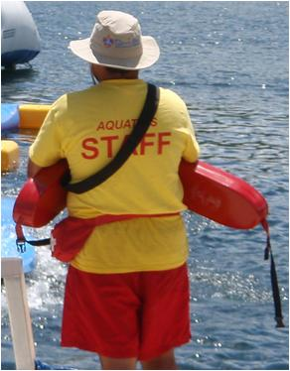
lifeguard equipment
rescue tube on person
identifying uniform
signal device
polarized sunglasses
PPE
UV protection
Notes:
Looking a bit more into the code, here are items required for each lifeguard on duty. Note that if glare is present, polarized sunglasses are required. The code does not require that each lifeguard be issued a hip pack with a CPR mask and gloves, but that has become a best practice, and is now required for some lifeguard training courses. Hip packs are not common items in Scout camps.

Slide 12
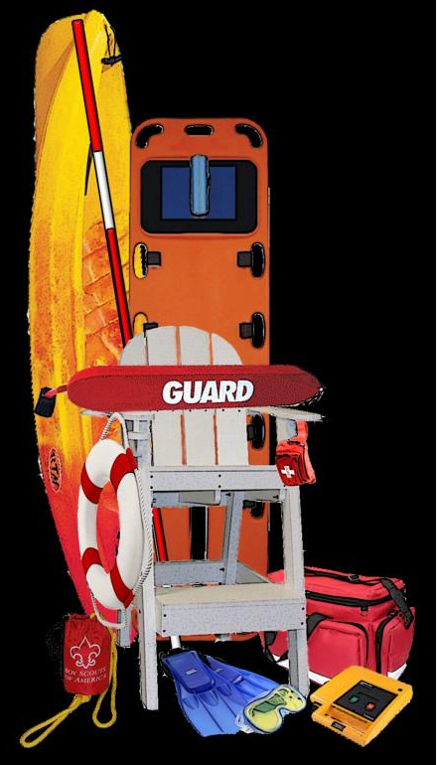
lifeguard equipment
communication system
chairs/stands
first aid kit
backboard w/ restraints
blood spill kit
AED/O2 not required
Notes:
There are additional items required within easy access. As an aside, the aquatics program at the 2013 Jamboree had to push back to get backboards and spill kits even though they were required by West Virginia codes. Note that AEDs are recommended at each pool not currently required.

Slide 13
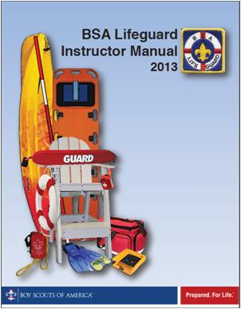
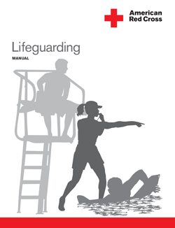
LG training: pre-employment
Current lifeguard
certification by
approved agency
Current CPR at
professional level
Notes:
The MAHC is very prescriptive about lifeguard course content, delivery, instructor qualifications, and program QC. The maximum allowed validity for lifeguard training is two years. BSA Lifeguard currently meets the code standards, but will need regular review.
Lifeguard training requirements for CPR are the same as those for health care professionals such as EMTs and nurses. That is written into BSA camp standards, but the distinction between CPR requirements for lifeguards and regular camp staff is sometimes unclear to camp administrators.
The Red Cross recently changed from a one-year to a two-year CPR certification to match the AHA. However, the MAHC requires CPR renewal every year.

Slide 14
LG training: pre-service
Demonstrate skills & knowledge of:
water rescue skills
EAPs (drowning, injury, weather,
chemicals)
Fecal, vomit, & blood
contamination procedures
Staffing plans, zones, &
rotations.
Notes:
Having current lifeguard certification is not sufficient to satisfy the codes. Prior to active duty, the facility must check that the lifeguards can demonstrate the skills required for certification as well as review and practice items specific to that venue. The BSA Aquatics Staff Guide outlines the training needed both to satisfy state swimming codes and prepare the staff for conducting the various swimming and boating programs. As we noted before, the BSA Summer Camp Staff Training Guide does not cover those particulars. Instead it has suggested camp-wide training sessions that total 23 of the allocated 28 training hours. It is doubtful that any camp actually follows all the recommendations in the Summer Camp Staff Training Guides, but it is not unusual for National Camp School aquatics section directors to hear from camp aquatics directors that they were not allowed sufficient time to properly evaluate and train their staffs.
Let’s look at other details that camp administers should be aware of.

Slide 15
Records
safety plan (EAPs)
lifeguard certifications
pre-service training
in-service training
incidents
3 years
Notes:
The MAHC requires specific records to be maintained, generally for three years. Those include the listed items. An “incident” occurs whenever a lifeguard interrupts surveillance to enter the water for a rescue or to perform first aid. Few states codes currently require this amount of record keeping, so BSA camps will need to adjust as states adopt the federal guidelines.

Slide 16
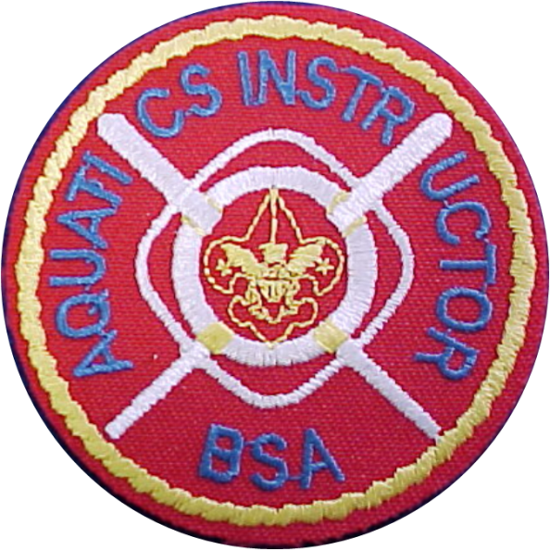
LG supervisor
required for 2 or more lifeguards
specific training requirements
minimum 3 months
lifeguard experience
Notes:
The MAHC also requires each facility to have a lifeguard supervisor present whenever two are more lifeguards are on duty. At BSA summer camps, the aquatics director would normally serve that function, but it can be meet by anyone with the required training, even a lifeguard on duty.
The code is very prescriptive about lifeguard supervisor training requirements. Aquatics Instructor BSA training, obtained at National Camping School, probably meets those requirements at present. The MAHC codes are very similar to current New York state codes, and the BSA Aquatics Task Force has worked with New York regulators to have them accept the AI training.
A new ripple that will affect camps is the requirement that the lifeguard supervisor must have at least 3 months of actual on-the-job experience.

Slide 17
Current BSA standards
Aquatics director is 21 years of age or older and holds a current certificate of training as a BSA Aquatics Instructor from a National Camping School. The aquatics
director also is currently certified as a BSA
Lifeguard, American Red Cross Lifeguard, or
equivalent training recognized by state
legislation or regulation (a “valid lifeguard
certification”), and is currently trained in
American Red Cross First Aid and CPR/AED for Professional Rescuers and Health Care Providers, or equivalent.
Notes:
Let’s now review how a few of the current BSA aquatics standards compare with the CDC MAHC, starting with requirements for a camp aquatics director.
The 21 year old age limit goes beyond the MAHC which leaves age restriction to the training agencies.
BSA Aquatics Instructor currently qualifies as MAHC lifeguard supervisor.
A separate lifeguard certification valid for two years gets around the 5 year validity period of BSA Aquatics Supervision.
The MAHC level of CPR certification is spelled out, but there might be future problems with how often it is renewed since the Red Cross course is currently valid for two years and the MAHC requires renewal every year.
In the future, they may be a need to add previous experience as a lifeguard.

Slide 18
Current BSA standards
Pre-Requisites for Aquatics Section Enrollment
Be 18 years of age or older.
Present evidence of a current lifeguard certification
Present evidence of Safe Swim Defense and Safety Afloat training.
Be able to complete the 100 yard BSA swimmers test.
Immediately after completion of the swimmers test, swim
continuously for an additional 450 yards.
Immediately after completion of the 450 yard swim, tread water for
two minutes.
Starting in the water, swim 20 yards using a front crawl or
breaststroke, surface dive 7 to 10 feet, retrieve a 10-pound object,
surface, swim with the object 20 yards back to the starting point,
and exit the water within one minute and 40 seconds.
Notes:
Over the last few years, entrance requirements to the aquatics section of National Camping School have become more stringent. In particular, the person has to already have current lifeguard training and then demonstrate skills needed to enroll in a lifeguard renewal or instructor course. Fortunately, that makes BSA Aquatics Instructor acceptable under the MAHC as a lifeguard supervisor and a lifeguard instructor. However, the trend is toward more training requirements and experience, not less, so the training components for camp aquatics director will need to evolve further.

Slide 19
Conclusions
Notes:
No need to panic, but government regulations keep getting more detailed and prescriptive. The BSA Aquatics Task Force tries to stay current or even anticipate trends. However, there is also a need to keep other BSA volunteers and professionals aware of changing standards of care. Camps that do not understand the standards may not comply, and that exposes the organization to rulings of negligence.
A few years ago, National Camp School lesson plans called for the aquatics section director to discuss program and regulation updates with program director and camp director sections. That session was dropped when those sections were combined into administration. It is probably prudent to add it back.

