Slide 1
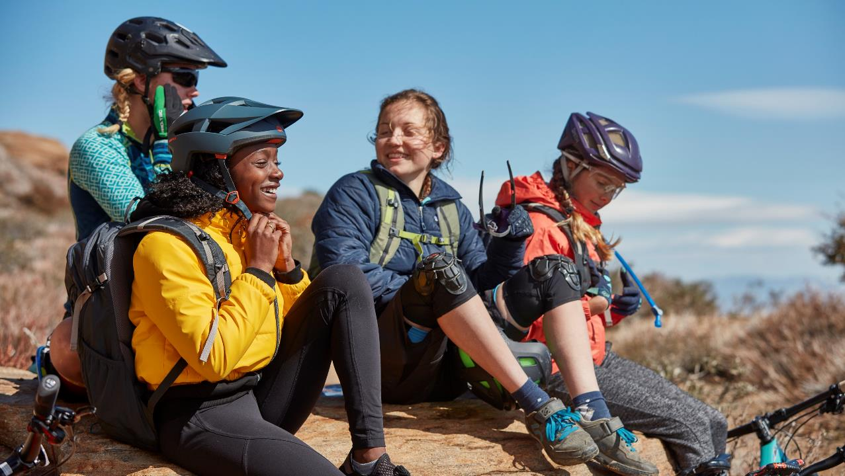
National Recruitment WEbinar
August 6, 2020

Slide 2
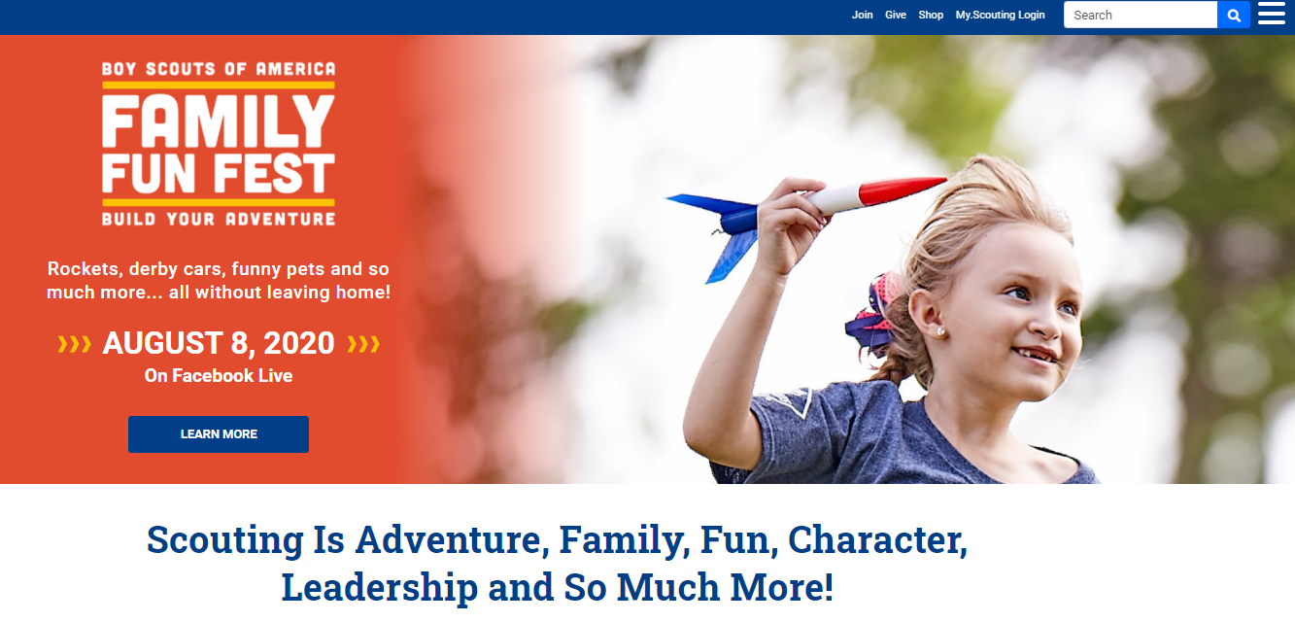

Slide 3
The Panel
Tanesha Polk Director of Marketing and Communications, National Capital Area Council
Amy Leslie Digital Asset Manager, National Council
George Snipes Field Director, Atlanta Area Council
Sean Fogle Field Director, Connecticut Rivers Council
Paul Verwers District Executive, Longhorn Council
Peggy Durbin Assistant Scout Executive/COO, South Florida Council
James Rhodes-Dreyer Director of Field Service/COO, Golden Empire Council
Wendy Shaw VP Council Services, National Council
Darin Kinn National Field Marketing Supervisor, National Council
Michael Ramsey Director of Marketing and Brand, National Council

Slide 4
PUBLIC RELATIONS 101
FOR CUB SCOUT LEADERS
Tanesha Polk Director of Marketing and Communications, National Capital Area Council

Slide 5
PR 101 Agenda
Recognizing Newsworthy Stories
Preparing a Pitch
Contacting Local Media
Assessing your Goals and Successes

Slide 6
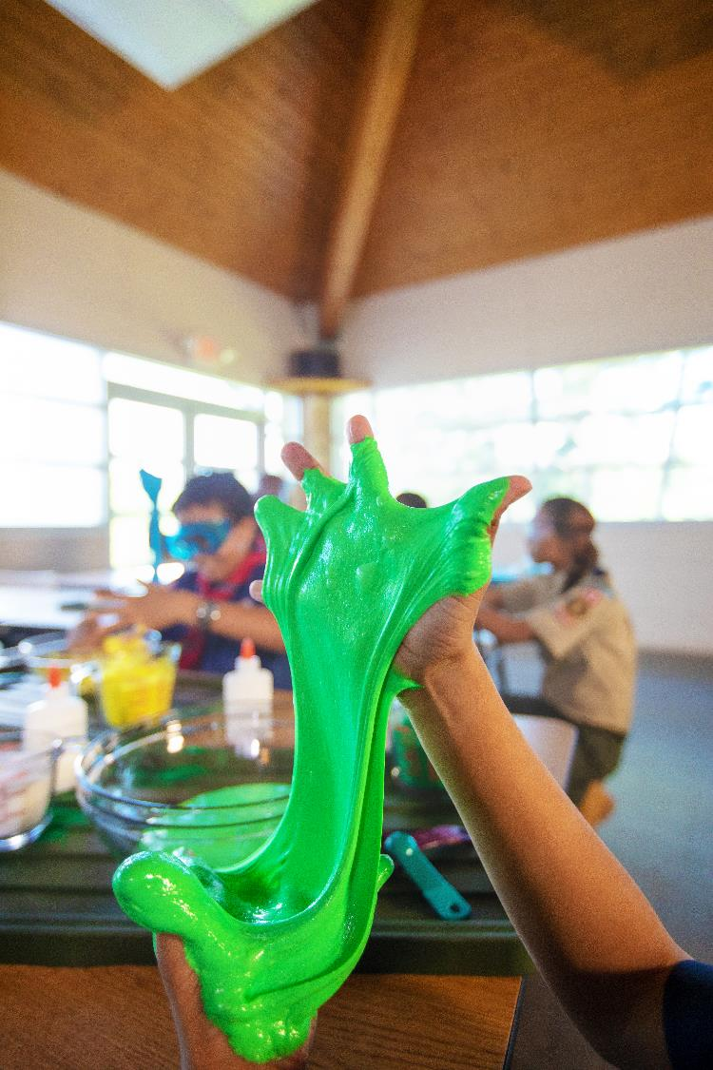
Recognizing Newsworthy Stories
What is news?
News is a fresh idea, story, launch or event that occurs that is relevant to your target audience and community.
How to recognize a newsworthy story?
Is it relevant? Will it impact the community?
Is the topic new and fresh? Does it have a good angle?
How does it benefit the overall branding and messaging for Scouting? Does it increase the likelihood of more youth joining BSA?
Does it have a strong visual for photojournalists or TV stations?
Example: A Scout in your Council being the first receive every NOVA award.

Slide 7
Preparing a Pitch
DIFFICULT OR EASY?
Pitches can be simple!
Start with a catchy headline.
Include all pertinent details (5 W’s) and a picture. Pictures are worth 10,000 words!
Include a point of contact so the reporter can follow up.
Proofread before sending. At least two pair of eyes need to see the pitch before it is sent.
Send your pitch a least a week before the event.
Say thank you!

Slide 8
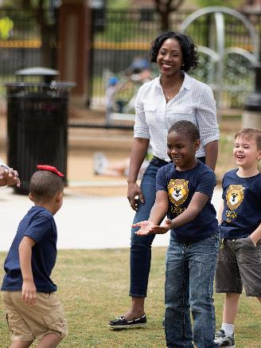
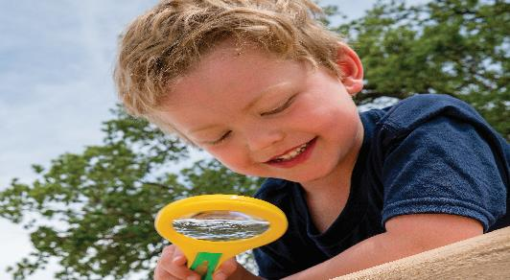
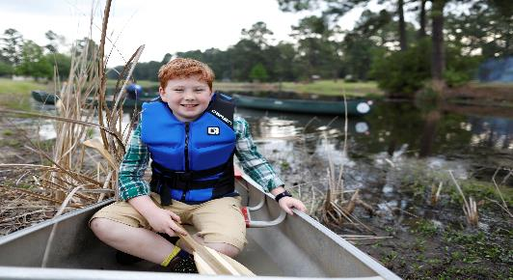
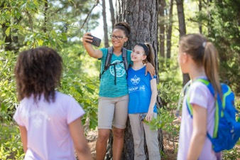
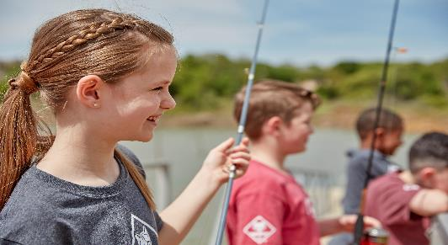
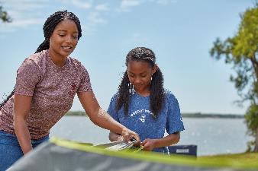
CONTACTING YOUR LOCAL MEDIA
Make a list of the best media outlets to help you reach the parents of Cub Scout–age youth in your community.
Daily newspaper
Community news papers
Online publications
Television stations
Develop a list of reporters and editors who cover events like yours. Find the best contact person by reading the newspaper or paying attention to radio and television broadcasts.
Name of Editor and Reporter
Email Address
Phone number
Use your new media list!

Slide 9
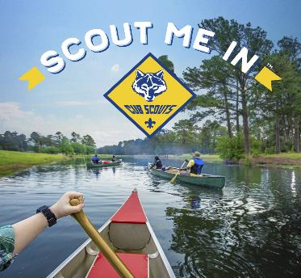
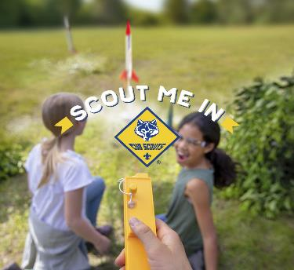
DID YOU REACH YOUR GOAL OR HAVE ANY SUCCESSES?
GOALS
Reach families and encourage them to join Scouting
Get your story published
Spread Scouting throughout your community
More Scouts join BSA due to your story spreading throughout the community and maybe the world
Successes
More Scouts join BSA due to your story spreading throughout the community
But if you don’t get published don’t fret post your stories on social media or build your own media platform. (weownadventure.com)

Slide 10
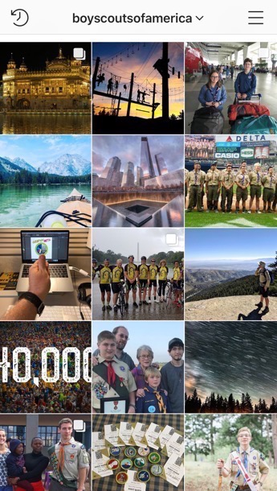
Social Media Tactics
Search
Google Ads buy to maximize search engine results
Social
Targeted ad campaign on Instagram, YouTube, and Facebook
Email
Regular communication to keep prospects interested in the program and updated on any changes or big news

Slide 11
THANK YOU!

Slide 15
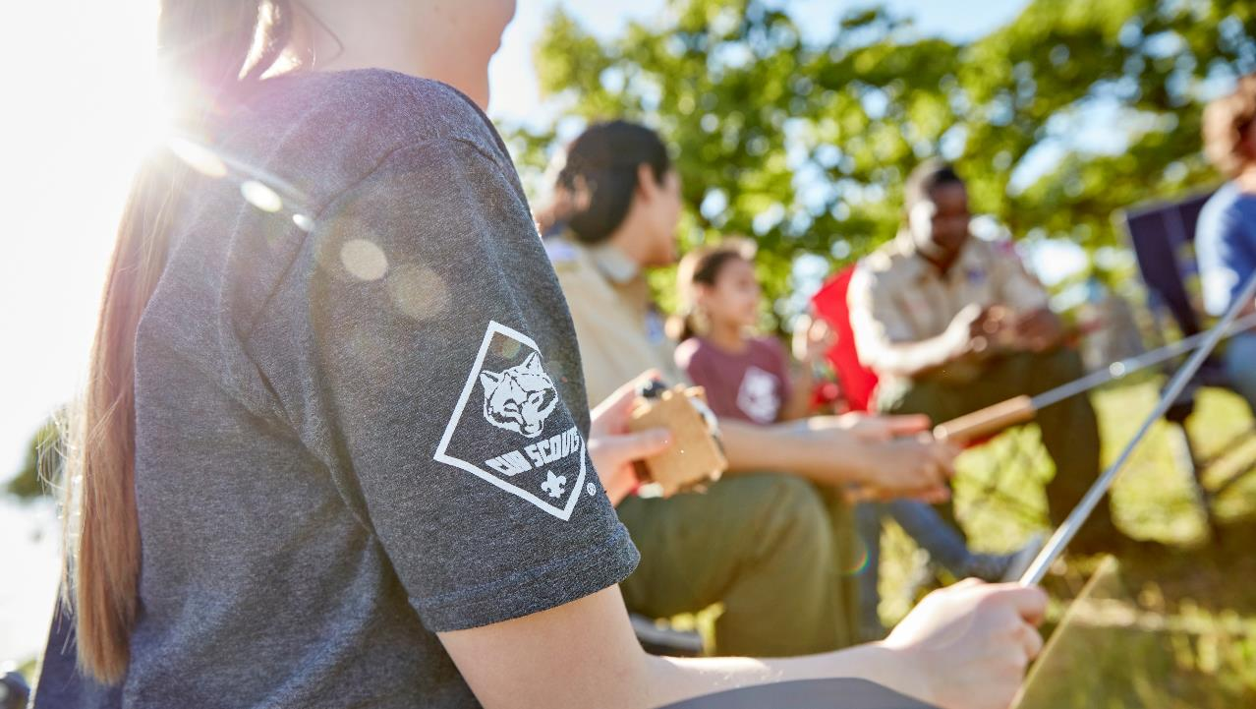
ThanK You
Find a Schedule of Webinars and Recordings of This and Other Webinars at
https://scoutingwire.org/marketing-and-membership-hub/

