Slide 1
National Restarting Webinar
October 14, 2020

Slide 2
National Restarting Webinar
October 14, 2020

Slide 4
The Panel
Lisa Wylie Chair National Cub Scouting Committee
Anthony Berger National Director of Cub Scouting
Darin Kinn National Field Marketing Supervisor
Michael Ramsey National Director of Marketing and Brand
Ben Orloff Cubmaster Pack 55 Tidewater Council, Virginia Beach, Virginia
Shelley Sprouffske Pack Committee Chair, Pack 9307 Pacific Harbors Council, Tacoma Washington
Ryan Vise Cubmaster, Pack 292 Cascade Pacific Council, Portland, Oregon

Slide 5
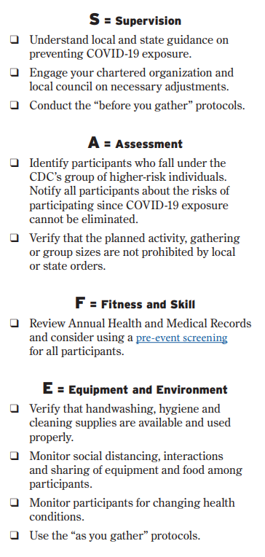
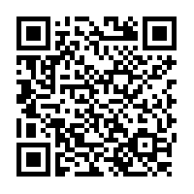
Scan Here for Full Resource
Or Use this URL
https://filestore.scouting.org/filestore/HealthSafety/pdf/680-693.pdf
Notes:
Richard (Then turn to Andrea)
Legal / Safe / Practical – where we started with COVID 6 months ago was used to lay this out along with our upcoming replacement to the Sweet 16, SAFE Checklist an acronym from Supervision, Assessment, Fitness & Skills and Equipment & Environment
Safe does not equal no Risk, these are proven strategies, they need to be localized.
Mention AHMR exemption expired 8/31 - recent studies where 94% of the deaths attributed to COVID-19 linked to co
And of course, someone is going to ask so lets be up front. If COVID is alleged to be transmitted at a Scouting event, it will be investigated and handled in accordance with either the General Liability Insurance Program or Accident and Sickness program. We will talk a little later in our session about why reporting and engaging swiftly and without delay protects you, your council and participants and the brand.

Slide 6
Can My Unit Start Meeting?
It depends on your local guidelines.

Slide 7
You may not be able to start meeting in-person because of guidance from local authorities….
… now is the time to be prepared for when we CAN meet in person!

Slide 8
Parents Are Looking for Scouting.

Slide 9
Parents told us…. What are you looking for...
48% Normalcy
45% Do something as a group, even if socially distant
44% Do something productive with peers, even online
30% Something to keep them busy
15% Waiting until pandemic subsides

Slide 10
Parents told us…. What parts of the Scouting program do you want….
51% online events so they feel like they’re part of the Scouting movement
50% character and leadership building opportunities
47% online events to keep them engaged in the day to day program
46% service and giving back to the community
44% outdoor experiences

Slide 11
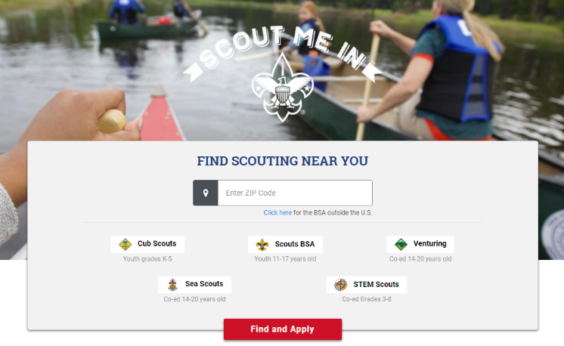
BeAScout.org – Leads are Coming In.
To find out more about how to manage BeAScout leads, pins and online registration, visit https://www.scouting.org/resources/online-registration/

Slide 12
Research: More Insights from Parents and Leaders

Slide 13
UNIT LEADERS GOOD NEWS!
98% OF UNIT LEADER EXPECT TO KEEP THEIR UNIT EVEN IF THEY ARE NOT MEETING
87.7% OF UNITS ARE MEETING EITHER VIRTUALLY, IN-PERSON, OR A COMBINATION
79.1% OF LEADERS ARE POSITIVE ABOUT STARTING THEIR UNIT THIS FALL

Slide 14
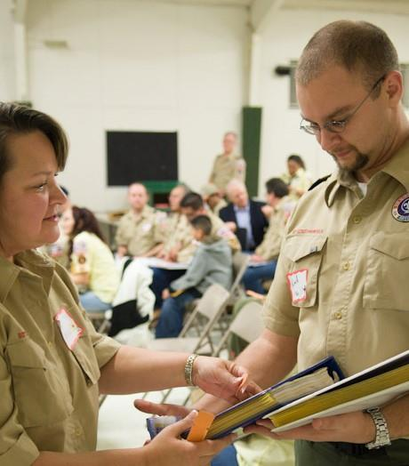
MORE UNIT LEADERS GOOD NEWS!
89.5% OF LEADERS ARE WILLING TO RECRUIT
78.1% OF LEADERS EITHER HAVE PLANS TO RECRUIT OR PLAN TO RECRUIT THIS YEAR
79.1% OF LEADERS ARE POSITIVE ABOUT STARTING THEIR UNIT THIS FALL

Slide 15
PARENTS GOOD NEWS!
75.4% OF PARENTS ARE POSTIVIE ABOUT THIS FALL AND PROGRAM YEAR
92.6% OF PARENTS IN UNITS THAT HAVE MET EITHER VIRTUALLY, IN-PERSON, OR A COMBINATION RATED THE MEETINGS AS EXCELLENT TO AVERAGE.
66% OF PARENTS IN UNITS THAT ARE NOT MEETING STILL PLAN TO STAY IN SCOUTING
27% OF PARENTS IN UNITS THAT ARE NOT MEETING MAY CONTINUE IN SCOUTING

Slide 16
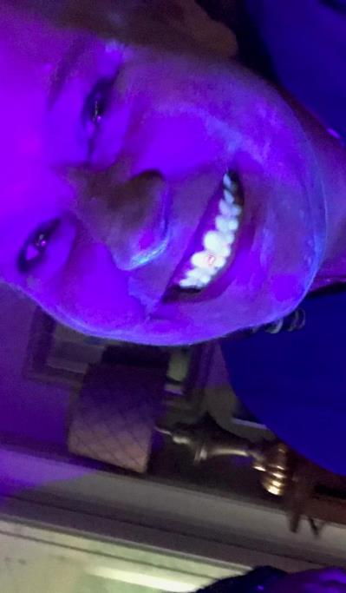
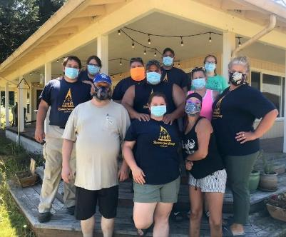
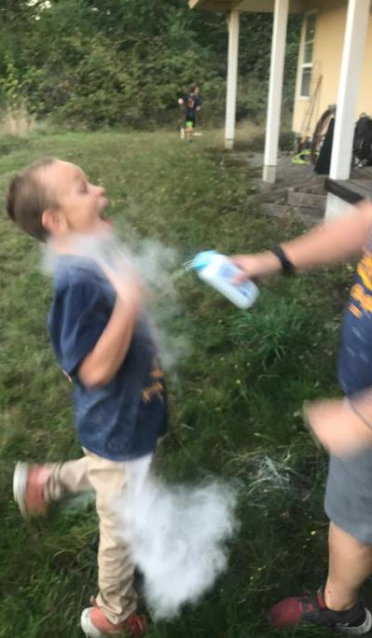
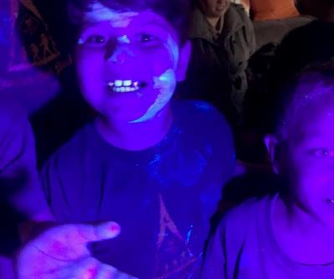

Slide 17
20% Off PeachJar:
Use discount code BSA2019

Slide 18
First Things First
1. Check your local requirements to see if you can meet.
2. Call the Families in Your Pack and Den.
3. Work with your parents and leaders to find solutions.
4. Engage your chartered partner.

Slide 19
BSA Brand CEnter
Notes:
Quick reminder that if you are not signed up for the ScoutingWire, do it now! It’s THE source for news and information coming out of the National Service Center. And it’s searchable, so if you’re looking for articles and content you can find it. It’s a great resource.
Did I mention you can access it on your smart phone? Good stuff.

Slide 21
ThanK You
Recordings of This and Other Webinars at
https://scoutingwire.org/marketing-and-membership-hub/marketing-webinars/

