Slide 1
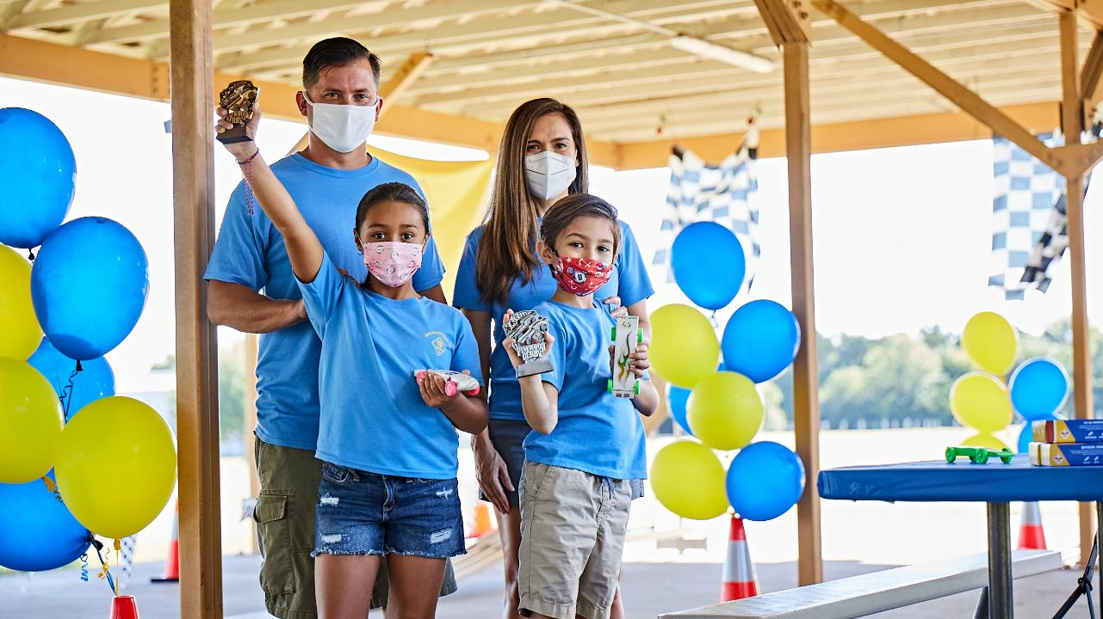
National Restarting WEbinar
Sept 30, 2020

Slide 2
Tonight….
Announcements!
Safety Moment
Some Quick Parent and Leader Research
Restarting Conversations with Cub Scout leaders

Slide 3
The Panel
Anthony Berger National Director of Cub Scouting
Michael Ramsey Director of Marketing and Communications
Darin Kinn National Field Marketing Supervisor, National Council
Richard Bourlon National Environmental Health and Safety Supervisor National Council
Lawrence Morris Cubmaster, Pack 133, Mendham, NJ
Patriots Path Council
Kevin Herndon Cubmaster, Pack 3289, Spring Hill, KS
Heart of America Council
Nicole Harris Committee Chair Pack 937 & District Membership Chair East Carolina Council

Slide 6
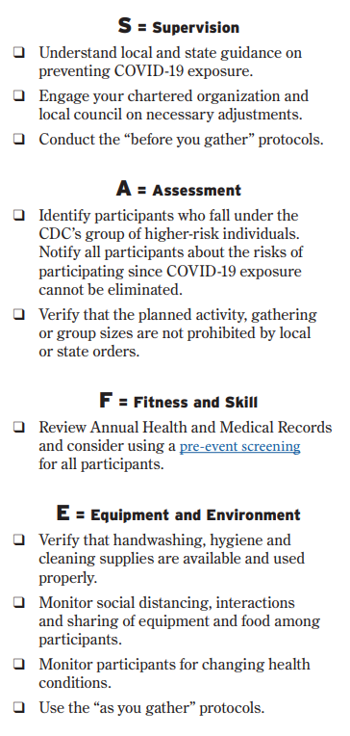
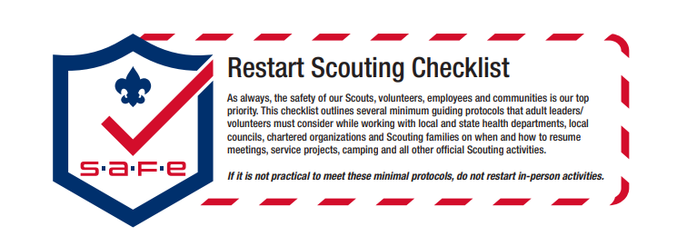
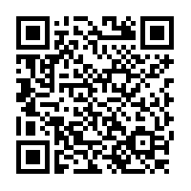
Safety Moment
Scan Here for Full Resource
Or Use this URL
https://filestore.scouting.org/filestore/HealthSafety/pdf/680-693.pdf
Notes:
Richard (Then turn to Andrea)
Legal / Safe / Practical – where we started with COVID 6 months ago was used to lay this out along with our upcoming replacement to the Sweet 16, SAFE Checklist an acronym from Supervision, Assessment, Fitness & Skills and Equipment & Environment
Safe does not equal no Risk, these are proven strategies, they need to be localized.
Mention AHMR exemption expired 8/31 - recent studies where 94% of the deaths attributed to COVID-19 linked to co
And of course, someone is going to ask so lets be up front. If COVID is alleged to be transmitted at a Scouting event, it will be investigated and handled in accordance with either the General Liability Insurance Program or Accident and Sickness program. We will talk a little later in our session about why reporting and engaging swiftly and without delay protects you, your council and participants and the brand.

Slide 7
Q: Can My Unit Start Meeting?
A: It depends on your local guidelines.

Slide 8
You may not be able to start meeting in-person because of guidance from local authorities….
… now is the time to be prepared for when we CAN meet in person!

Slide 9
Q: How do I find out if my unit can meet?
Q: Any ideas on where to meet?

Slide 10
Research: Insights from Parents and Leaders

Slide 11
Parent Insights: What are you looking for in a youth-serving program this fall given the impact of COVID?
48% Normalcy
45% Do something as a group, even if socially distant
44% Do something productive with peers, even online
30% Something to keep them busy
15% Waiting until pandemic subsides

Slide 12
Parent Insights: What parts of the Scouting program do you want to continue as the pandemic progresses?
51% online events so they feel like they’re part of the Scouting movement
50% character and leadership building opportunities
47% online events to keep them engaged in the day to day program
46% service and giving back to the community
44% outdoor experiences

Slide 13
Leader Insights: Why is your unit not meeting right now?
49.5% We have no place to meet
36.9% Virtual meeting fatigue because of work school being virtual
34% Families in our unit are not comfortable
28.6% School started late and we haven’t started back up yet.
21.6% Covid is increasing in our area
16.9% Our unit tried meeting virtually and found it ineffective
11.9% Underlying health conditions

Slide 14
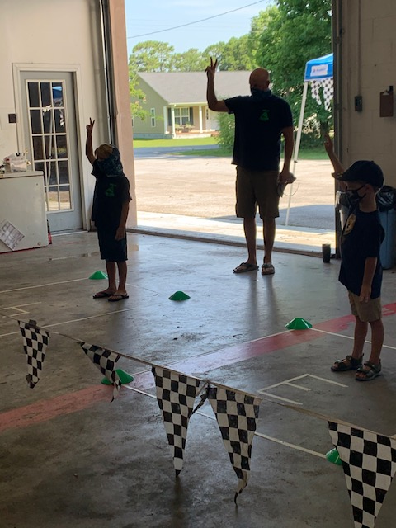
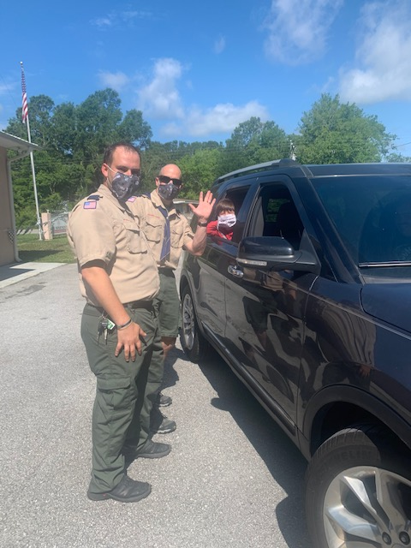
Pack 937

Slide 15
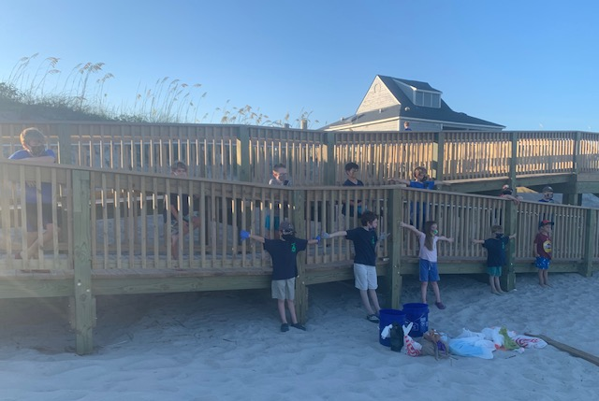
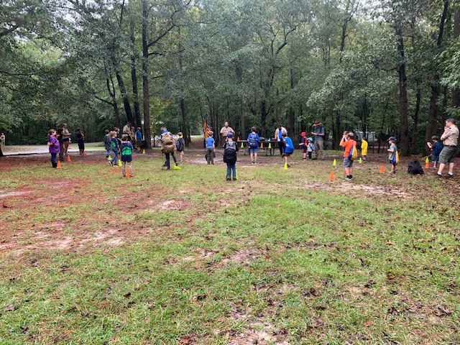
Pack 937

Slide 16
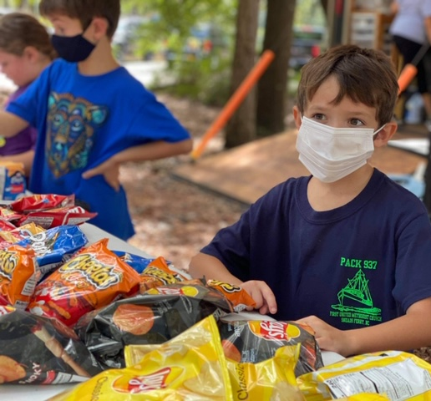
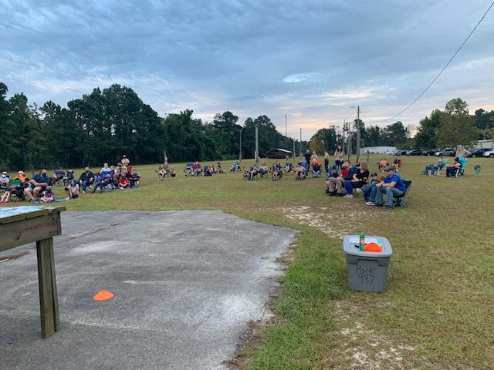
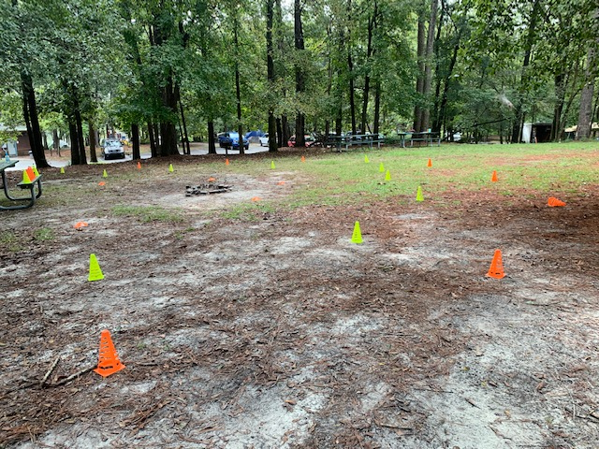
Pack 937

Slide 17
Things to Get Started

Slide 18
1. Check your local requirements to see if you can meet.

Slide 19
2. Call the Families in Your Pack and Den

Slide 20
3. Meet to find solutions. (Even If It’s Virtually!)

Slide 21
4. Engage your chartered partner.

Slide 22
5. Reach out to the school in your neighborhood

Slide 23
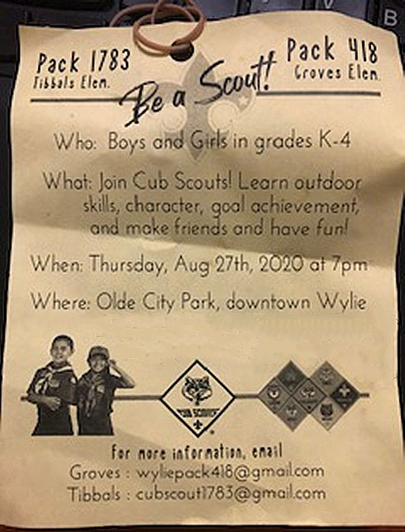

Slide 24
6. BeAScout.org Pins

Slide 26
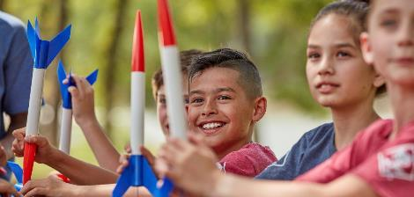
BSA Brand CEnter
Notes:
Quick reminder that if you are not signed up for the ScoutingWire, do it now! It’s THE source for news and information coming out of the National Service Center. And it’s searchable, so if you’re looking for articles and content you can find it. It’s a great resource.
Did I mention you can access it on your smart phone? Good stuff.

Slide 28
ThanK You
Recordings of This and Other Webinars at
https://scoutingwire.org/marketing-and-membership-hub/

