Slide 1
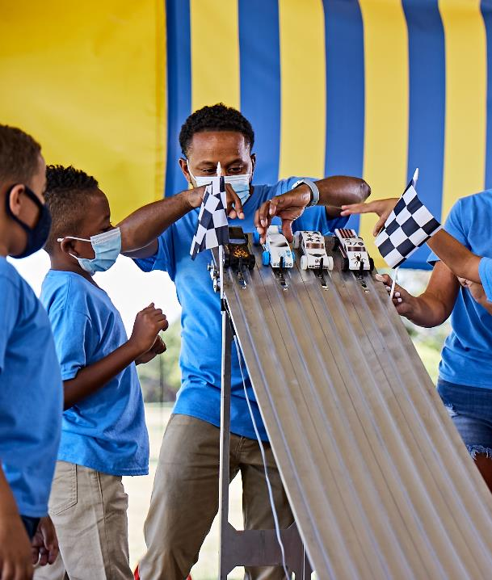
National Restarting Webinar
November 4, 2020

Slide 3
Tonight’s Panel
Anthony Berger National Director of Cub Scouting
Darin Kinn National Field Marketing Supervisor
Michael Ramsey National Director of Marketing and Brand
Cubmaster Jimmy Panos Pack 7083, Greater Alabama Area Council
Pack Committee Chair Lynne Haberstroh Pack 2214, Baltimore Area Council
Pack Committee Chair Adam Bull Cubmaster Anthony Benedetti Pack 67, Seneca Waterways Council

Slide 4
Are we recording this?
Yes!

Slide 5
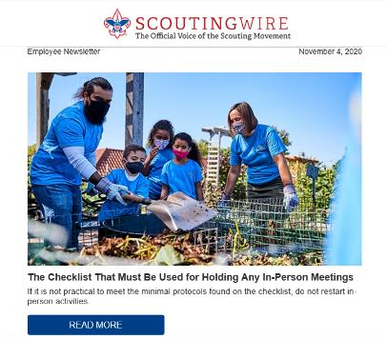
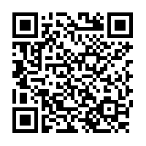
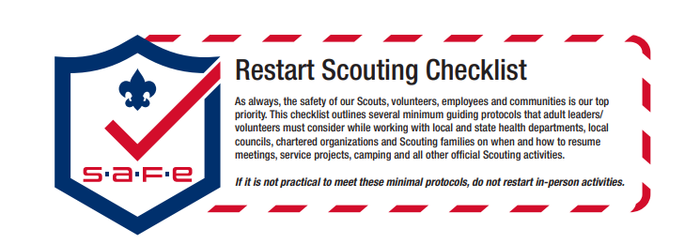
Scan Here for Full Resource
https://filestore.scouting.org/filestore/HealthSafety/pdf/680-693.pdf
Notes:
Richard (Then turn to Andrea)
Legal / Safe / Practical – where we started with COVID 6 months ago was used to lay this out along with our upcoming replacement to the Sweet 16, SAFE Checklist an acronym from Supervision, Assessment, Fitness & Skills and Equipment & Environment
Safe does not equal no Risk, these are proven strategies, they need to be localized.
Mention AHMR exemption expired 8/31 - recent studies where 94% of the deaths attributed to COVID-19 linked to co
And of course, someone is going to ask so lets be up front. If COVID is alleged to be transmitted at a Scouting event, it will be investigated and handled in accordance with either the General Liability Insurance Program or Accident and Sickness program. We will talk a little later in our session about why reporting and engaging swiftly and without delay protects you, your council and participants and the brand.

Slide 6
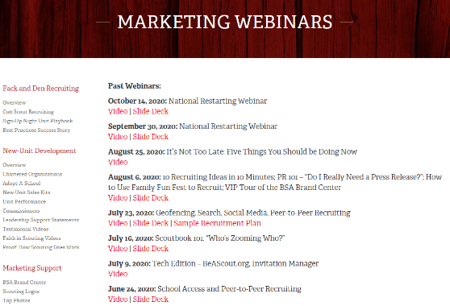
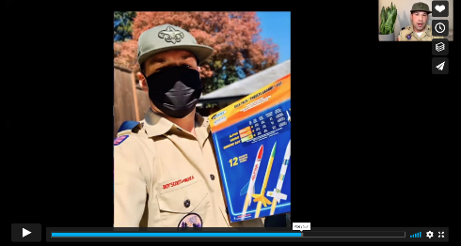
National Webinars
https://scoutingwire.org/marketing-and-membership-hub/marketing-webinars/

Slide 7
First things first:
“Can My Unit Start Meeting?”
It depends on your local guidelines.

Slide 8
Parents told us…. What are you looking for...
45% Do something as a group, even if socially distant
44% Do something productive with peers, even online

Slide 9
Parents told us…. They are okay with Virtual… but want outdoor experiences, too!
51% online events so they feel like they’re part of the Scouting movement
44% outdoor experiences

Slide 10
UNIT LEADERS GOOD NEWS!
87.7% OF UNITS ARE MEETING EITHER VIRTUALLY, IN-PERSON, OR A COMBINATION

Slide 11
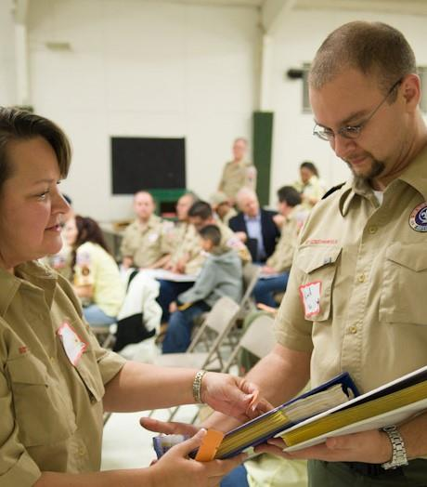
MORE UNIT LEADERS GOOD NEWS!
78.1% OF LEADERS EITHER HAVE PLANS TO RECRUIT OR PLAN TO RECRUIT THIS YEAR

Slide 12
PARENTS – GOOD NEWS!
92.6% OF PARENTS IN UNITS THAT HAVE MET EITHER VIRTUALLY, IN-PERSON, OR A COMBINATION RATED THE MEETINGS AS EXCELLENT TO AVERAGE.

Slide 13
Leader Insights: Why is your unit not meeting right now?
49.5% We have no place to meet
36.9% Virtual meeting fatigue because of work school being virtual
34% Families in our unit are not comfortable
28.6% School started late and we haven’t started back up yet.
21.6% Covid is increasing in our area
16.9% Our unit tried meeting virtually and found it ineffective
11.9% Underlying health conditions

Slide 14
Location Location Location

Slide 15
4,000+ Leads in BeAScout.org Have Not Been Followed Up On.
As of Nov. 4, 2020

Slide 16
Let’s hear from our Leaders.

Slide 17
TakeAways
Check First. - Check your local requirements to see if you can meet.
2. Pull your community back together. - Call the Families in Your Pack and Den.
3. Don’t go it alone.
- Work together to find parents and leaders to find solutions.
4. Work with your chartered partner.

Slide 18
Questions

