Slide 1
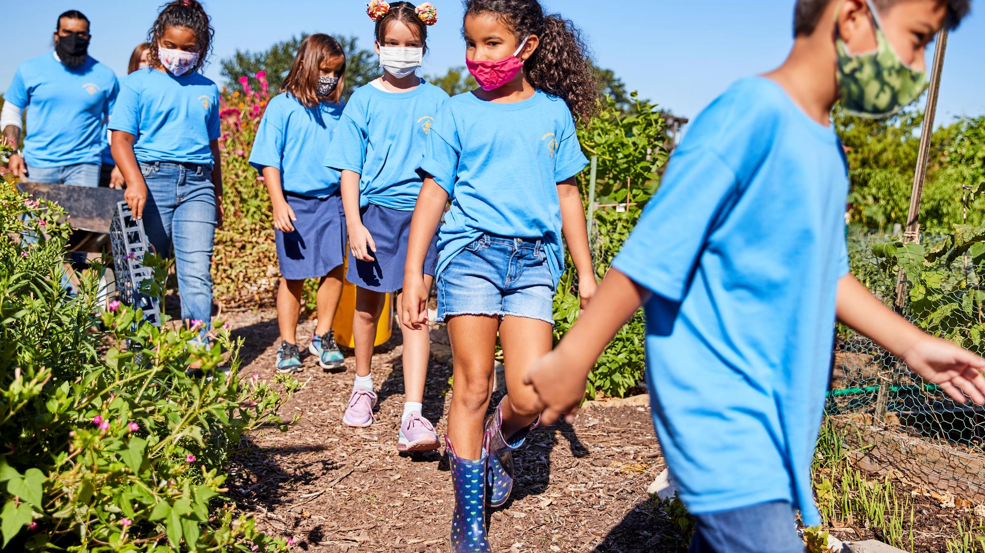
Spring Into Scouting!
March 2021 8 pm E / 7 pm C

Slide 2
The Panel
Wendy Kurten National Director of Membership
Nicole Lopez Harris Membership Chair, East Carolina Council Pack 937 Committee Chair
Darin Kinn Marketing Manager for Field Support
Michael Ramsey Director of Marketing & Brand

Slide 3
Are we recording this?
Yes!
https://scoutingwire.org/marketing-and-membership-hub/marketing-webinars/

Slide 4
First things first:
“Can My Unit Start Meeting?”
It depends on your local guidelines.

Slide 5
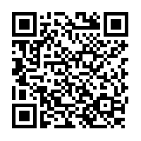
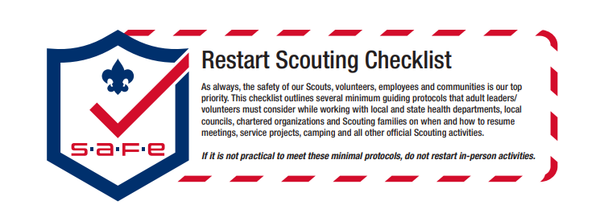
Scan Here for the Full Resource
https://filestore.scouting.org/filestore/HealthSafety/pdf/680-693.pdf
Notes:
Richard (Then turn to Andrea)
Legal / Safe / Practical – where we started with COVID 6 months ago was used to lay this out along with our upcoming replacement to the Sweet 16, SAFE Checklist an acronym from Supervision, Assessment, Fitness & Skills and Equipment & Environment
Safe does not equal no Risk, these are proven strategies, they need to be localized.
Mention AHMR exemption expired 8/31 - recent studies where 94% of the deaths attributed to COVID-19 linked to co
And of course, someone is going to ask so lets be up front. If COVID is alleged to be transmitted at a Scouting event, it will be investigated and handled in accordance with either the General Liability Insurance Program or Accident and Sickness program. We will talk a little later in our session about why reporting and engaging swiftly and without delay protects you, your council and participants and the brand.

Slide 6
Fun FAct 1.1 million Merit Badges earned in 2020

Slide 7
- 2020 -
45,794 Male Eagle Scouts
942 Female Eagle Scouts

Slide 9
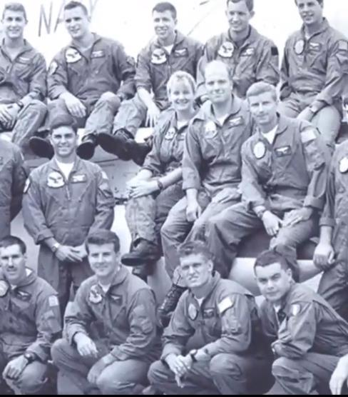
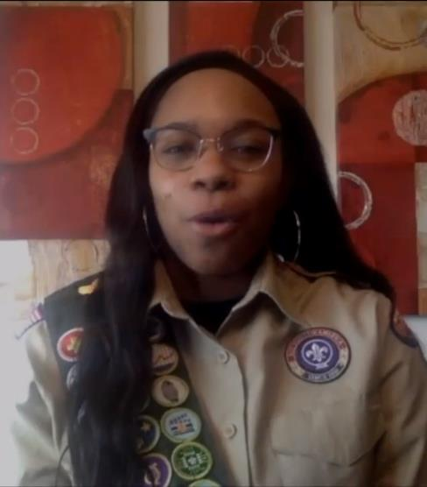
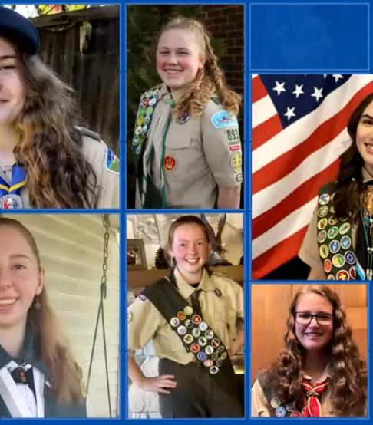
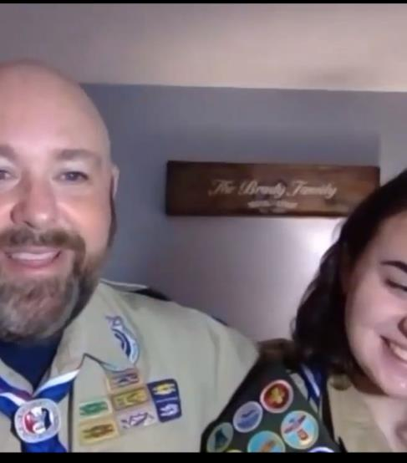
More than 342,433+ people watched the event or have seen it on Facebook or You Tube.
You can watch it, too!
Go to Scouting.org/bethechange

Slide 10
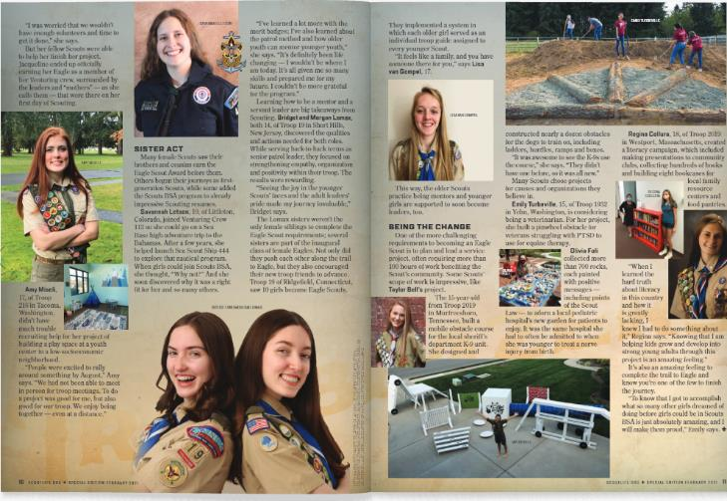
www.scoutlife.org
Notes:
Also, check out the Inaugural Edition of Scout Life magazine. It’s all digital and it celebrates the rank of Eagle Scout and the Inaugural Class. It’s truly an inspirational piece of work – and it’s free. So share it!

Slide 11
Spring Into Scouting!

Slide 12
Nicole Lopez Harris East Carolina Council

Slide 14
5 Things you should Do now!

Slide 15
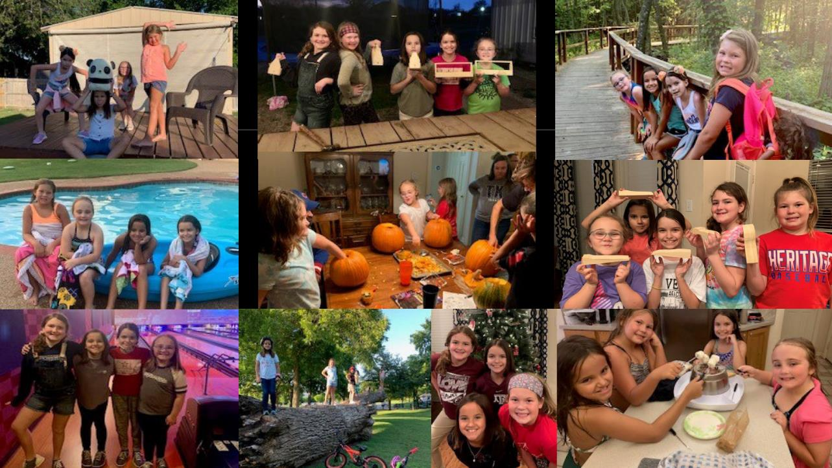
1 - Plan a Summer Program!

Slide 16
#1 - Plan a Summer Program!
Day Camp / Resident Camps (A must!)
Swim Parties
Camp Outs
Bike Rides
Trips to the Park….
…..Just Get Outside!

Slide 17
2 - Work with Your Schools….
Fliers
Posters
Yard Signs
Videos – From the Brand Center in School or as Part of Virtual Class
Flag Raisings in Front of Schools
Emails to Other Parents
…

Slide 18
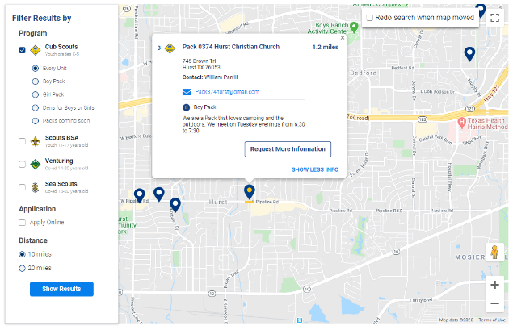
Update those Pins enable Online Registration
3 - Be found on BeAScout
QR Codes and Unit Specific URls

Slide 19
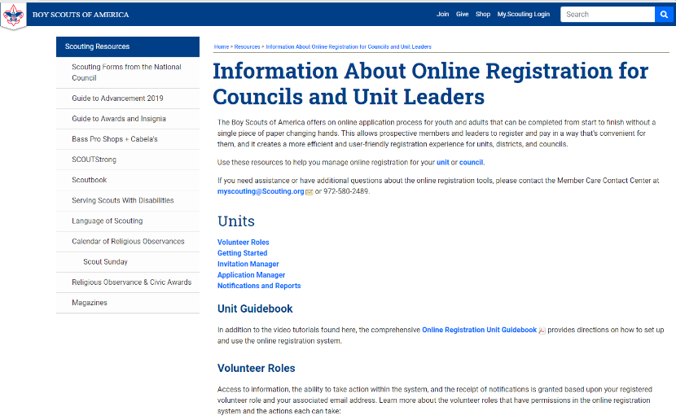
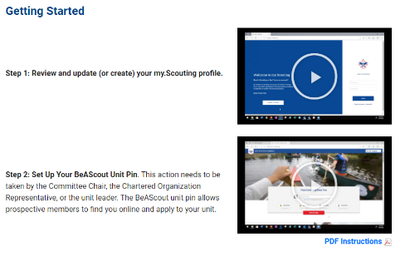
Training Videos
https://www.scouting.org/resources/online-registration/
Notes:
There are informational videos available to help keep this information updated.

Slide 20
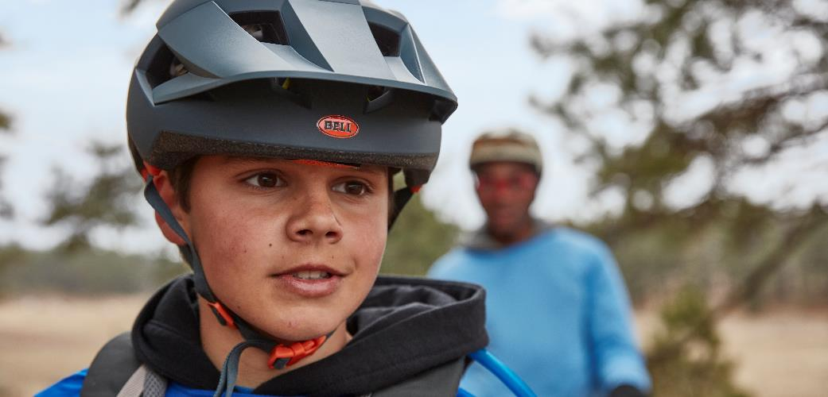
4 - Be Visible.
Tell your Story.

Slide 21
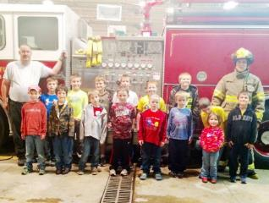
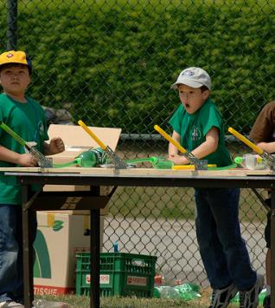
Be Visible
Events at schools, community centers, libraries, parks.
Fire Station Open Houses/ Joining Events
Hikes, bike rides, etc.
Focus on Outdoor Experiences! Parents are eager to get their children and involved in activities.
Notes:
If you have a Sam’s Club or a CostCo….
Anybody been to a Sam’s or Costco on Saturday? What happens on Saturday? Yes… samples. Lot’s of them. And I typically come home with a cheesecake or three.
Sampling is a great way to introduce families to Scouting. Examples….
Flag raisings at school, etc.
Fire Station Open Houses/Joining Events
Mobile Day Camps
Community Park Events
Derby car tracks at the local mall or park
Open Houses
Other examples or ideas?_____________

Slide 22
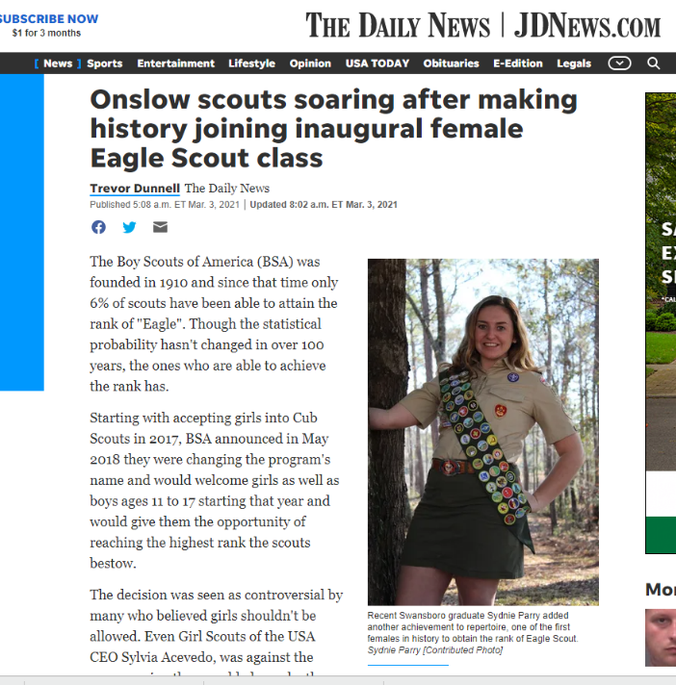

Slide 23
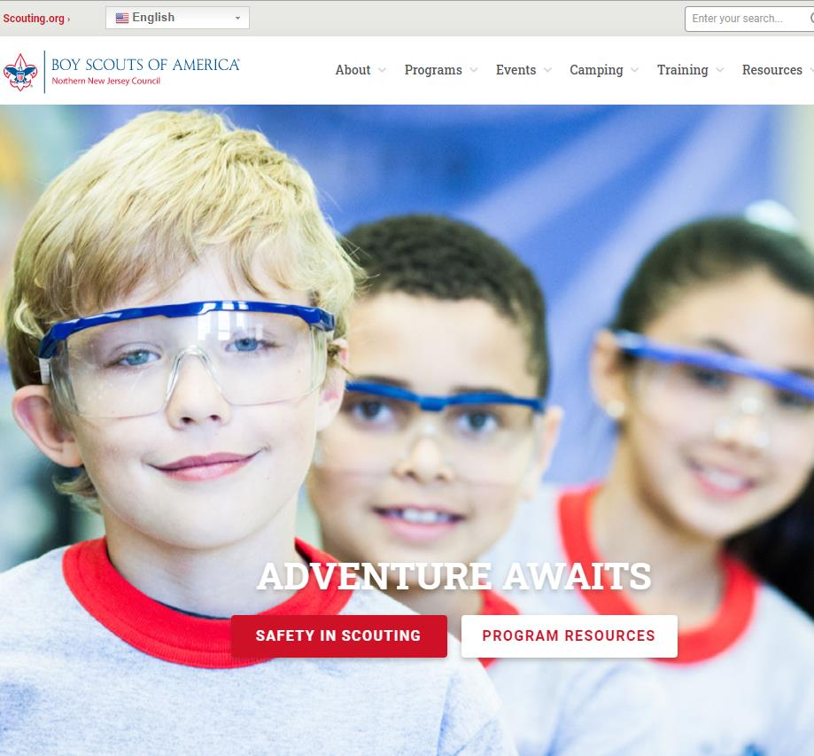
5 - Review Your Web Pages
Pro-Tip: Find a non-Scouting parent to look at your site.
Can you easily find out how to join?
Is your site information up-to-date?
Is it jargon-free?
Notes:
This fall, the marketing team surveyed dozens of local council web sites. It was an interesting exercise. We talk to ourselves a lot. In fact, most sites seem designed to speak to only to volunteers and parents. As a result, most are not a good first experience for a parent who is trying to find out how to join.
Here are some basic questions to ask about your sites.
Can you easily find out how to join?
Is your site information up-to-date?
Is it jargon-free? (Think about it. For someone who doesn’t know what a ‘Wood Badge’ or Okpik is – even ‘BSA’ could be considered jargon.)
If you are concerned, find a new parent… or mom and ask her to take a look at the site. Get their feedback.

Slide 24
www.scouting.org/brandcenter
Notes:
Looking for marketing assets and resources – check out the BSA Brand Center.

Slide 25
Questions

Slide 26
Are you recording this?
We REALLY are!
https://scoutingwire.org/marketing-and-membership-hub/marketing-webinars/

Slide 27
Thank You

