Slide 1
Today’s webinar will begin at 7pm CT

Slide 2
Growing membership through day camp
Notes:
Michael - welcome etc etc

Slide 3
Q&A Feature
Recorded Meeting Link
QR Codes
Housekeeping
Notes:
Andrea
Note some photos today in our slide deck were taken in 2019 or before.

Slide 4
Are we recording this?
Yes!
https://scoutingwire.org/marketing-and-membership-hub/marketing-webinars/
Notes:
Andrea

Slide 5
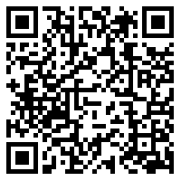
Safety Moment
Notes:
Andrea
April is National Child Abuse Prevention Month. It recognizes the importance of families and communities working together to strengthen families to prevent child abuse and neglect.
Https://www.scouting.org/programs/cub-scouts/preview-adventures/protect-yourself-rules/
The Boy Scouts of America is committed to creating safe environments for Scouts and leaders. Child abuse is an uncomfortable topic but an important one for us to cover to ensure the safety and well-being of our Scouts. The Boy Scouts of America has partnered with subject-matter experts from the Barbara Sinatra Children’s Center Foundation to present the “Protect Yourself Rules” that help children recognize, respond to, and report abuse.
Before starting work on this adventure, the den leader should review Scouting’s Barriers to Abuse since the Protect Yourself Rules adventure is intended to complement our many existing youth-protection measures.
The Protect Yourself Rules Preview Adventures may be used as an elective adventure OR they may be earned in place of the Cyber Chip requirement for the Tiger, Wolf, Bear, Webelos, and Arrow of Light badges of rank. If used in place of the Cyber Chip requirement for a rank, it may not be used as an elective adventure for that rank.

Slide 6
Today’s Panelists
Andrea Watson Director Outdoor Programs and Properties
Wendy Kurten Director of Membership
Michael Ramsey Director of Marketing & Brand
Notes:
All introduce yourself – michael will go first and then call on others

Slide 7
Top 3 Myths Membership and Day camp
Notes:
Andrea

Slide 8
Myth #1 You must be registered before you can attend. And you must have participated throughout the school year. All adults must be registered to attend and serve on staff or as “helpers”.
Notes:
Insurance
Incoming Tigers
myth: day camp for cub scouts is not day care TRUTH: parents need to be able to use us as a cheap alternative to day care and your program better be good enough for me to miss the $$$ day care i am spending money on to come to the one you are hosting for a week. As a parent i am probably still paying for that day care week anyway.
myth: day camp for cub scouts is not day care TRUTH: parents need to be able to use us as a cheap alternative to day care and your program better be good enough for me to miss the $$$ day care i am spending money on to come to the one you are hosting for a week. As a parent i am probably still paying for that day care week anyway.

Slide 9
Myth #2 Day Camp must be held during the week, Monday- Friday. “Day Camp” can’t happen at night and/or must be 8 hours in length.
Notes:
myth: i can run my program on my schedule. Truth: you have to allow early drop off and late pick up for parents who work

Slide 10
Myth #3 “If you build it, they will come.”
Notes:
Marketing is beyond important. We must educate our membership on why/what more than ever before. We especially have to educate and market to non members.

Slide 11
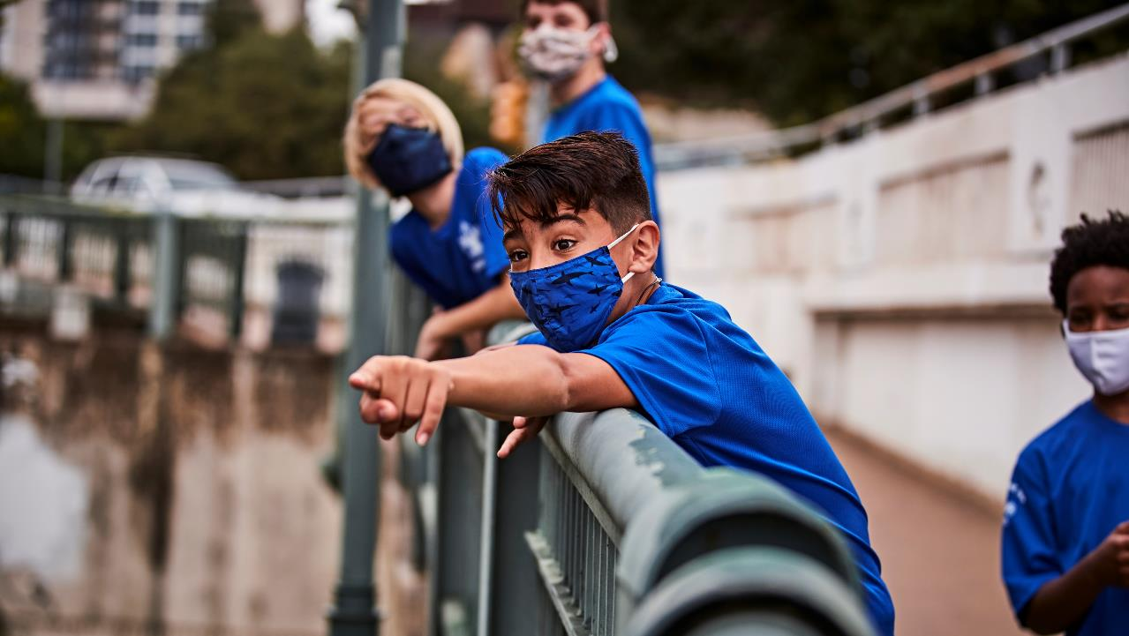
But what about NCAP?
Notes:
Andrea
- Connect with council

Slide 12
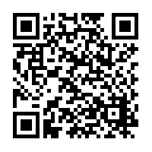
NCAP Considerations
Fully understand SQ-401 and SQ-402
Consider program design, PD-101, PD-102
Consider specialty programs that fall under PS-200 series
Remember Youth Protection, HS-501 and HS-502
Notes:
Consider NCS training that may be required for some programs?
Do you talk about the assessment and who does it? how? Too in the weeds?
Add NCAP link

Slide 13
So How do we do it?
Notes:
Andrea

Slide 14
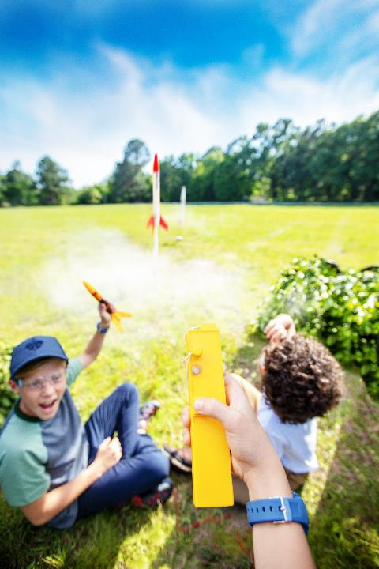
How To:
Registration options
Staff recruitment solutions
Quality experience, first impressions
Marketing, marketing, marketing

Slide 15
Ideas on Promoting Your Day Camp
Think About this from the Parent’s Point of View.

Slide 16
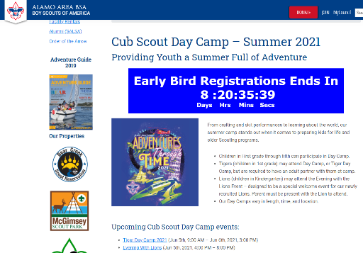
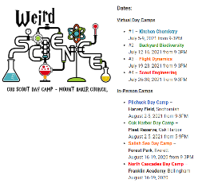
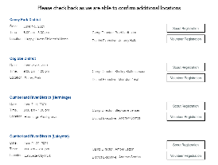
First… Look at Your Web Site
Is it up-to-date?
Is it easy to navigate and understand?
Is it free of BSA jargon?
Is it easy to sign up?

Slide 17
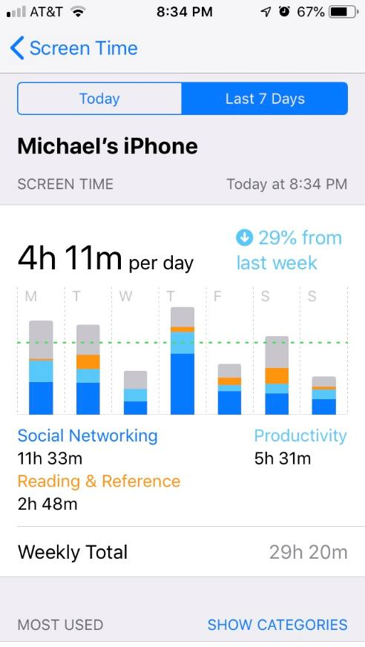

Slide 18
Ideas on Promoting Your Day Camp
Yard Signs
Fliers / emails through schools
Social Media
Parents groups on social media
Posting, Sharing
Paid Ads
Facebook Geofencing
Community & city pages, Parent Groups
Friends and Family (Word of Mouth) >> Social Media
In-person visits to units – In person Promotion!
…Get Creative….

Slide 19
scouting.org/brandcenter
Notes:
Quick reminder that if you are not signed up for the ScoutingWire, do it now! It’s THE source for news and information coming out of the National Service Center. And it’s searchable, so if you’re looking for articles and content you can find it. It’s a great resource.
Did I mention you can access it on your smart phone? Good stuff.

Slide 22
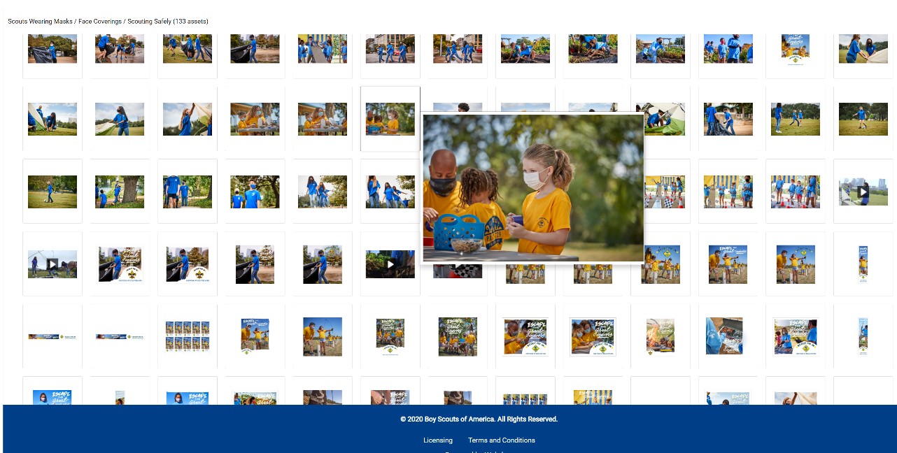

Slide 23
Membership Options
Notes:
Michael ask Wendy
Signing up : Before – During – After
Before – Encourage BSA registration. You can include registration fees into their day camp fee if desired. Visit with packs prior to daycamp; see who is eager to accept new members in their unit/den
Put joining information on all day camp promotions
Ask during the day camp registration process if they would like to Join Scouts (make sure you have a unit for them to join or start a council unit for them)
Offer incentives for families to join Scouting (ex. Member/non-member fee for day camp, discount (use discount code when joining online), etc.)
During – Register them with a local unit or create a “council level” pack with intentions to move them to a pack or run the council pack as needed.
Distribute information to families on how to join during the week.
Recognize new Scouts during day camp (Announcement of new members)
After – Follow up with attendees who did not join to engage in future activities.
Have a committee of volunteer make personal phone calls to these families and ask them to join
Connect them to a local unit if possible
Don’t let day camp be it!
Engage them in other council or district events throughout the summer. Be intentional now about other opportunities. You should be looking at what other event are happening over the summer and promote those during day camp.
Unit leaders should promote their summer activities too!

Slide 24
Summary
NCAP and the BSA has a path forward to engage “nonmembers” into day camp!
Marketing efforts need to reflect multiple audiences.
Get creative in engaging them in the future as well as moving day camp attendees to traditional registered members.

Slide 25
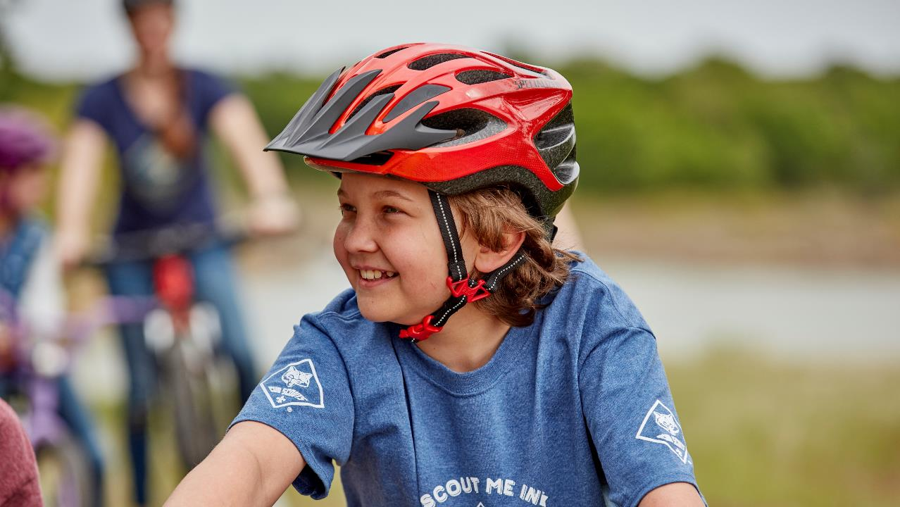
Q&A

Slide 26
Find the Recording at…
https://scoutingwire.org/marketing-and-membership-hub/marketing-webinars/

