Slide 1
Membership / Marketing Webinar: Tech Edition
April 7, 2021

Slide 2
The Panel
Pat Wellen Director of Research
Wendy Kurten Director of Membership
Darin Kinn Marketing Manager for Field Support
Michael Ramsey Director of Marketing & Brand

Slide 3
Are we recording this?
Yes!
https://scoutingwire.org/marketing-and-membership-hub/marketing-webinars/

Slide 4
Pat Wellen Director of Research

Slide 6
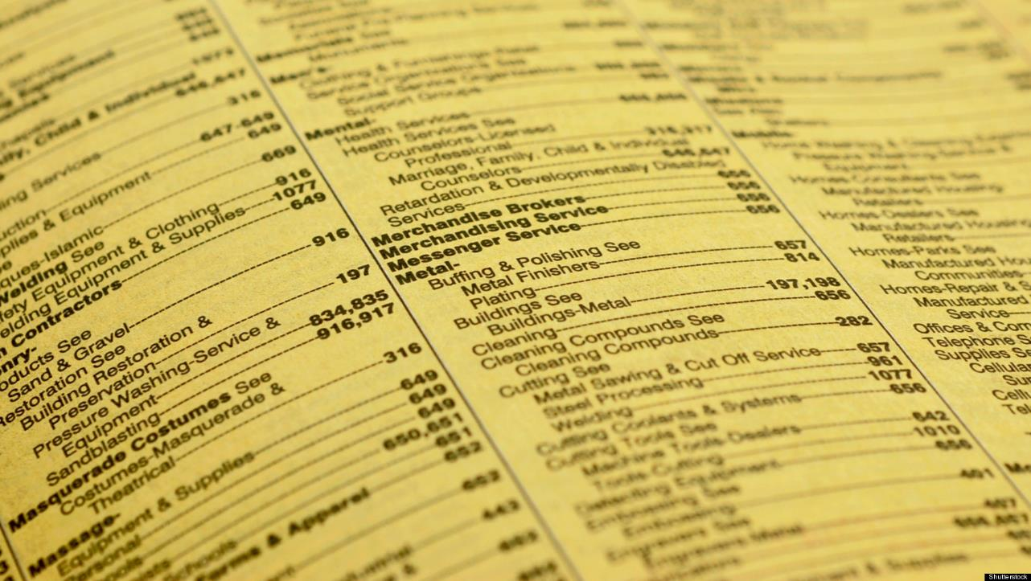

Slide 7
Marketing has Changed…

Slide 13
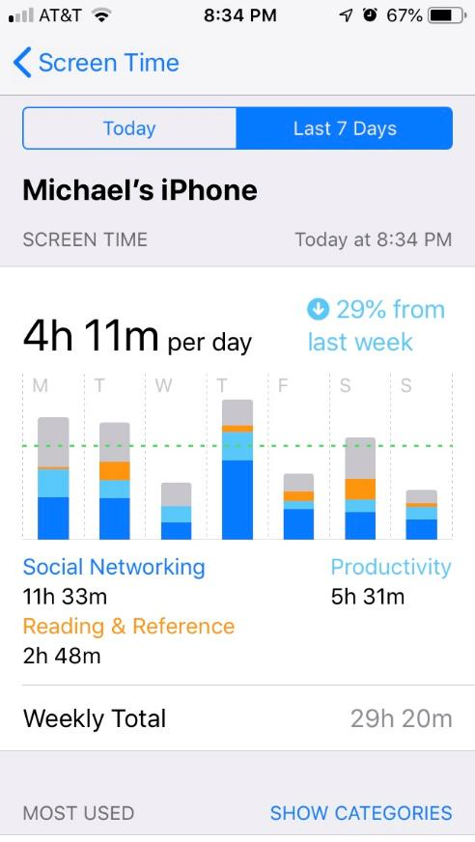

Slide 14
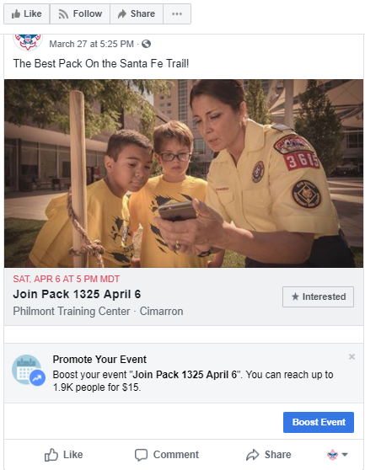
What is a ‘Geofence’?
Notes:
Boosting an event means paying to have your event seen by more people in Facebook. This can be for as a little as a dollar a day.
To begin boosting the event, click on the button that says “Boost Event”.

Slide 15
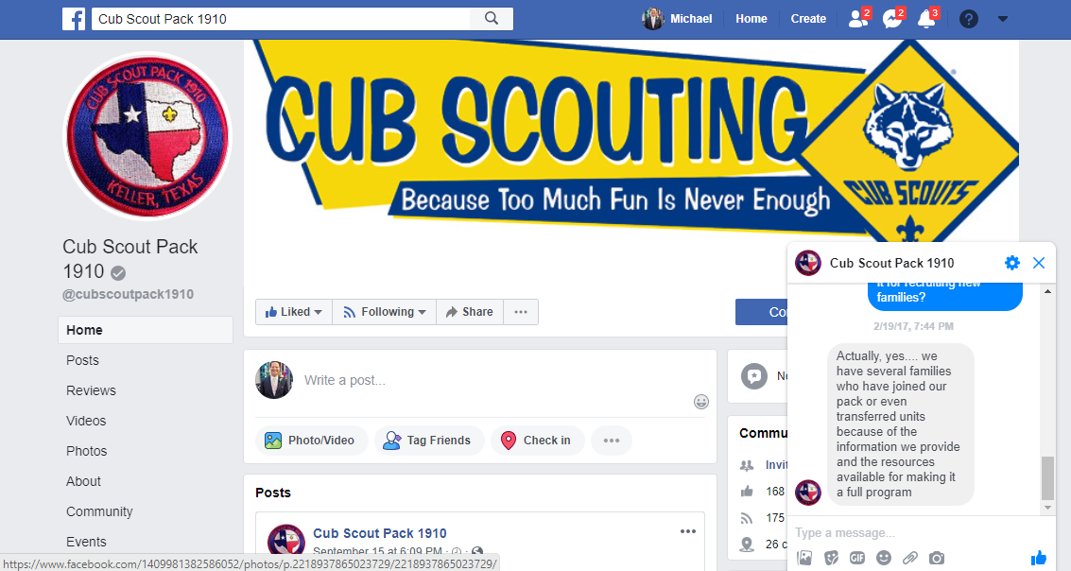

Slide 16
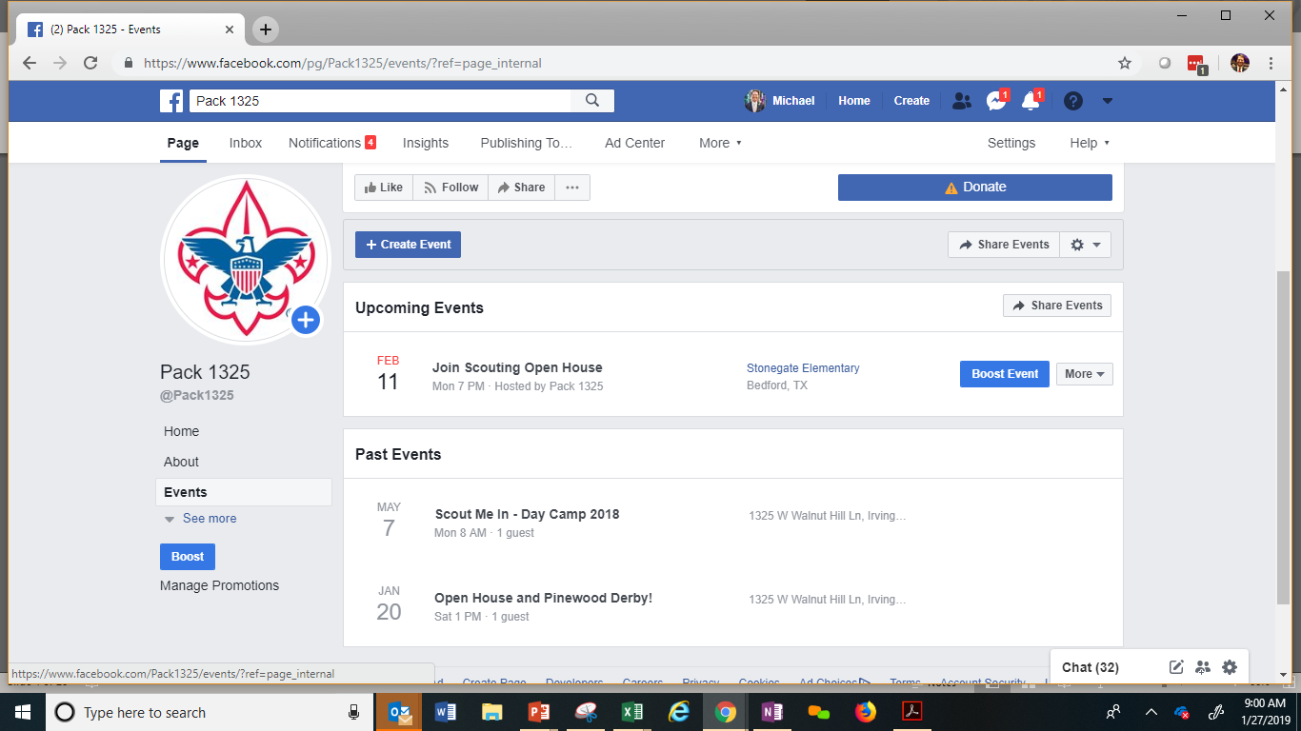
Notes:
Here’s an example of the Events page in Facebook. Pretty handy!
See that button that says ‘boost’? That’s what we’re going to talk about.

Slide 17
Create an Event
Notes:
So first you have to create an event.

Slide 18
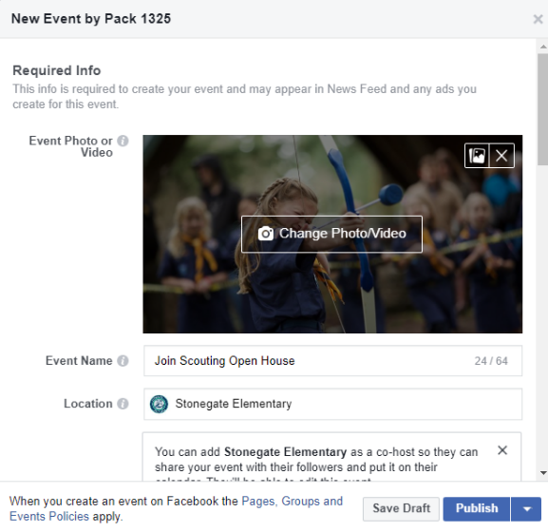
Notes:
It’s just like setting events in other software… date, time, location, etc…..
Select “Events” and create a new event.

Slide 19
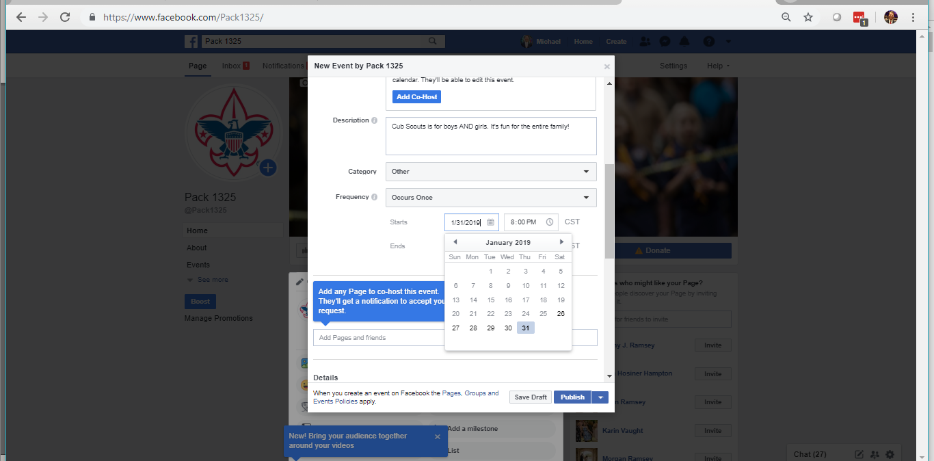
Notes:
In this window you can add a description of your event, set the date and time.

Slide 20
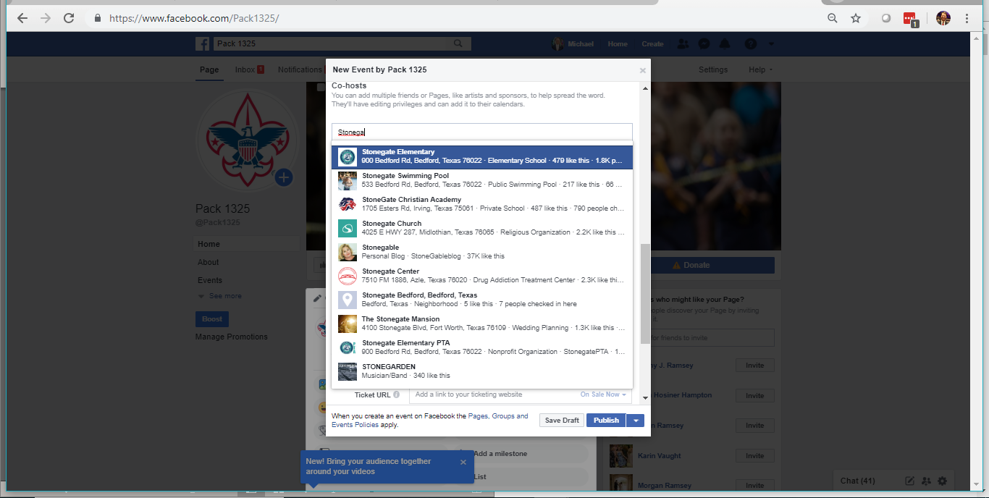
Notes:
Tip: Depending on the type of event, you may decide to ‘co-host’ the event with another organization, such as a school, PTA, PTO, etc. This will increase the number of people who see your event.

Slide 21
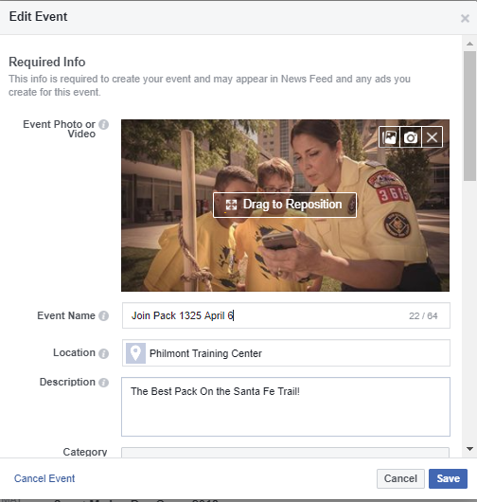
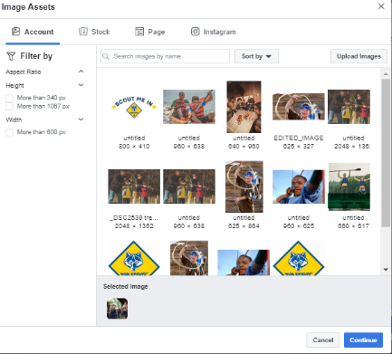
Notes:
In the Boost Event window, you can change the image for the event and add or change the text that will appear in the event posting.

Slide 22
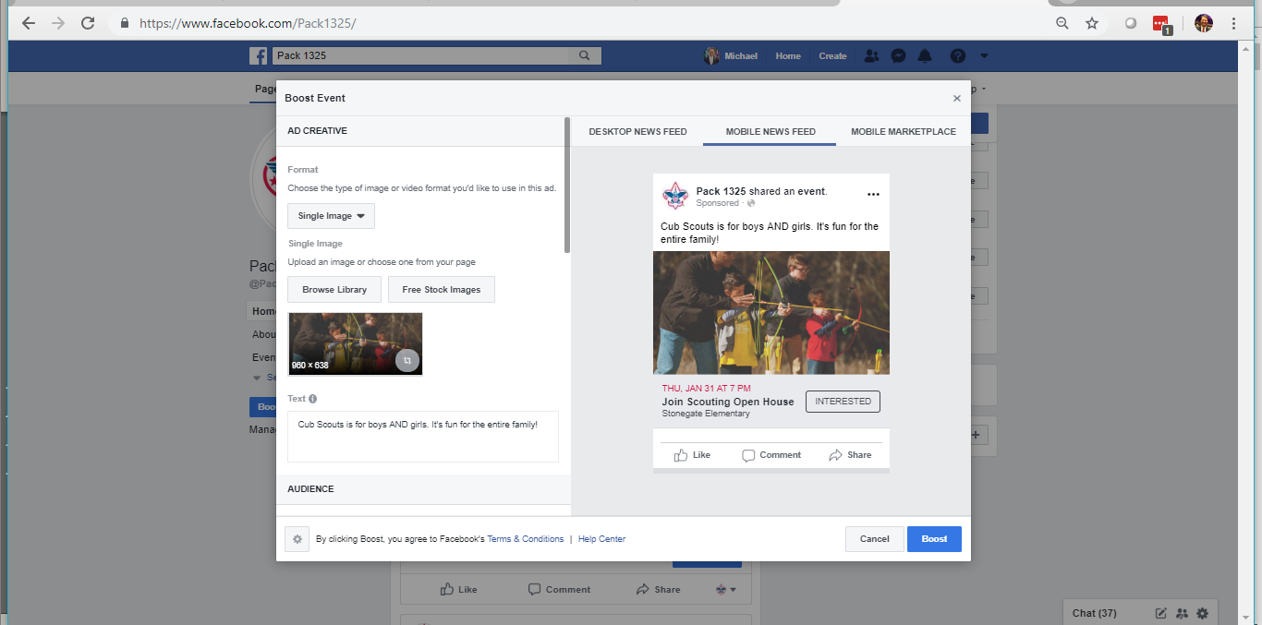
Notes:
All along the process, Facebook shows you how your event will look… on desktop and on mobile.

Slide 23
‘Boost’ the Event
Notes:
Let’s talk about boosting….

Slide 24
Notes:
Boosting an event means paying to have your event seen by more people in Facebook. This can be for as a little as a dollar a day.
To begin boosting the event, click on the button that says “Boost Event”.

Slide 25
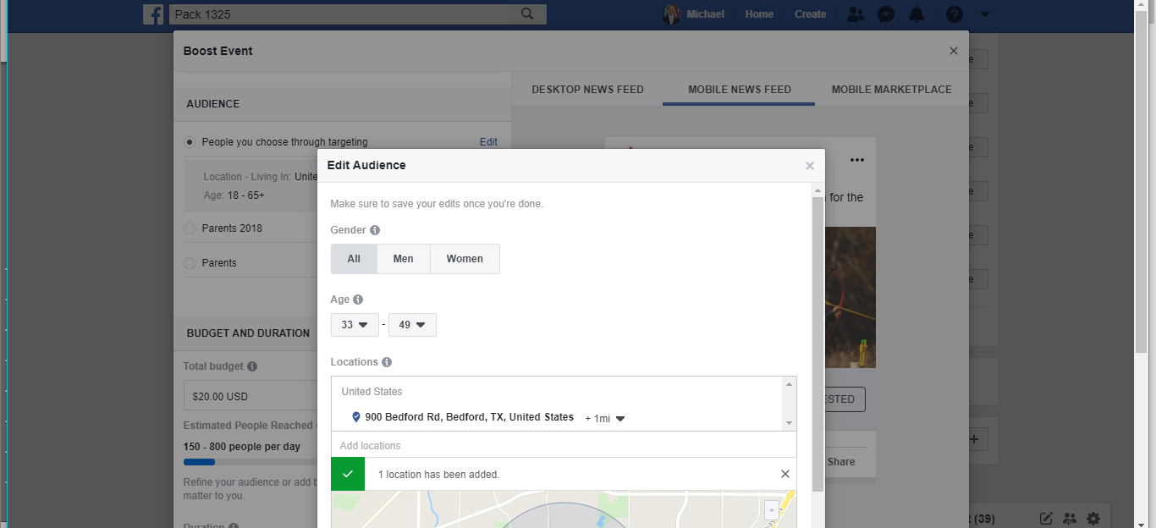
Notes:
Facebook will then bring up this window called Edit Audience. Here you select who you want to target.
Both men and women ages 33-49 is what National has been using.
Remember the average age of the new cub parent? 41….

Slide 26
Set the Geofence

Slide 27
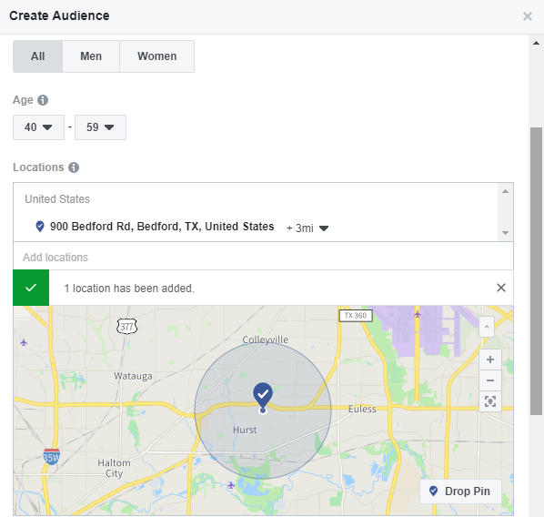
Notes:
Then you add the location of the geofence. This is the physical address of the school, for example.

Slide 28
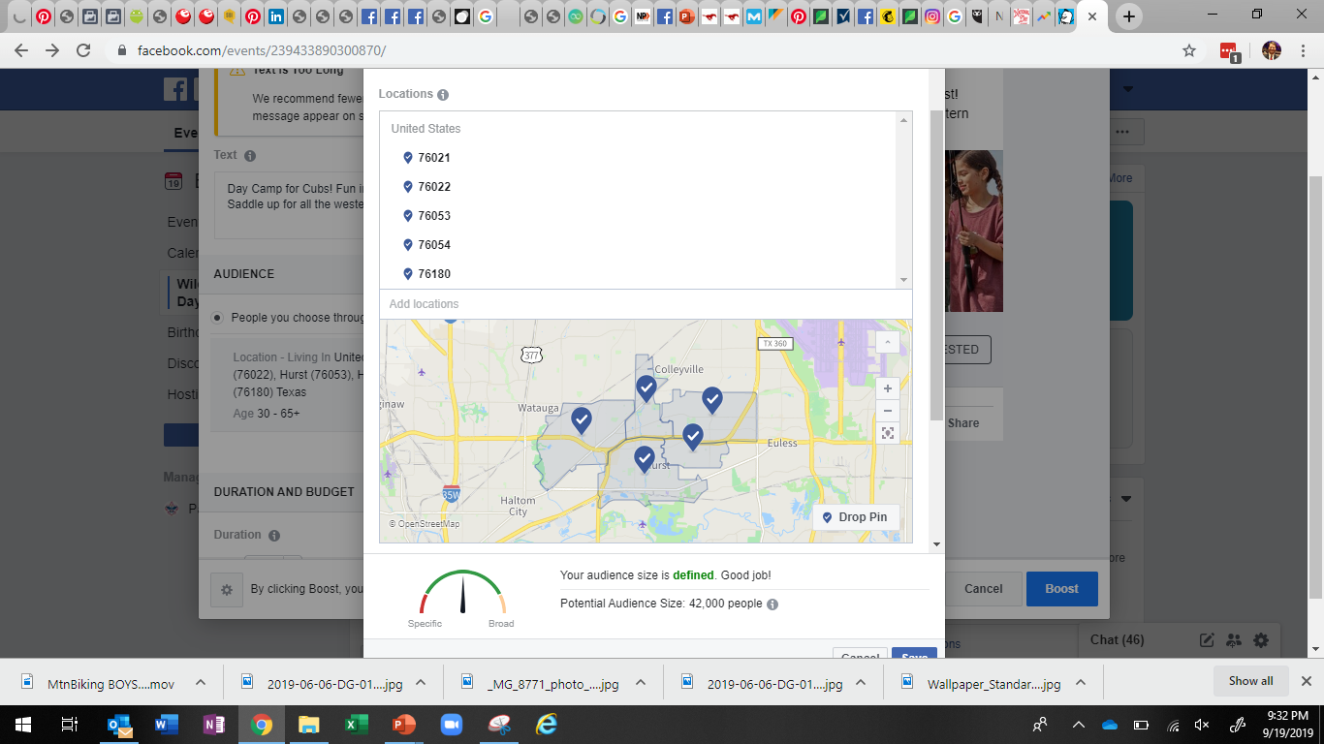
Notes:
Then you add the location of the geofence. This is the physical address of the school, for example.

Slide 29
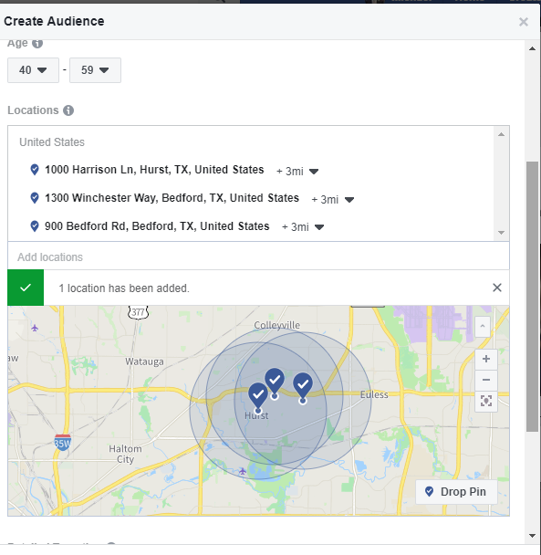
Notes:
You can even geofence multiple locations….. These just happened to overlap. In this case you should increase the radius of the geotargeting…. To maybe a mile for each.

Slide 30
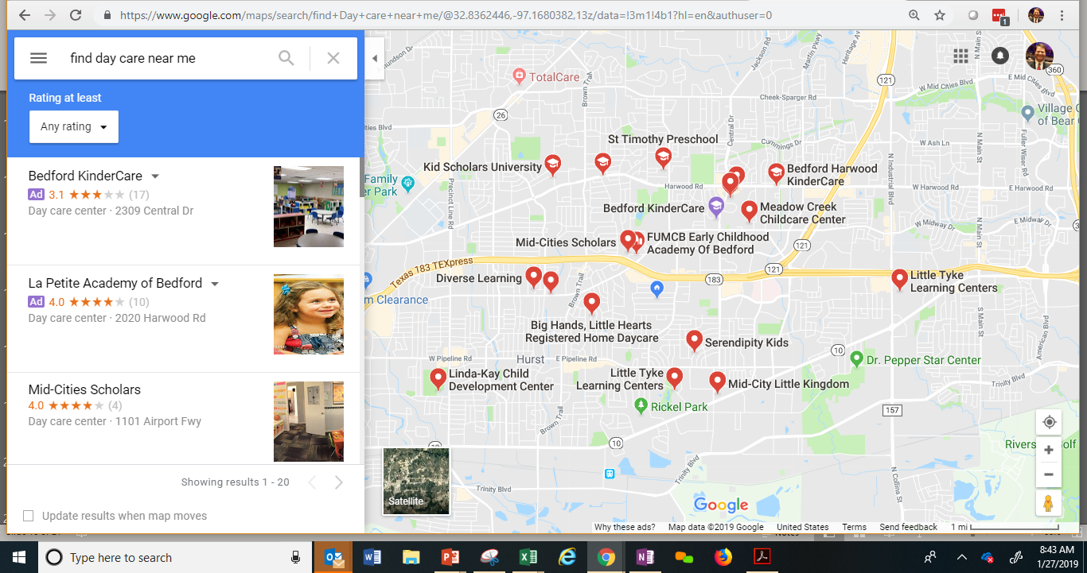
Notes:
Where else could you drop geofences? Maybe daycare centers? Where else? Target stores, Walmart --- where people buy school supplies?

Slide 31
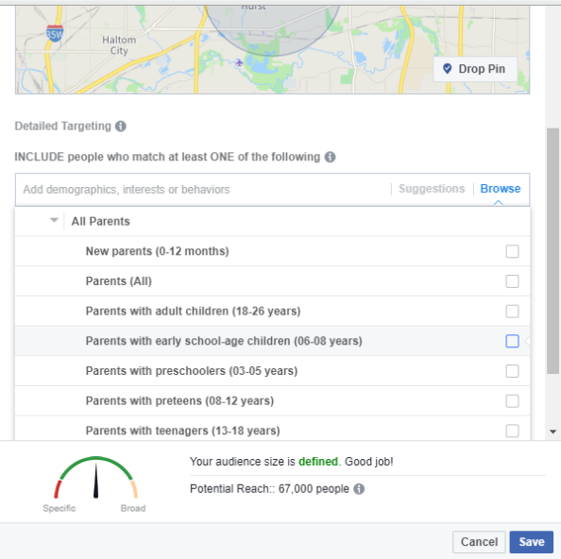
Notes:
You can even be very selective and target parents. There are many categories…. Be careful not to become too restrictive on who you invite. For example, a lot of grandparents raised their grand kids. You don’t want to exclude them with this tool.

Slide 32
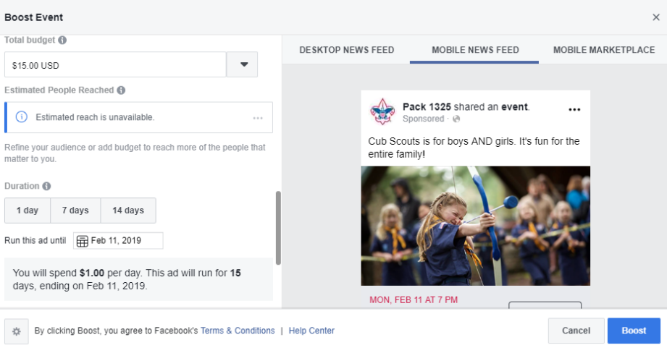
Notes:
And here’s what it looks like….

Slide 33
What does it cost?

Slide 34
Notes:
Then it asks about money – of course.
To boost an event, you can spend as little as $1 a day. In this scenario, that’s a whopping $14 bucks (lunch at Chick-Fil-a) to reach between 1000 and 2700 people. That’s really good.
You can choose a 1, 7 or 14 day run.
Increasing the budget increases the estimated people reached. (Note: Population density in an area will greatly impact this.)
It’s simple.

Slide 35
Notes:
And you can spend as much as you like…. Here’s an example in this market.
Of course it will vary by market density and the size of the area you select. (2 mile, 3 mile, 5 mile, etc.)
In our tests, we spent $1 per day, typically from anywhere from 1 week to one month out. One to two weeks out from the joining event seems to be optimal. Most people don’t plan one month in advance.)

Slide 36
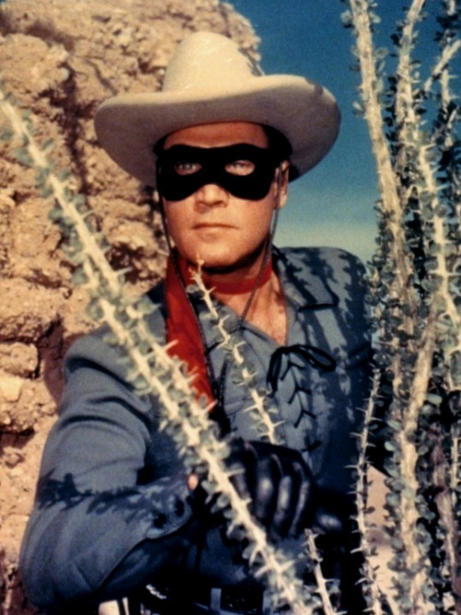
Notes:
There are no silver bullets here! This is one more tactic we can use to reach today’s parents!

Slide 37
www.scouting.org/brandcenter
Notes:
Looking for marketing assets and resources – check out the BSA Brand Center.

Slide 38
Questions

Slide 39
Find the Recording at…
https://scoutingwire.org/marketing-and-membership-hub/marketing-webinars/

Slide 40
Thank You

