Slide 1
June 2021 8 pm E / 7 pm C

Slide 3
The Panel
Wendy Kurten Director of Council Service
Michael Creagh Applications Manager for IT
Darin Kinn Marketing Manager for Field Support
Michael Ramsey Director of Marketing & Brand

Slide 4
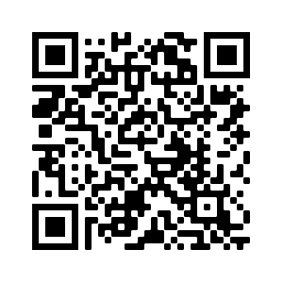
Find all of the webinar recordings here!
https://scoutingwire.org/marketing-and-membership-hub/marketing-webinars/

Slide 5
Top 3 things that drive unit satisfaction among parents are:
Support from Scouting leaders that help me be a more effective contributor.
We have great outdoor activities in our Scout unit.
Our family feels like we belong in our Scout unit.

Slide 6
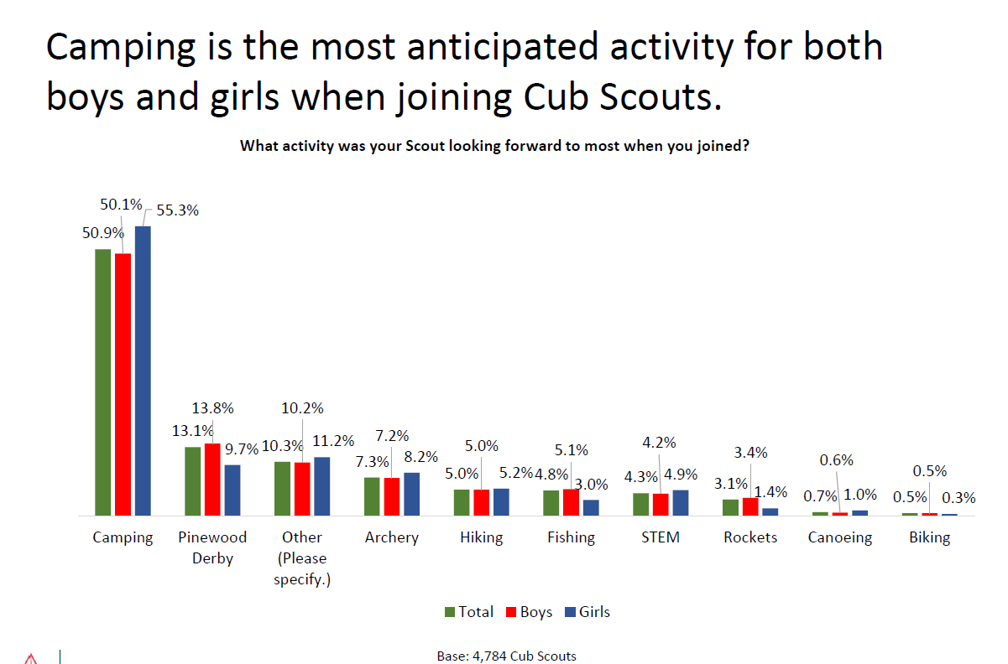
REASON FOR JOINING

Slide 7
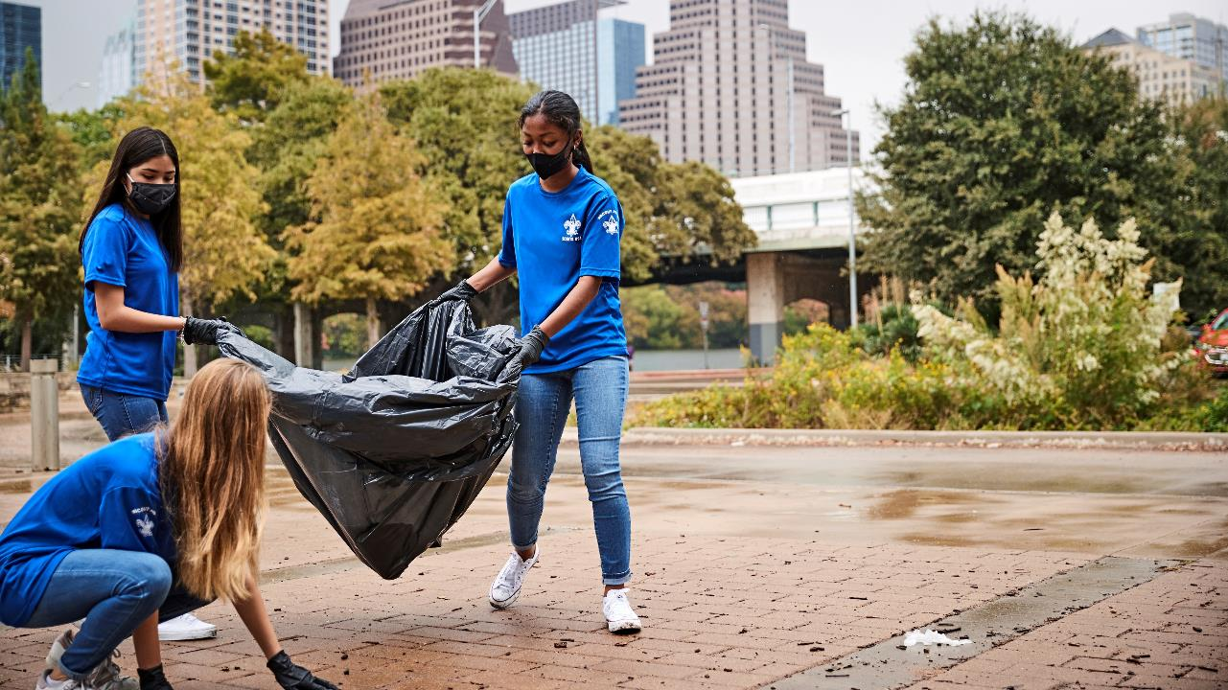
Notes:
service

Slide 8
Summer of Service
Engage members in the higher-calling of “service” through a national push
this summer that will increase local visibility and reinvigorate Scouting’s local brand.
April-October
Open to anyone connected to Scouting…or not yet connected to Scouting!
“Serve” in a variety of ways – defined by the individual
Easy Process:
Perform Service - Service defined by the individual or group…big or small…adaptable to local circumstances
Post About It - When done, post about it on your social channels using #SummerofService
Tell Us About It - Report basic information about the project, # of hours, # of people, etc. and upload images/videos
Order Recognition - There will be downloadable certificates and a patch available for purchase
Council Adaptability – may range from no council involvement to council-wide projects
Mine for great stories – The Environment, Health & Wellness, Our Communities, Neighbors In-Need

Slide 9
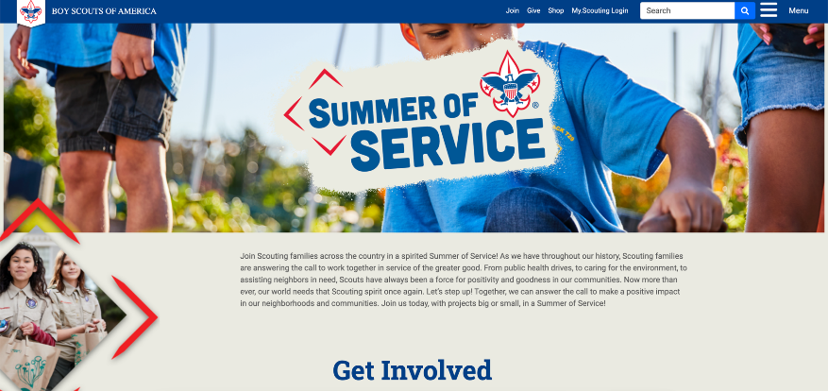
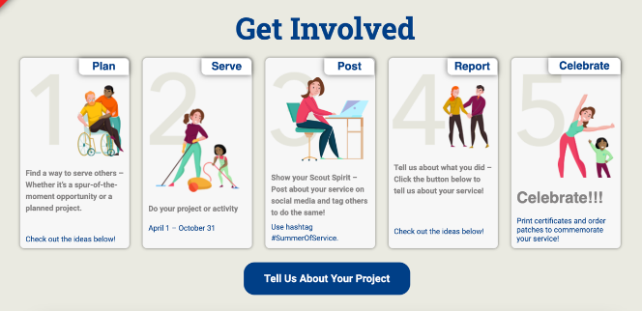
scouting.org/summerofservice
Notes:
Council “Kits” on BSA Brand Center
Logos/Graphics
Zoom backgrounds & Facebook frames
PR playbook
Library of social posts
Library of newsletter articles
Large banner sign template/artwork
Website banner ads
Email templates
1/4-pg and 1/2-pg ad sizes
Recognition Banquet program template
Beneficiary email template
Beneficiary doorhanger template
Yard sign template
Window cling templates
Report to the ___ (congregation, mayor, etc.)

Slide 10
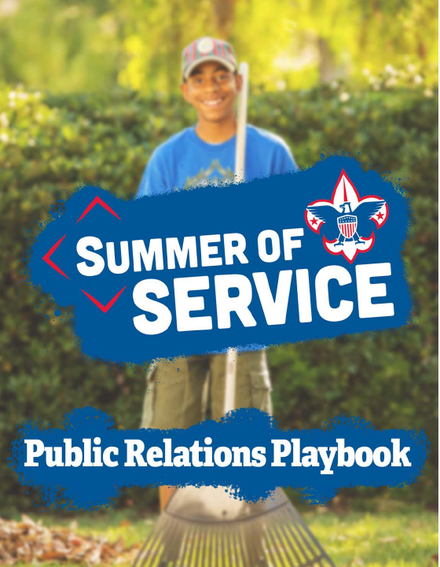
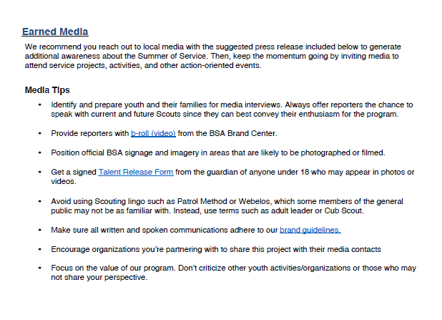
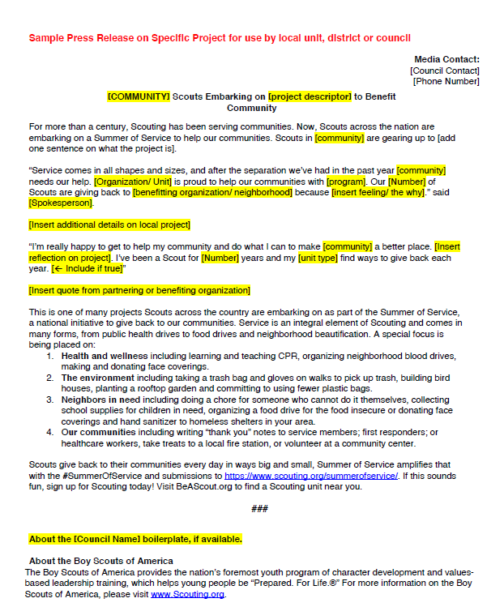

Slide 11
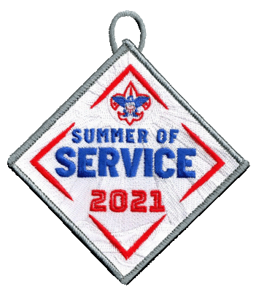
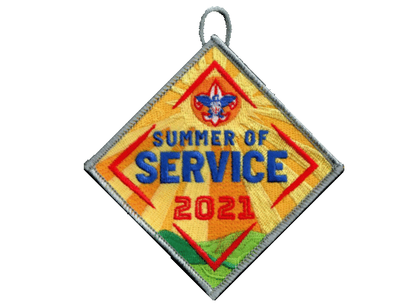
Notes:
And of course there is a patch….

Slide 12
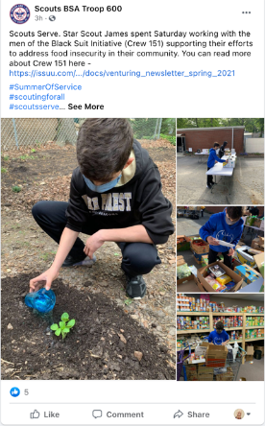
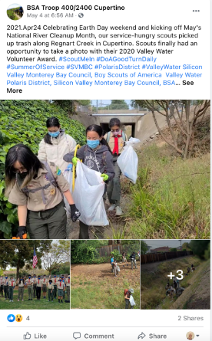
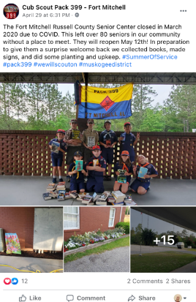
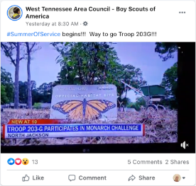
Social Posts Using Hashtag

Slide 13
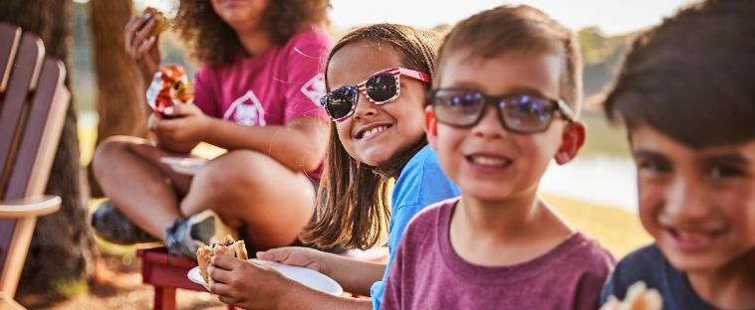
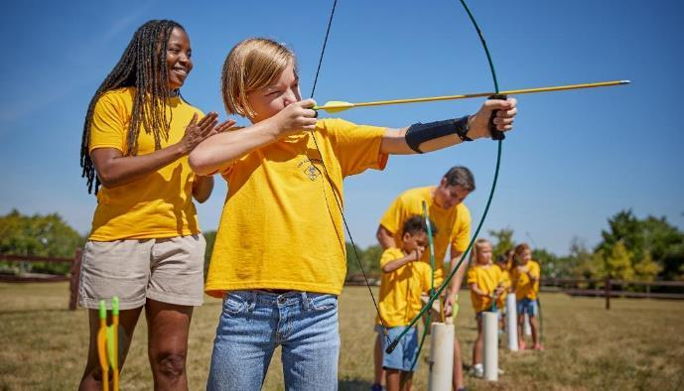
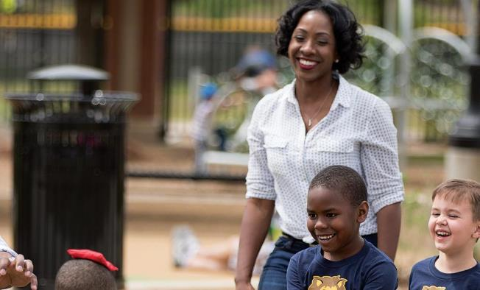
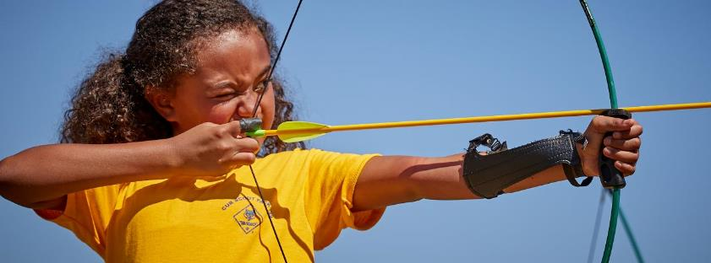
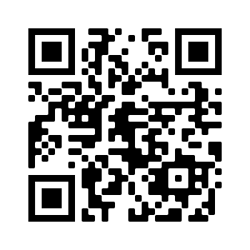
Scouting.org/BrandCenter

Slide 14
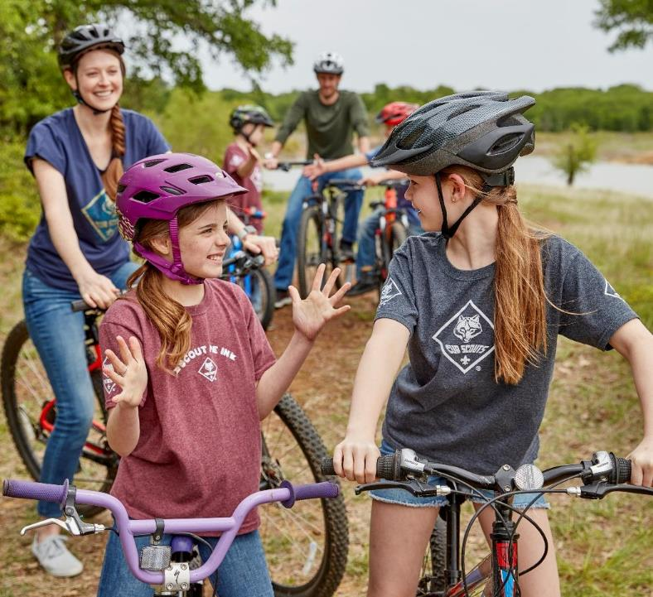
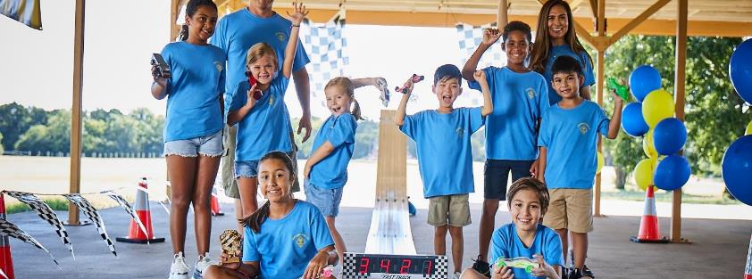
Scouting.org/BrandCenter

Slide 15
Michael Creagh

Slide 16
Darin Kinn

Slide 17
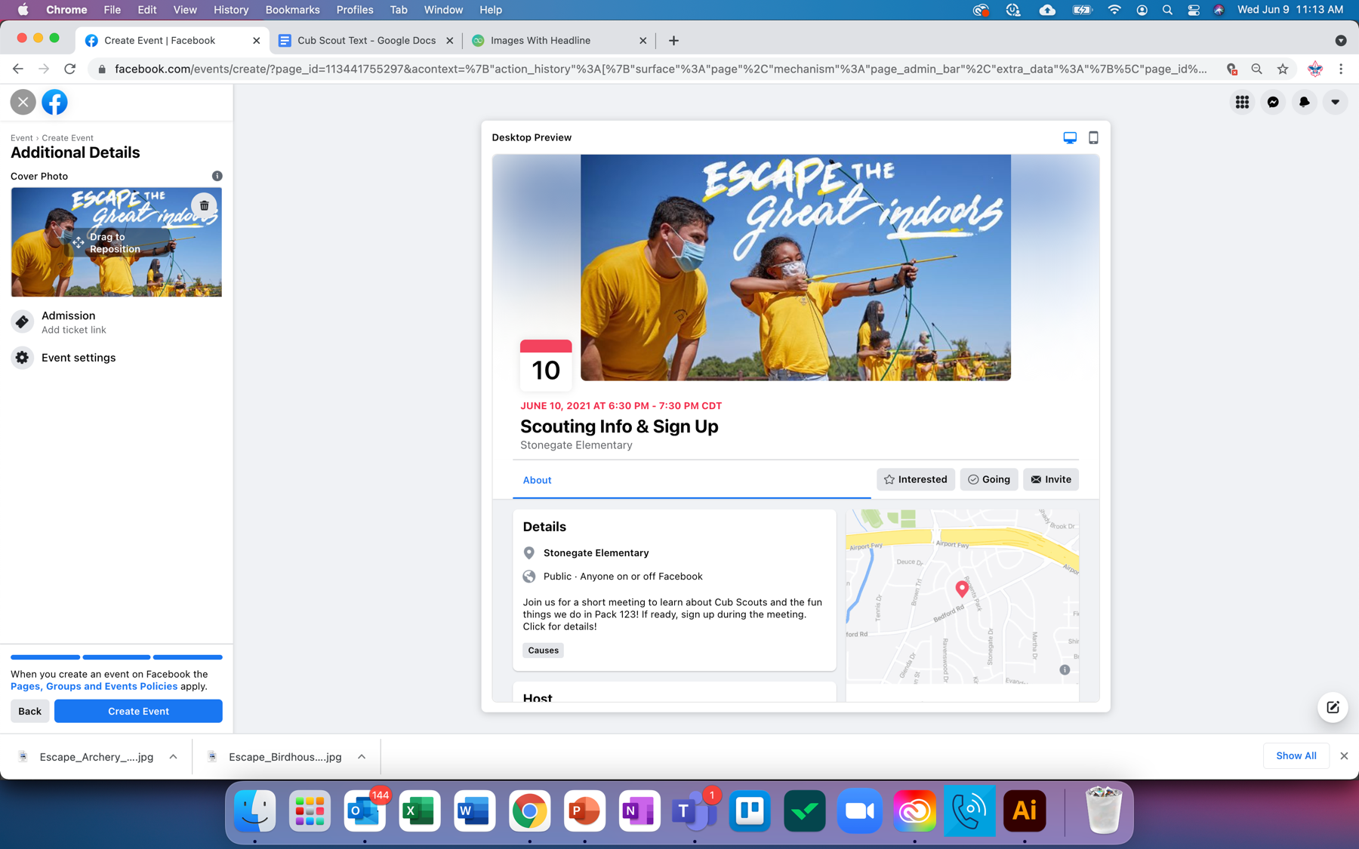
Geofencing 101

Slide 18
What is “geofencing”?…
Defining a geographical area within which to serve an ad
Setting the boundary = setting the geofence
Radius, zip code, city, state, country, etc.
We (BSA vernacular) use the term to refer to…
Serving a calendar invite (Facebook Event) to people within the fenced area
Very tactical “closing the sale” type of execution – date/time/location of a joining event

Slide 19
Why Facebook?
Facebook still dominant among adults 18+
TikTok showing significant growth potential among under 30 crowd
Reddit also seeing dramatic growth
Facebook still dominant!
PEW Research – Feb 2021

Slide 20
Setting Up a Facebook Geofence
Two-Step Process:
Creating the Event
Boosting the Event
Boosting = Turning the event into an “ad” that is served to people on Facebook. Putting paid dollars behind the event.

Slide 21
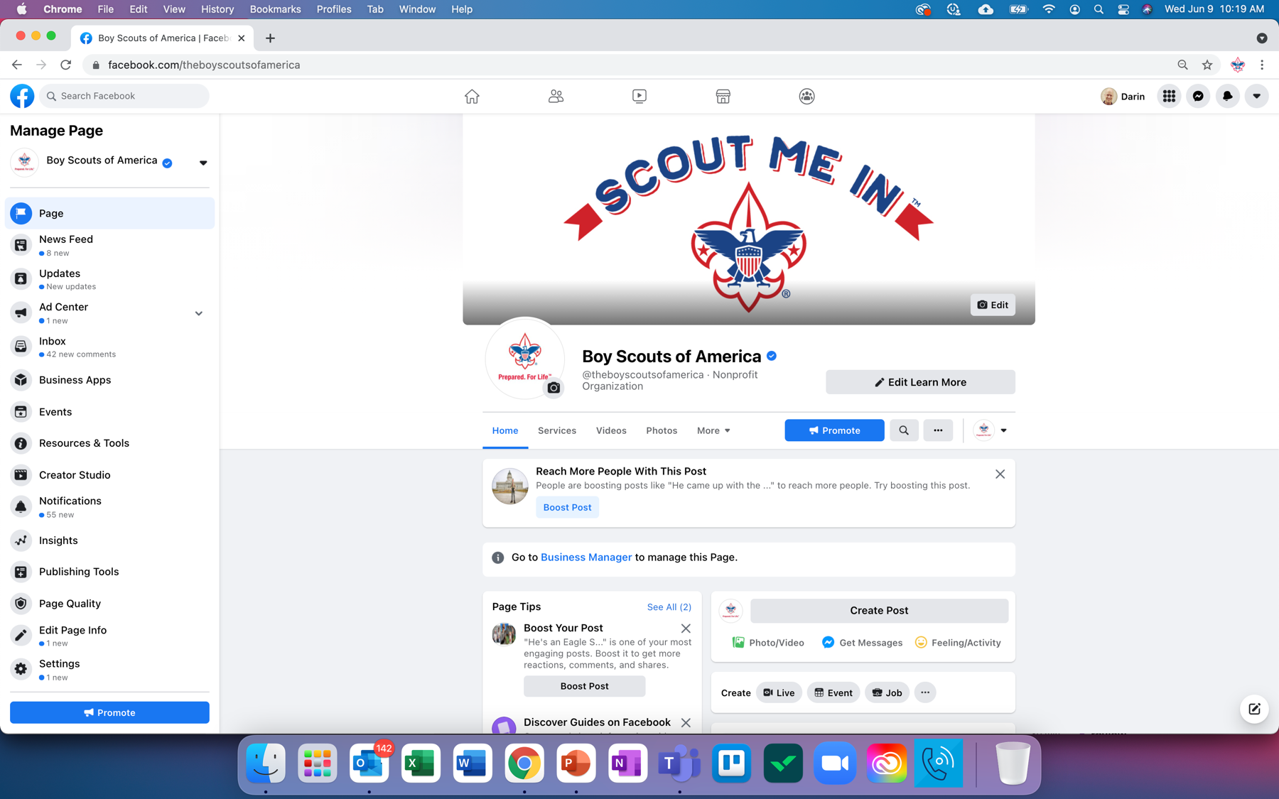

Slide 22
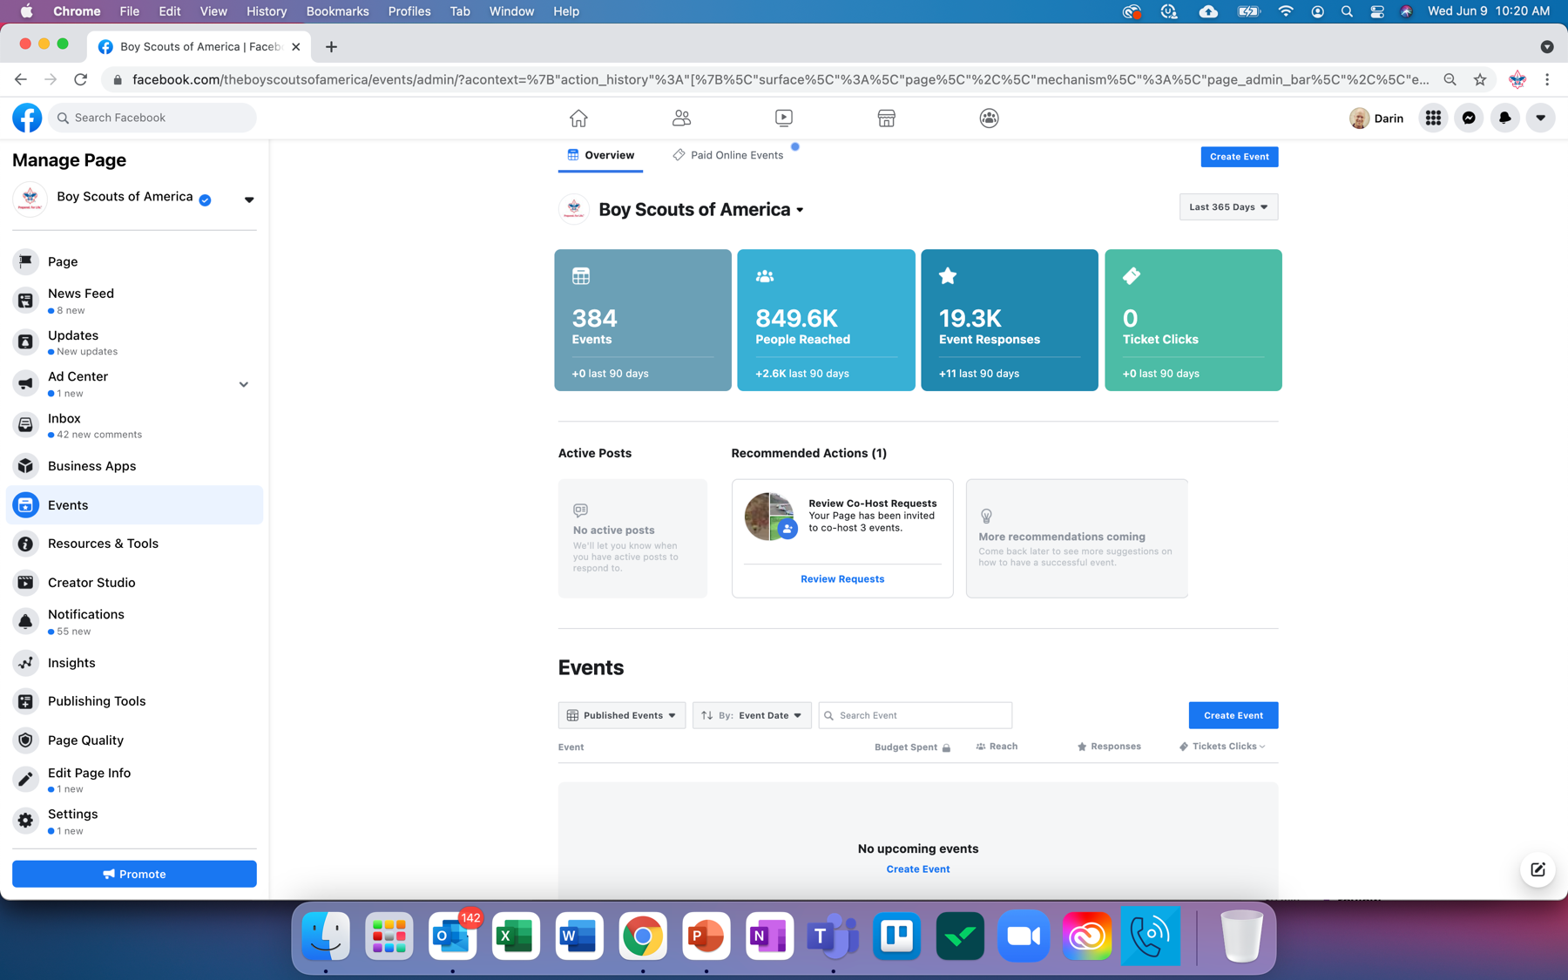

Slide 23
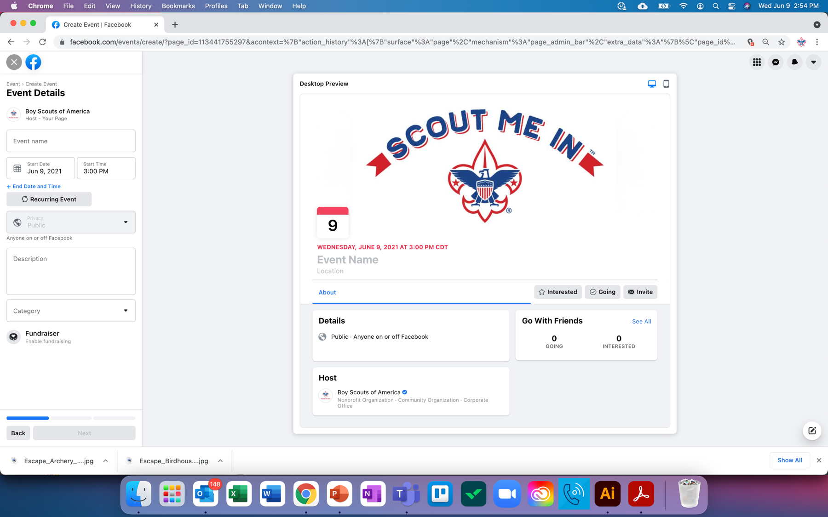

Slide 25
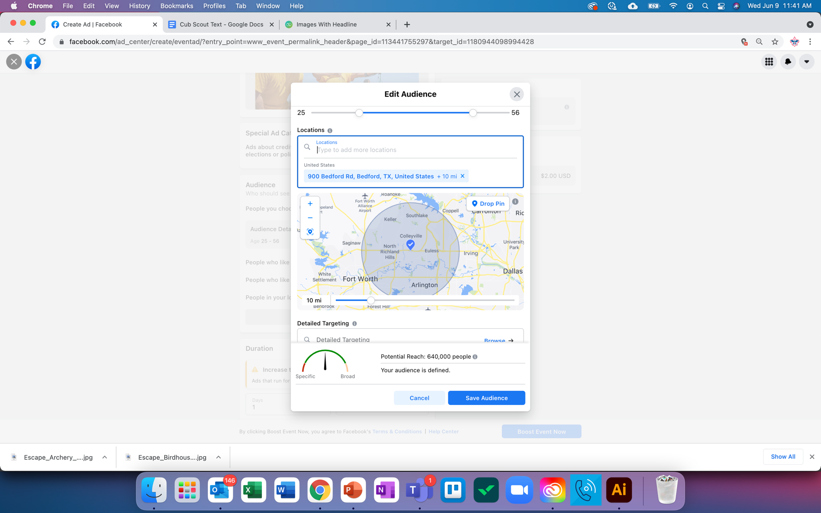

Slide 26
Algorithm
Will everyone see my ad? - - - - NO!
People who fit the profile you’ve set will be in the pool of potential viewers
Algorithm that tries to determine who will respond to the ad or engage
If you’ve been served similar ads before and not engaged or clicked…you may not get this one…even if you fit the profile
Spend level or length of time…
Too much text on your ad creative, Facebook will limit your reach (not engaging)

Slide 27
The Geofencing Mindset
Not a silver bullet
Should be a part of your overall mix:
Flyers
Promotional Events
Getting in Schools
Scout Talks
Starting New Units
Win-Back Campaigns
Media Relations/PR
Other advertising
… AND…Geofenced Facebook Events

Slide 28
Q&A

Slide 29
Find all of the webinar recordings here!
https://scoutingwire.org/marketing-and-membership-hub/marketing-webinars/

Slide 30
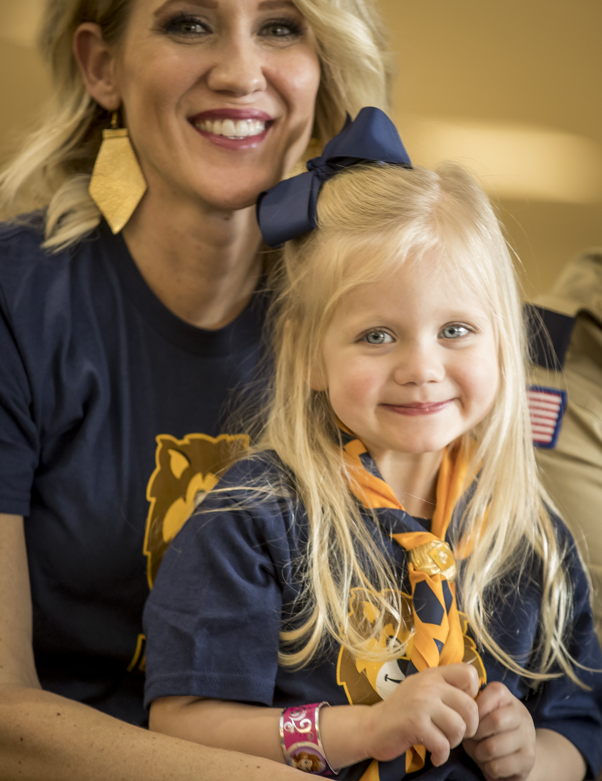
Thank You

