Slide 1
July 15 2021 8 pm E / 7 pm C

Slide 2
The Panel
Rachel Scholan Director of Marketing & Ecommerce
Kate Matthews Director of Social Media
Darin Kinn Marketing Manager for Field Support
Michael Ramsey Director of Marketing & Brand

Slide 3
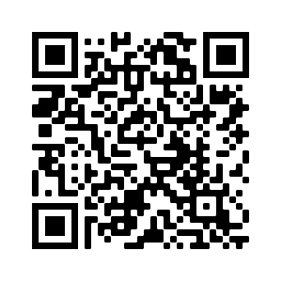
Find all of the webinar recordings here!
https://scoutingwire.org/marketing-and-membership-hub/marketing-webinars/

Slide 4
Audience Insights
Notes:
All of the BSA’s marketing assets are developed based on research with our audiences. I want to share just few insights on our target audiences.

Slide 5
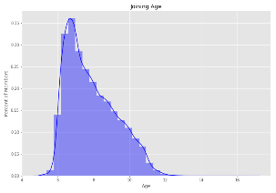
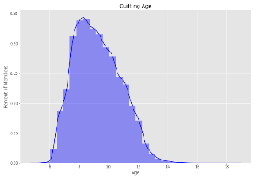
Average Recruitment & Expiration Age Traditional, Cub Scouts1, Non-LDS, last 5 years
Joining
Average: 7.88 Years (σ: 1.38)
Most Common: 6.91 Years
Median: 7.59 Years
Last Registration Expiration
Average: 9.24 Years (σ: 1.56)
Most Common: 8.00 Years
Median: 9.10 Years
Notes:
Note the average age at which people join and then exit the program.
The average age of a new Cub Scouts is 7.8 years – So almost 8 years old.

Slide 6
Average Recruitment & Expiration Age Traditional, Cub Scouts1, Non-LDS, last 5 years
Tenure
Average: 1.37 Years (σ: 0.94)
Most Common: 1.33 Years
Median: 1.33 Years
First Program | Records in Sample | Joining Age | Expiration Age | Tenure (Years)
Tiger | 84,285 | 6.593388 | 8.077781 | 1.484393
Wolf/Bear | 106,727 | 7.875428 | 9.240781 | 1.365353
Webelos | 55,227 | 9.854925 | 11.040180 | 1.185255
Notes:
Key takeaway here is the median tenure of a Cub Scout 1.33 years.
Delivering a great program experience (to parents and adults alike) is key to keeping youth in Scouting longer.

Slide 7
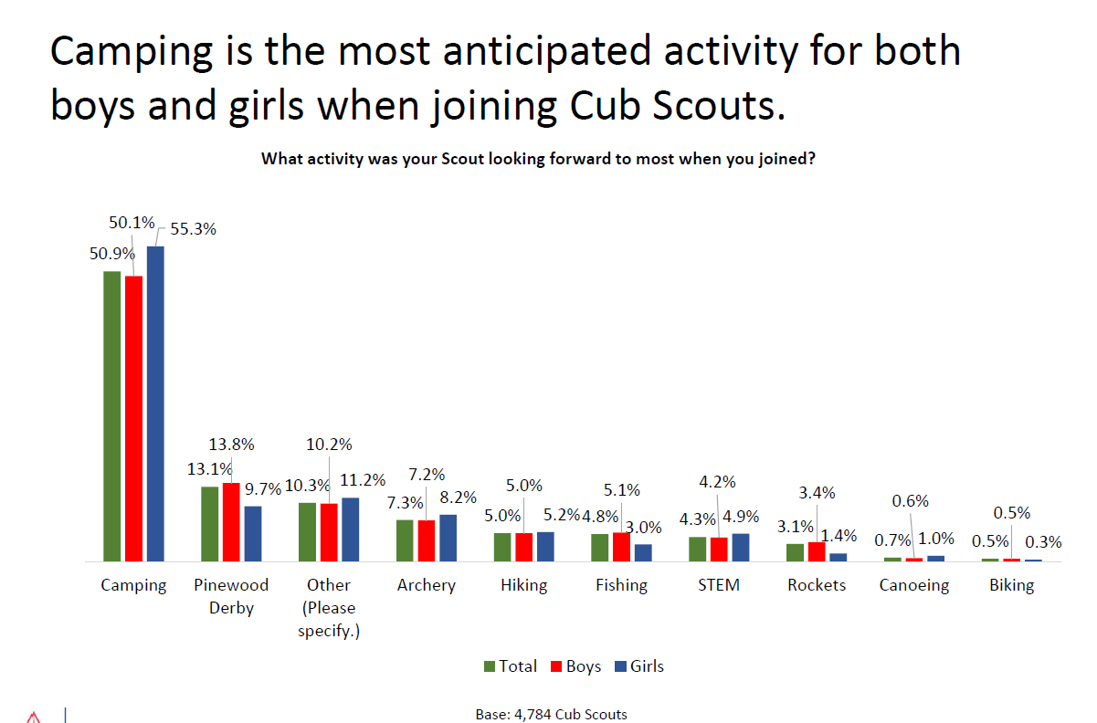
Notes:
Think girls and boys don’t want to go on outdoor adventures? According to the latest research,
girls and boys, alike, want to do similar activities in Cub Scouts. There is no significant difference.

Slide 8
Very Positive Impressions of Cub Scouting.
Parents….
Notes:
From recent qualitative research with mothers from 24 markets. Hispanic, African American, Caucasian.
They have very positive impressions of Cub Scouting – even though they don’t know a lot about the program.

Slide 9
Generally Unaware of Cub Scouts Locally.
Parents….
Notes:
From recent qualitative research with mothers from 24 markets. Hispanic, African American, Caucasian.
They are unaware of Cub Scouting in their community.

Slide 10
Don’t Know that… Girls Can Join.
Parents….
Notes:
From recent qualitative research with mothers from 24 markets. Hispanic, African American, Caucasian.
They don’t know girls can join Cub Scouting.

Slide 11
Tired of Masks.
Parents….
Notes:
From recent qualitative research with mothers from 24 markets. Hispanic, African American, Caucasian.

Slide 12
Don’t Want to Fundraise.
Parents….
Notes:
Fundraising was a big turnoff to parents. We’re not suggesting that units shouldn’t fundraise, but be aware that it could be negative for parents.

Slide 13
Want to Get Outside.
Parents….
Notes:
From recent qualitative research with mothers from 24 markets. Hispanic, African American, Caucasian.

Slide 14
80% of Families are Brand New To Scouting
They Have NO Idea What You Are Talking About Because….
Notes:
Why is this important? Keep in mind that new families may know very little about the Scouting program, unlike “generational” Scouting families. Keep this in mind when onboarding new families and making them feel welcome.

Slide 15
New for 2021

Slide 16
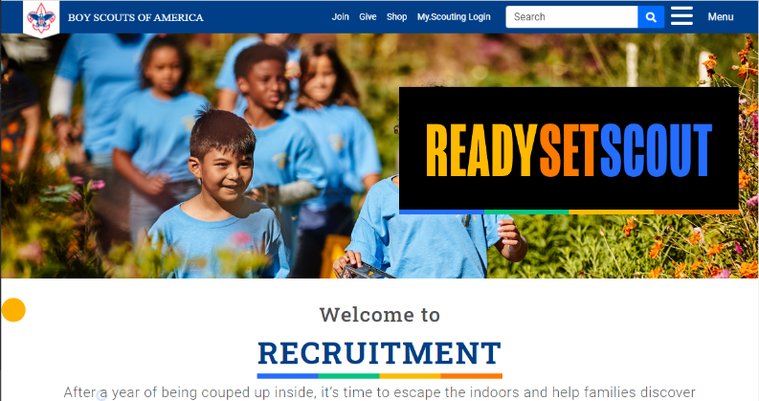
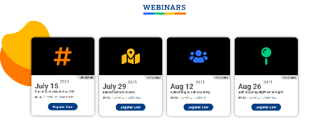
New Membership Marketing Landing Page
Scouting.org/recruitment
Notes:
In the past, you’d have to go to three different pages (or more) to find all of your recruitment marketing materials.
Now there is a new page.
Scouting.org/recruitment is the new landing page for all things on membership marketing. On this site, you’ll find links to recruiting materials, webinars and event.
Check it out!

Slide 17
Notes:
Some of you may have noticed a slight shift in the headline treatment of Escape the Great Indoors. Based on very recent research we conducted with mothers of elementary school-age youth, we have shortened the headline slightly to Escape the Indoors. The updated treatment is shorter and easier to read on social and digital media – which are among our primary communications channels. We are making this subtle shift now to the material on the brand center and should be complete shortly.

Slide 18
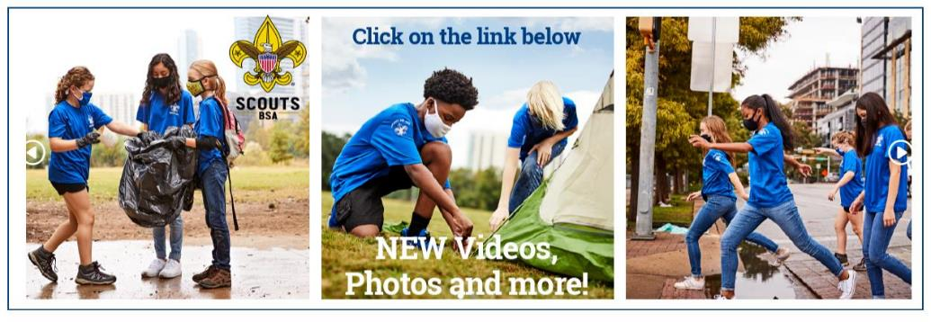
www.scouting.org/BrandCenter
Notes:
The BSA Brand Center is the one-stop shop for marketing assets and resources, including recruiting, Summer of Service, and more. It includes photos, hi-res video, artwork, social posts and much more.

Slide 19
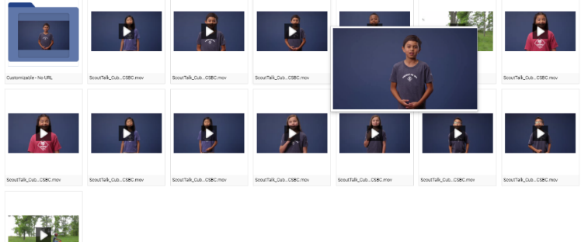
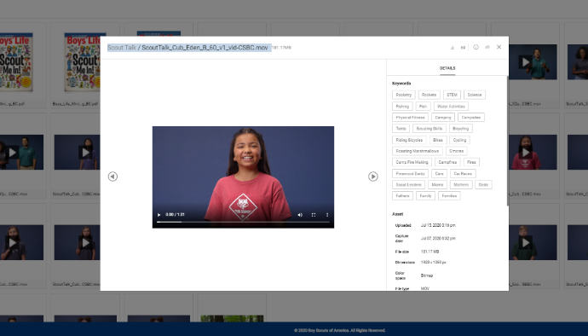
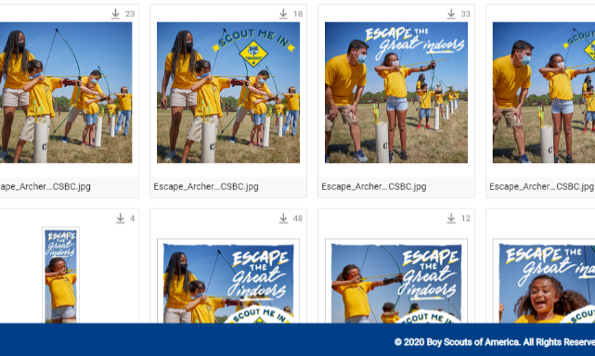
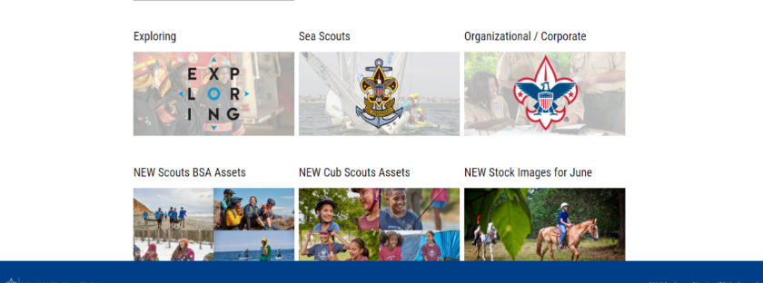
Notes:
Recruiting assets on the site are popular. The five questions videos and “Scout Talk” videos are popular for recruiting. Check them out.

Slide 20
Notes:
This is new… on the BSA Brand Center and on Scouting.org/recruitment you’ll find ads for Supply Groups annual Fall Uniform Offer.
Share this! It’s a great time to upgrade your uniform – and to help make sure our new families get they need from their local Scout Shop.

Slide 21
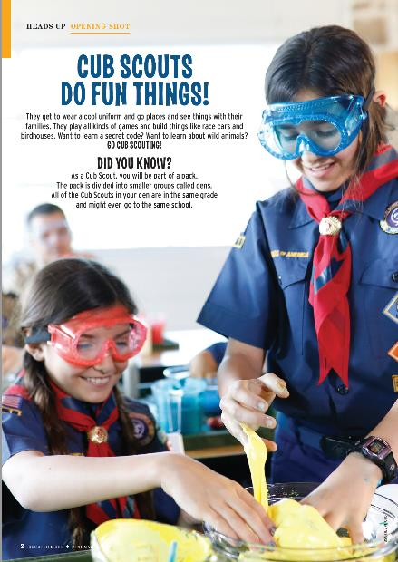
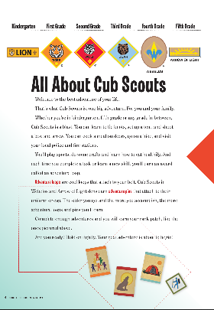
Notes:
The Scout Life Mini-Mags are available on the BSA Brand Center in digital format.
These are not just small versions of the magazines – they have lots of great information on Cub Scouting and why you should get involved!
There are several versions including versions that can be printed on an computer printer and versions that can be printed professionally.
(Preprinted versions are not available – sorry!)

Slide 22
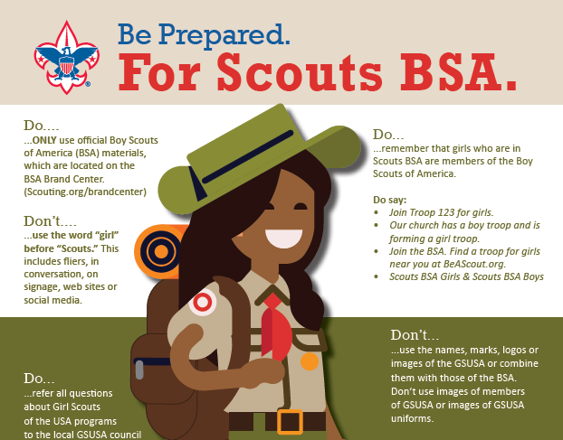
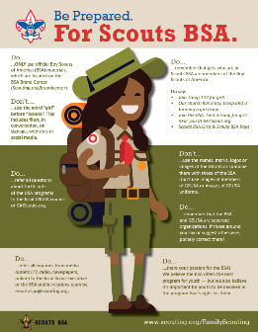
Notes:
An important reminder… help protect our brand.
We never put the word ‘girl’ in front of Scout or say “Girl Scout troop”.
You can find this infographic on materials have been on brand center and distributed widely for several years. If you have questions please refer to the infographic on the brand center or see the articles in the ScoutingWire.

Slide 23
Paid Search Nationwide
Notes:
We want parents to be able to find us, so the BSA has paid search up through Google yeararound. So if someone searching for Cub Scouts, they’ll get a link to BeAScout.org

Slide 24
The BSA is hosting membership and marketing webinars throughout the summer. You can find a listing, recordings of past webinars and link to register for future events at
Scouting.org/recruitment

Slide 25
Tuesday, July 27, 8 pm E/7 pm Central
Register at Scouting.org/recruitment
Notes:
Don’t miss the national membership kickoff on July 27! Register today at Scouting.org/recruitment.

Slide 26
Social Media 101

Slide 27
Q&A

Slide 28
Find all of the webinar recordings here!
https://scoutingwire.org/marketing-and-membership-hub/marketing-webinars/

Slide 29
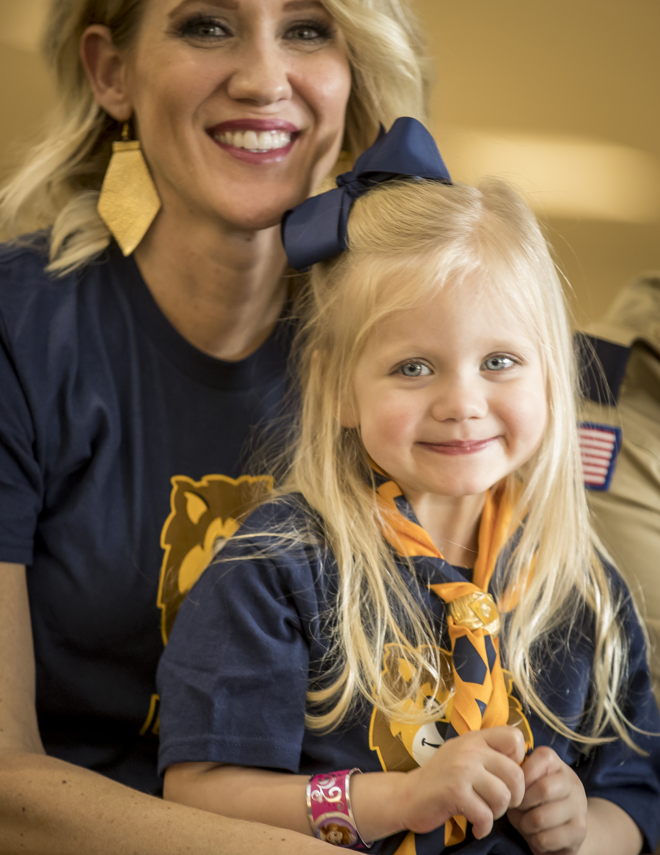
Thank You

