Slide 1
Membership / Marketing Webinar
August 12, 2021

Slide 2
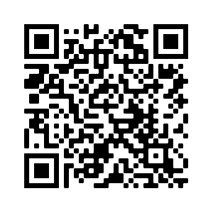
Find all the webinar recordings here!
https://scoutingwire.org/marketing-and-membership-hub/marketing-webinars/

Slide 3
The Panel
Pat Wellen
Director of Research & Strategy
Winnie Lee
Chair of the New Member Coordinator Committee
San Diego Imperial Council
Catheryne Hasley
Den Leader, Pack Committee with Pack 76, District Committee Bay Area Council
Tracy Miller
District Chair
Western Los Angeles County Council
Darin Kinn Marketing Manager for Field Support
Michael Ramsey Director of Marketing & Brand

Slide 4
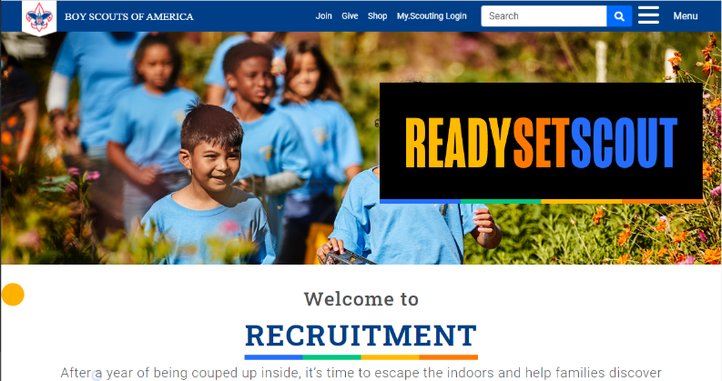
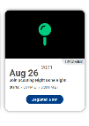
New Membership Marketing Landing Page
Scouting.org/recruitment
Notes:
In the past, you’d have to go to three different pages (or more) to find all of your recruitment marketing materials.
Now there is a new page.
Scouting.org/recruitment is the new landing page for all things on membership marketing. On this site, you’ll find links to recruiting materials, webinars and event.
Check it out!

Slide 5
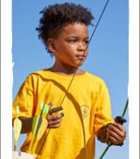
Notes:
Some of you may have noticed a slight shift in the headline treatment of Escape the Great Indoors. Based on very recent research we conducted with mothers of elementary school-age youth, we have shortened the headline slightly to Escape the Indoors. The updated treatment is shorter and easier to read on social and digital media – which are among our primary communications channels. We are making this subtle shift now to the material on the brand center and should be complete shortly.

Slide 6
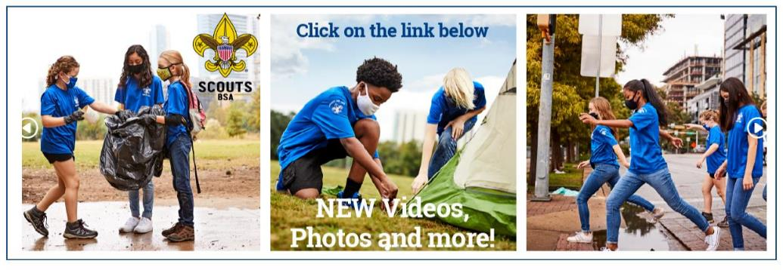
www.scouting.org/BrandCenter
Notes:
The BSA Brand Center is the one-stop shop for marketing assets and resources, including recruiting, Summer of Service, and more. It includes photos, hi-res video, artwork, social posts and much more.

Slide 7
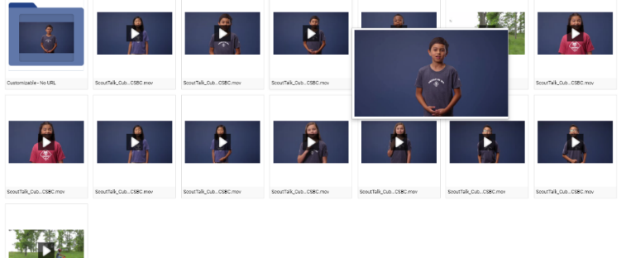
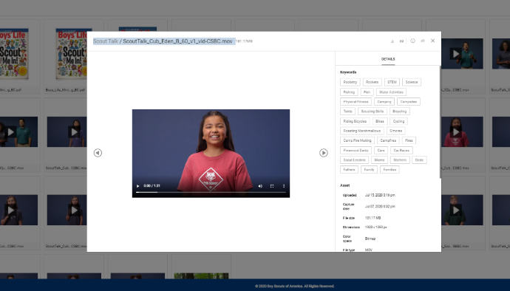
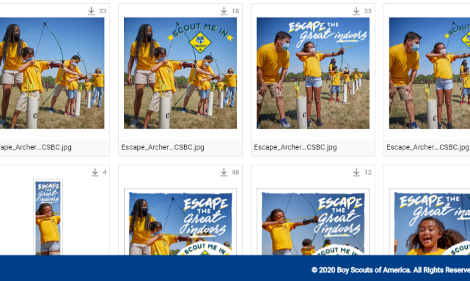
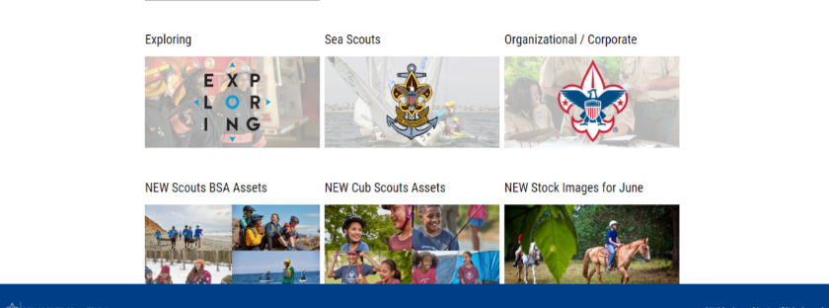
Notes:
Recruiting assets on the site are popular. The five questions videos and “Scout Talk” videos are popular for recruiting. Check them out.

Slide 8
Welcome Back Kit
Copy and graphics for local leaders to use to invite families back to the pack!
Including:
Suggested email copy
Suggested text copy
Social graphics and Social photo frames
Suggested social copy

Slide 9
Welcome Back Kit
Copy and graphics for local leaders to use to invite families back to the pack!
Including:
Suggested email copy
Suggested text copy
Social graphics and Social photo frames
Suggested social copy

Slide 10
Welcome Back Kit
WELCOME BACK SUGGESTED EMAIL COPY
Subject Line: We miss you at Cub Scouts!
Hi there, [NAME], I wanted to send a quick note to let you know that our Cub Scouts pack has started meeting again, and it’s not the same without you!
This year, the pack is meeting at [LOCATION] on [DAY] from [START TIME] to [END TIME]. We’d love to see you. Drop in anytime! If you‘ve got any questions about Cub Scout meetings or your Scout’s rank and status, feel free to send me an email or give me a call at [PHONE NUMBER].
Hope to see you soon!
[DEN LEADER NAME]

Slide 11
Your Pictures Here…

Slide 12
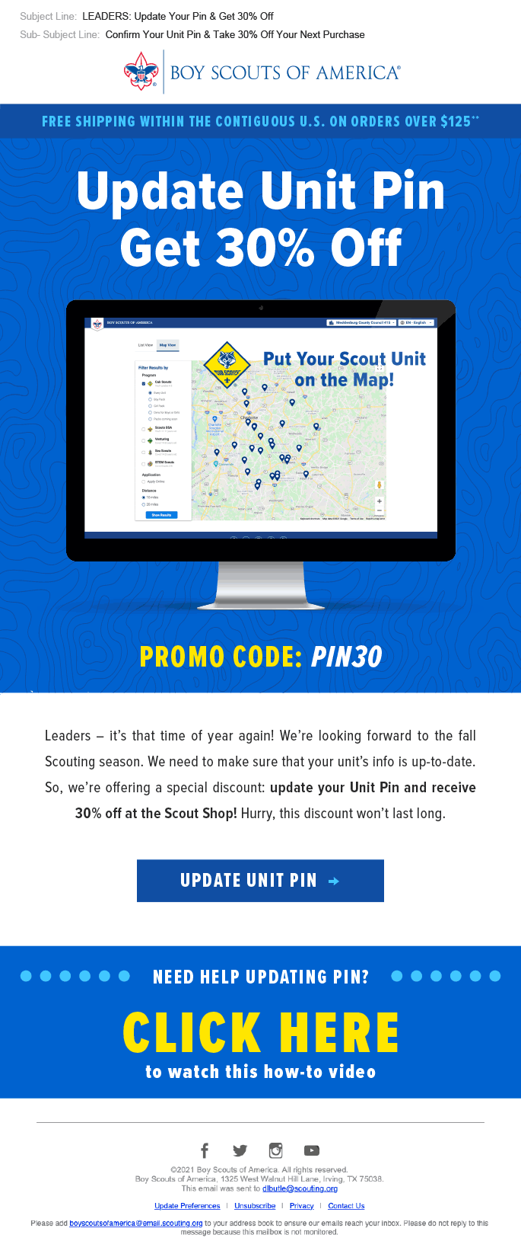
Update Your Pin Get 30% Off
Update your BeAScout.org unit pin and get a promo offer from Scout Shop of 30% off.
Included:
Suggested email copy
Suggested text copy
Social graphics and Social photo frames
Suggested social copy

Slide 13
Discount Code: BSA2019

Slide 14
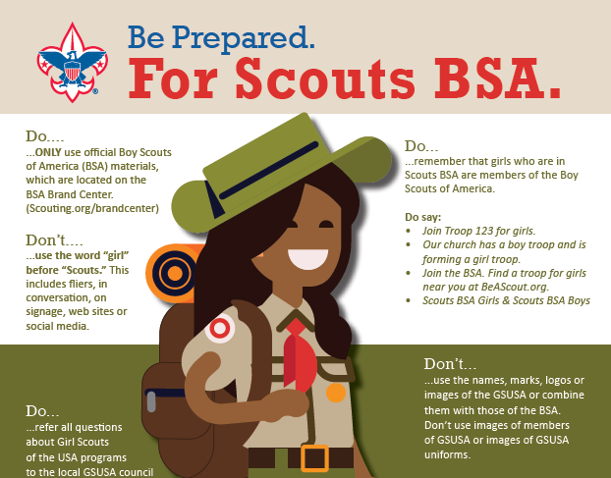
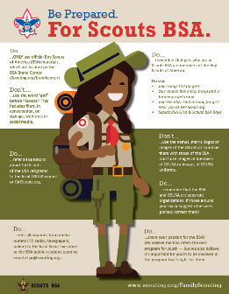
Notes:
An important reminder… help protect our brand.
We never put the word ‘girl’ in front of Scout or say “Girl Scout troop”.
You can find this infographic on materials have been on brand center and distributed widely for several years. If you have questions please refer to the infographic on the brand center or see the articles in the ScoutingWire.

Slide 15
Pat Wellen Director of Research and Strategy

Slide 16
Net Promoter Score
59.3% joined because of a personal recommendation from someone they know.
2019 Cub Scout New Member Joining Study.
Notes:
Onboarding begins with the first interactions the family has with the unit. That could be your website, a flyer, or a person in your unit. 59.3 percent of new youth joined in 2019 because of a personal recommendation from someone they know. Activating your families to make the ask – invite someone to join is the first step to a great onboarding experience.

Slide 17
What Drives Unit Level Satisfaction
 | Cub Scout Parents Unit sat. | Scouts BSA Parents Unit sat.
I have support from leaders that help me be a more effective contributor | 1
We have great outdoor activities | 2 | 1
Our family/I feel like we belong in our unit. | 3 | 2
Scout meetings are a good use of our family time. |  | 3
Top 3 Drivers
Notes:
Understanding what drives unit level satisfaction will help you also understand the key elements you need to focus on when onboarding new families – for cub scouts that is leaders providing support and information so that the parent can feel like they are effective contributors. Having a great program plan with outdoor activities, and ensuring that you have a welcoming atmosphere in your unit so that new families feel like you are happy they are there and want them in your unit. This will lead to families feeling like they belong in your unit – these are my people.
For Scouts BSA troops you can see that having a great program plan with outdoor activities is paramount, having that welcoming experience so that they feel like their family belongs in the unit, and having youth leadership that has a planned program so that Scout meetings are a good use of their time are the things that drive unit level satisfaction – this is what keeps youth and families in Scouting.

Slide 18
Parents who said their joining experience was not very or not at all easy
Lack of communication, nobody ever called or emailed
Lack of onboarding information – they did not know who to call.
2019 Cub Scout New Member Joining Study.
Notes:
More than 80% of families indicated their joining experience was easy or very easy. So, we are doing pretty good, but 20% or one in five says they did not have a good experience because – of a lack of communication from the unit and also because they did not receive any information about who to call of when and where the meeting time was. These parents are not feeling the support from leaders so that they can be effective contributors nor are they feeling like they are welcome or that they belong in this unit.

Slide 19
Reasons for leaving
Cub Scout Parents
Our family did not feel welcome – 20.6%
Scouts BSA Parents
Our family did not feel welcome – 17.0%
Notes:
And these numbers correspond to the percent who left telling us that their family did not feel welcome in the unit. – so welcoming is not only important during recruitment, but also in onboarding and retention of these new families.

Slide 20
Welcome to Scouting
Winnie Lee Chair of the New Member Coordinator Committee San Diego Imperial Council Catheryne Hasley Den Leader, Pack Committee with Pack 76, District Committee Bay Area Council Tracy Miller District Chair Western Los Angeles County Council

Slide 21
Find all the webinar recordings here!
https://scoutingwire.org/marketing-and-membership-hub/marketing-webinars/

Slide 22
Q&A

Slide 23
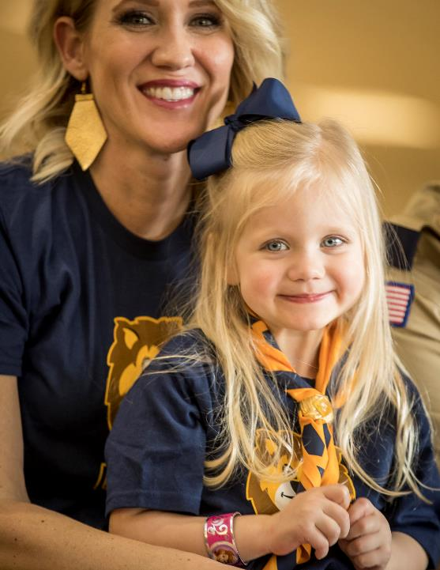
Thank You

