Slide 1
Membership / Marketing Webinar
August 26, 2021

Slide 2
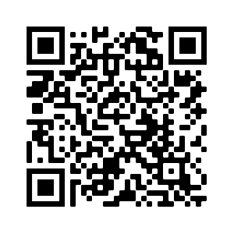
Find all the webinar recordings here!
https://scoutingwire.org/marketing-and-membership-hub/marketing-webinars/

Slide 3
The Panel
Dwayne Jones
Chief Operating Officer/DFS Greater Tampa Bay Area Council Tampa, Florida
Mark Saxon
Scout Executive/CEO Green Mountain Council Moretown, Vermont
Darin Kinn Marketing Manager for Field Support
Michael Ramsey Director of Marketing & Brand

Slide 4
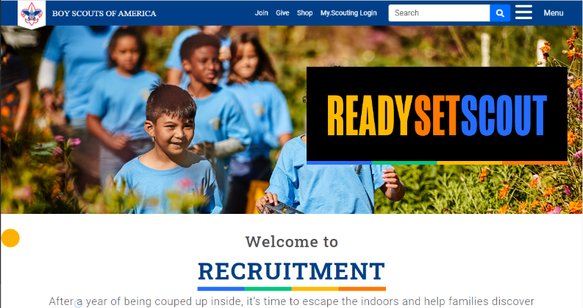
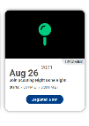
New Membership Marketing Landing Page
Scouting.org/recruitment
Notes:
In the past, you’d have to go to three different pages (or more) to find all of your recruitment marketing materials.
Now there is a new page.
Scouting.org/recruitment is the new landing page for all things on membership marketing. On this site, you’ll find links to recruiting materials, webinars and event.
Check it out!

Slide 5
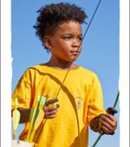
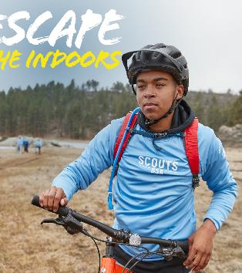
Notes:
Some of you may have noticed a slight shift in the headline treatment of Escape the Great Indoors. Based on very recent research we conducted with mothers of elementary school-age youth, we have shortened the headline slightly to Escape the Indoors. The updated treatment is shorter and easier to read on social and digital media – which are among our primary communications channels. We are making this subtle shift now to the material on the brand center and should be complete shortly.

Slide 6
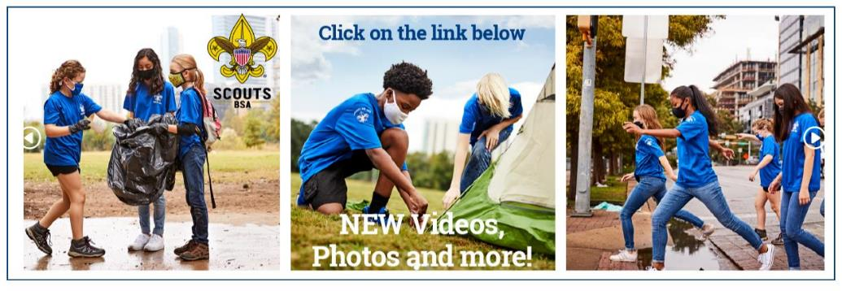
www.scouting.org/BrandCenter
Notes:
The BSA Brand Center is the one-stop shop for marketing assets and resources, including recruiting, Summer of Service, and more. It includes photos, hi-res video, artwork, social posts and much more.

Slide 7
Welcome Back Kit
Copy and graphics for local leaders to use to invite families back to the pack!
Including:
Suggested email copy
Suggested text copy
Social graphics and Social photo frames
Suggested social copy

Slide 8
Discount Code: BSA2019

Slide 9
Dwayne Jones
Chief Operating Officer/DFS Greater Tampa Bay Area Council

Slide 10
Mark Saxon
Scout Executive/CEO Green Mountain Council

Slide 11
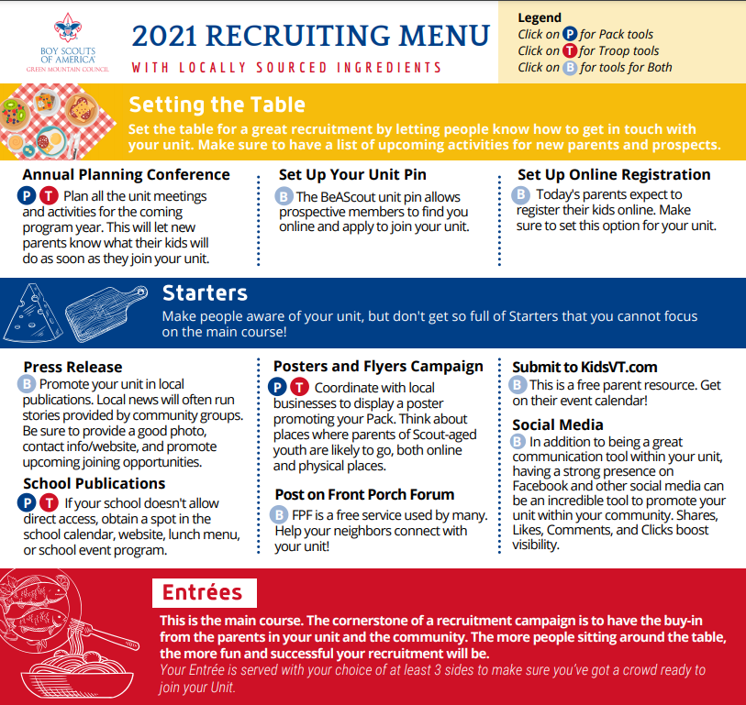

Slide 12
5 Things You Should Be Doing Right Now

Slide 13
1. Connecting with the Leaders in Your Pack and Den

Slide 14
2. Reach out to the school in your neighborhood

Slide 15
Thanks to Kara Hill @ Circle 10!

Slide 16
3. BeAScout.org Pins

Slide 17
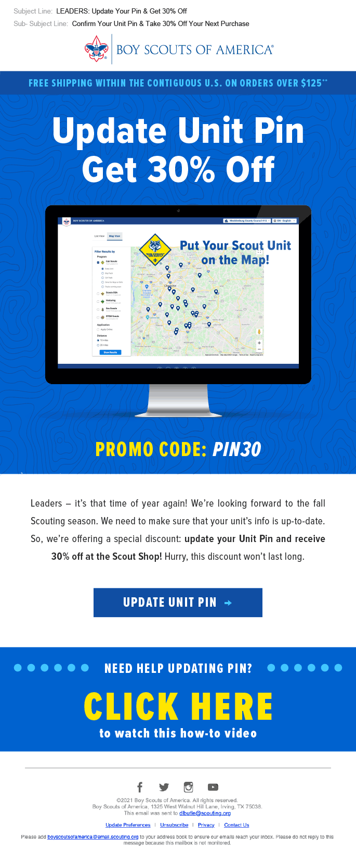
Update Your Pin Get 30% Off
Update your BeAScout.org unit pin and get a promo offer from Scout Shop of 30% off.
Included:
Suggested email copy
Suggested text copy
Social graphics and Social photo frames
Suggested social copy

Slide 18
4. Make a List of Friends to Personally Invite.

Slide 19
Net Promoter Score
59.3% joined because of a personal recommendation from someone they know.
2019 Cub Scout New Member Joining Study.
Notes:
Onboarding begins with the first interactions the family has with the unit. That could be your website, a flyer, or a person in your unit. 59.3 percent of new youth joined in 2019 because of a personal recommendation from someone they know. Activating your families to make the ask – invite someone to join is the first step to a great onboarding experience.

Slide 20
“Friend storming”

Slide 21
5. Use Social Media

Slide 22
Find all the webinar recordings here!
https://scoutingwire.org/marketing-and-membership-hub/marketing-webinars/

Slide 23
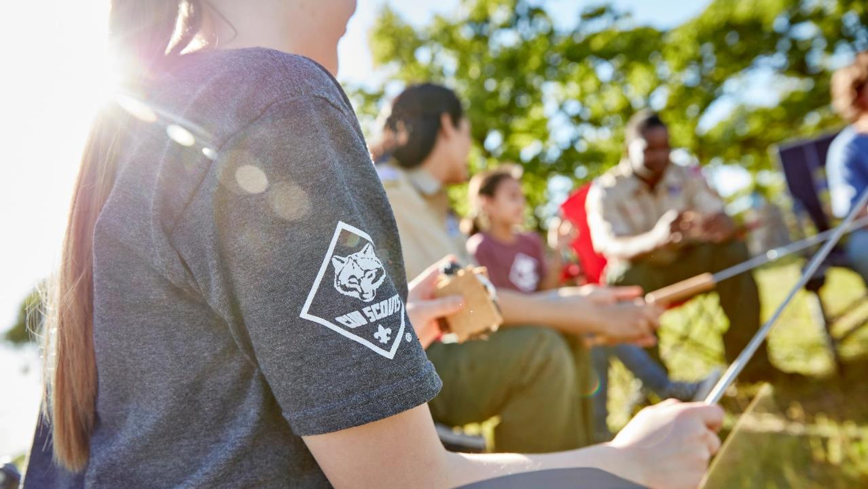
Q&A

Slide 24
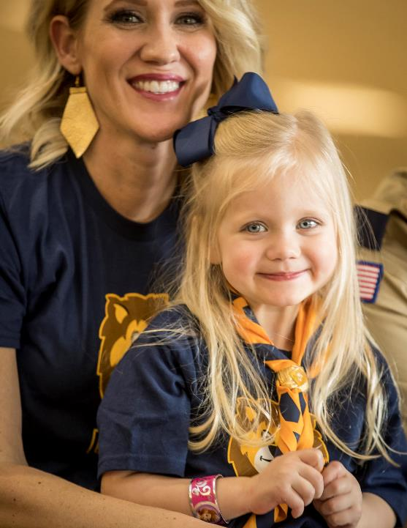
Thank You

