Slide 1
2022 Spring Recruitment Webinar

Slide 2
The Panel
Michael Ramsey National Director of Marketing and Brand
Lisa Wylie National Chair Cub Scouting Committee
Frank Capozzi Seneca Waterways Council, Director of Field Service
Anthony Berger
National Director of Cub Scouting/STEM programs
Otto Goedhart National Director of Membership

Slide 3
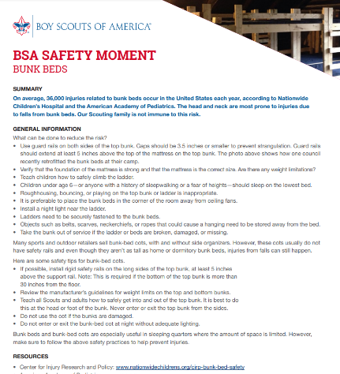
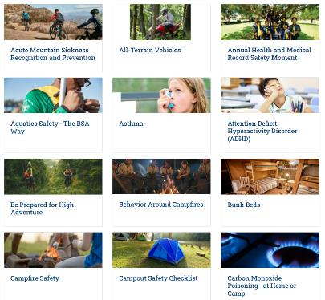
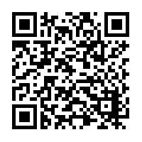
Safety Moment
Safety Moments
https://www.scouting.org/health-and-safety/safety-moments/

Slide 4
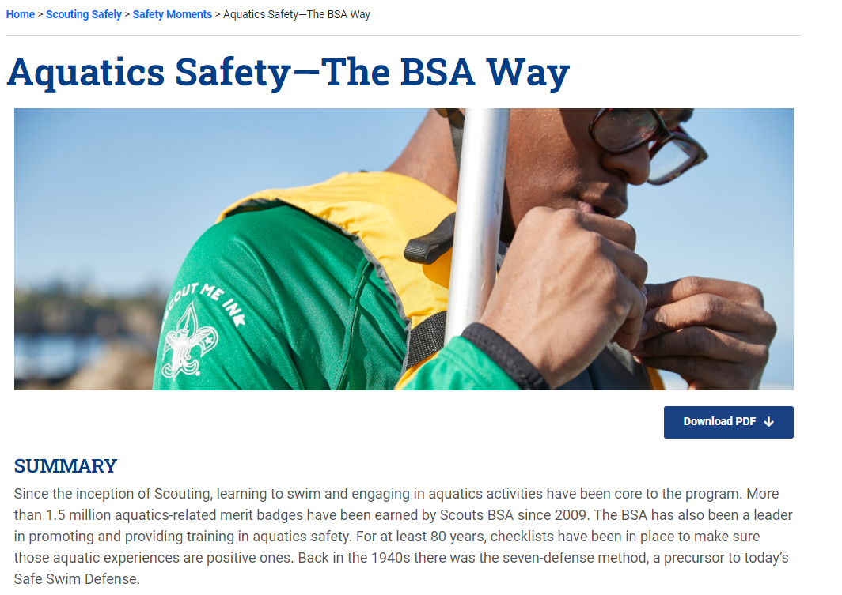
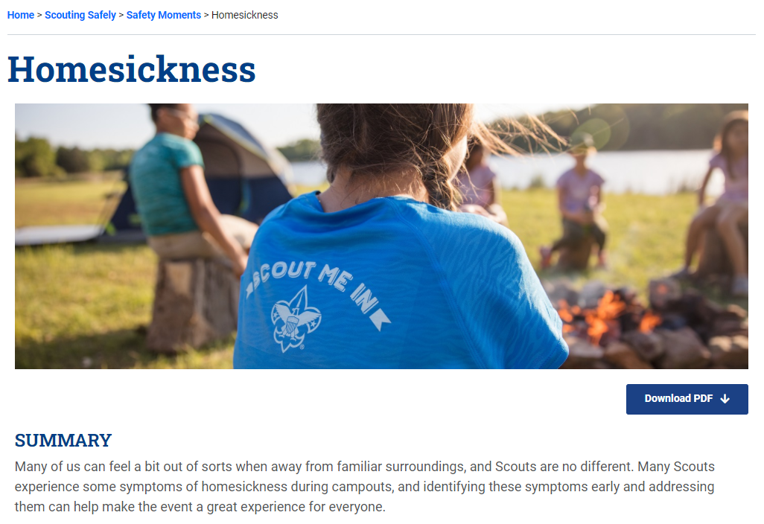
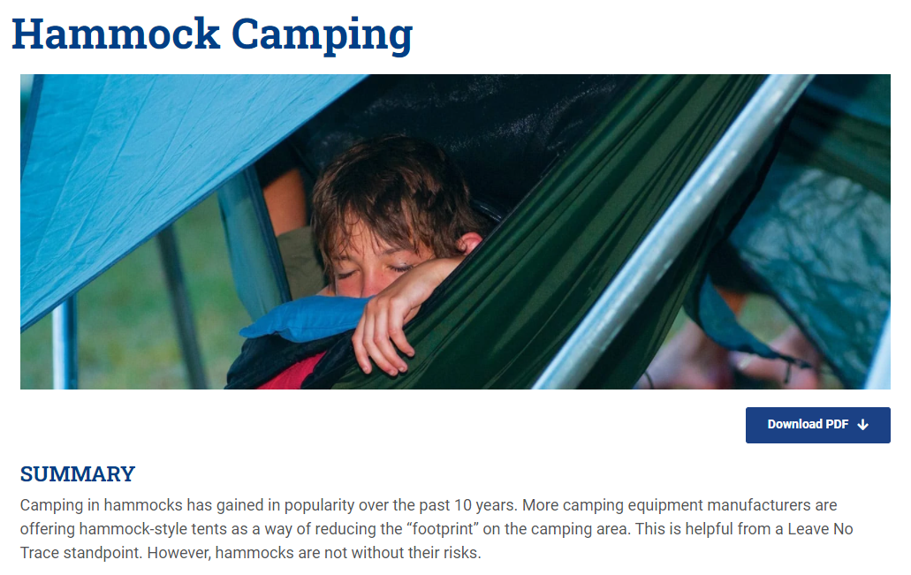
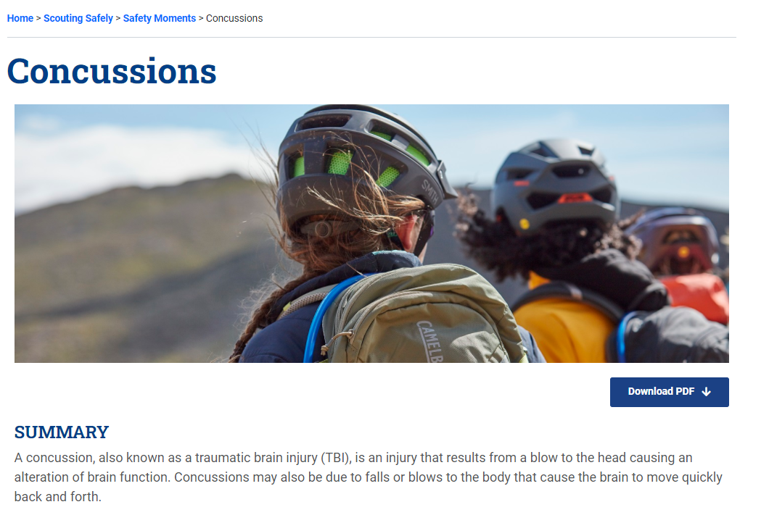

Slide 5
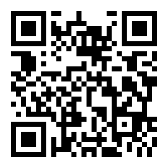
Are you recording this?
Yes…
www.scouting.org/recruitment

Slide 6
Fast Facts…
Notes:
Onboarding begins with the first interactions the family has with the unit. That could be your website, a flyer, or a person in your unit. 59.3 percent of new youth joined in 2019 because of a personal recommendation from someone they know. Activating your families to make the ask – invite someone to join is the first step to a great onboarding experience.

Slide 7
“Families are either extremely or very satisfied with their Cub Scout unit.”
Notes:
Onboarding begins with the first interactions the family has with the unit. That could be your website, a flyer, or a person in your unit. 59.3 percent of new youth joined in 2019 because of a personal recommendation from someone they know. Activating your families to make the ask – invite someone to join is the first step to a great onboarding experience.

Slide 8
“What drives unit satisfaction?”
1. We have great outdoor activities in our Scout unit.
2. I have support from Scouting leaders that help me be a more effective contributor.
3. Our family feel like we belong in our Scout unit.
4. Scout meetings are a good use of our family's time.
5. Our Scouting unit has a welcoming feel to it.
6. I have support from other parents that help me be a more effective contributor.
Notes:
Onboarding begins with the first interactions the family has with the unit. That could be your website, a flyer, or a person in your unit. 59.3 percent of new youth joined in 2019 because of a personal recommendation from someone they know. Activating your families to make the ask – invite someone to join is the first step to a great onboarding experience.

Slide 9
Why Recruit in the Spring?
Notes:
Onboarding begins with the first interactions the family has with the unit. That could be your website, a flyer, or a person in your unit. 59.3 percent of new youth joined in 2019 because of a personal recommendation from someone they know. Activating your families to make the ask – invite someone to join is the first step to a great onboarding experience.

Slide 10
How do packs recruit this spring?
Notes:
Onboarding begins with the first interactions the family has with the unit. That could be your website, a flyer, or a person in your unit. 59.3 percent of new youth joined in 2019 because of a personal recommendation from someone they know. Activating your families to make the ask – invite someone to join is the first step to a great onboarding experience.

Slide 11
Lisa Wylie National Chair Cub Scouting Committee

Slide 12
Normal Friend Activities

Slide 13
Net Promoter Score
59.3% joined because of a personal recommendation from someone they know.
2019 Cub Scout New Member Joining Study. – needs to be updated.
Notes:
Onboarding begins with the first interactions the family has with the unit. That could be your website, a flyer, or a person in your unit. 59.3 percent of new youth joined in 2019 because of a personal recommendation from someone they know. Activating your families to make the ask – invite someone to join is the first step to a great onboarding experience.

Slide 14
Starting new dens…. (Cub Chat Live March 11th )

Slide 16
1. Set a Goal.

Slide 17
2. Recruiting girls if you are a Family Pack.

Slide 18
3. Be found on BeAScout.org.

Slide 19
4. Social Media

Slide 20
Seneca Waterways Council Frank Capozzi, Director of Field Service

Slide 21
Resources

Slide 22
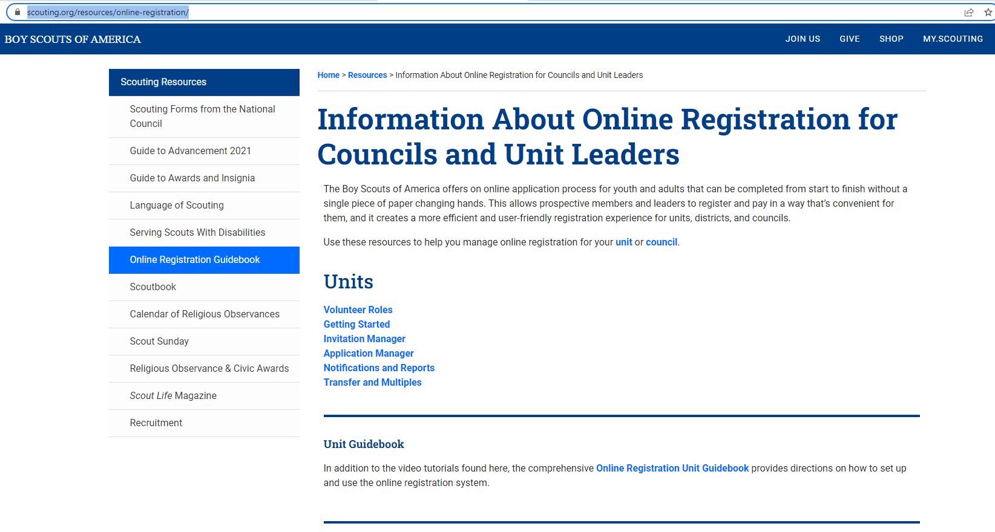
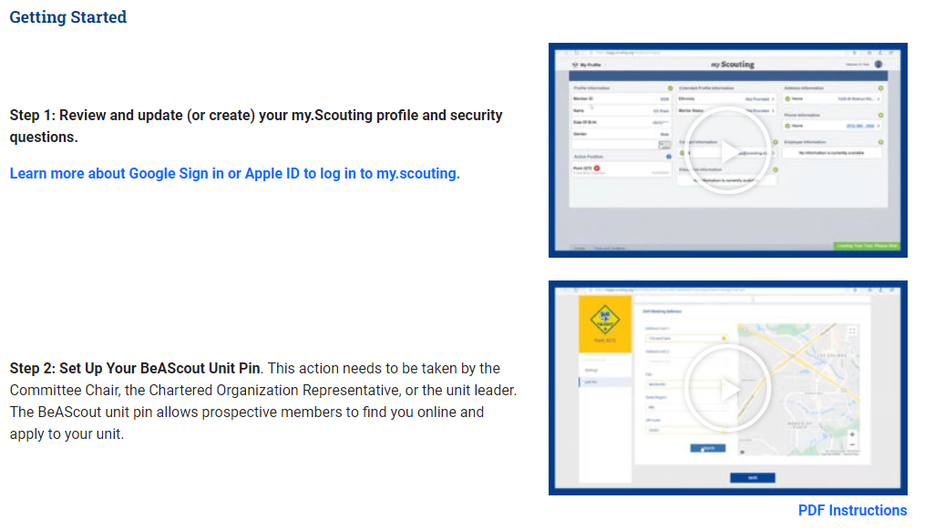
https://www.scouting.org/resources/online-registration/

Slide 23
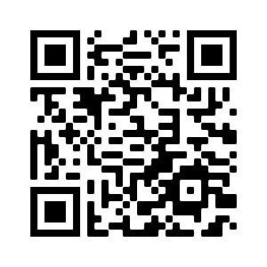
For 2022
Web Banners
Social Images
Adventure-Themed
Deliver brand promise through outdoor imagery
Councils and Units
Available on the BSA Brand Center
Variety of Assets
Digital and print assets available
Posters & Fliers
Post Cards

Slide 24
Safety Moment
Relationships
Relationships
Relationships

Slide 25
Are you recording this?
Yes…
www.scouting.org/recruitment

Slide 26
Thank You

