Slide 1
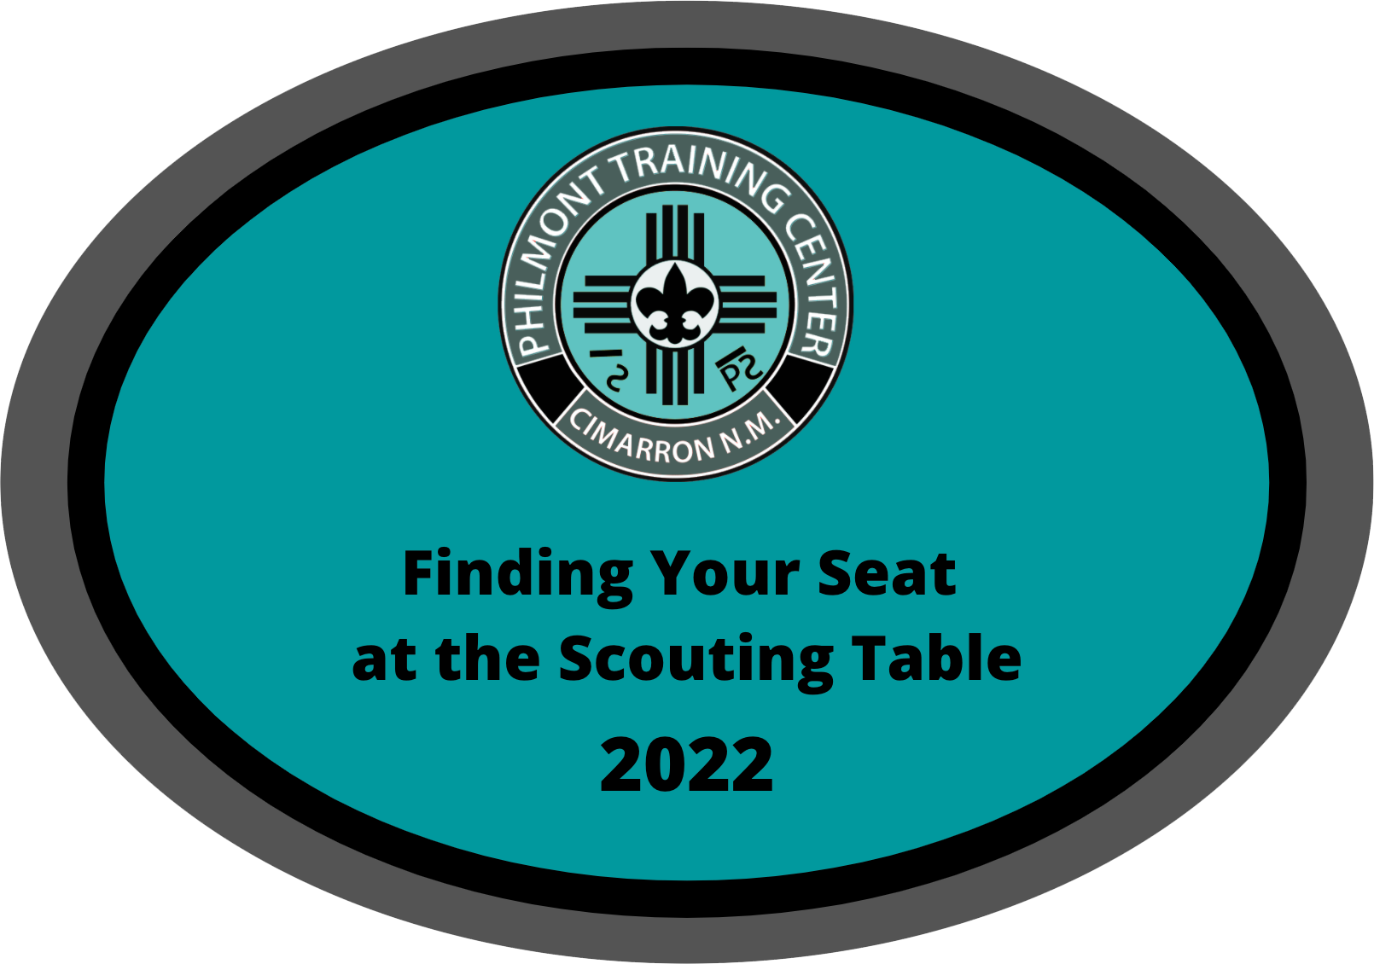
The Path to Membership Growth: Dynamic Recruiting Adapted from: “I Heart Recruitment” Colleen Coffey and Jessica Gendron

Slide 2
BSA Recruiting Facts
We’ve been on a five-decade membership decline
Too many kids join our program, but don’t stay
We have brand problems
We’re not accustomed to competing for kids
We’re a tribe that others don’t understand
if they aren’t legacy Scouters
Notes:
We’re spoiled, joining Scouting used to be a given,
It’s not just recruitment, it’s also retention!

Slide 3
Typical Cub Recruitment A True Horror Story…
PTC 2022
Notes:
The recruitment horror story: A family gets recruited at the school night or seeks out a pack because they're interested in Scouting. They show up at the Pack meeting…
Two often one of two things happen…
no one invests the time to really talk to them. To find out what brought them to the meeting and what they want for their kids. They don’t their questions answered, and they kind of have figure out what is happening in the meeting because no one is supporting them in this first Scouting experience. They probably don’t return!
Or everyone jumps on them because they are the new family and skips right to the close. The family still doesn’t get the chance to ask questions, express their families wants/desires for their child because the unit has already moved to putting on the pressure to join tonight by filling out the form right now, buying a uniform by tomorrow, and taking an adult leadership role in the pack by the next meeting. This overwhelming experience may be the reason they don’t return!
Either the experience is feeling uncared for, or it is being overwhelmed with "have to do's: before they are ready.

Slide 4
Static Recruitment
Static recruitment is time-based and/or event-based.
Eventitis and Dependicitis – Scouting recruitment diseases that place an unhealthy dependence on formal strategies that take a lot of time.
Is your recruitment focused on inviting strangers?
Notes:
This is how Scouting has historically done recruiting. School Join Nights, Spring or Fall Recruitment Campaigns. How fun is it to try and recruit from the Safeway lobby? How stressful is this type of recruitment? Do you look forward to it? How well does it work?
Eventitis and Dependicitis – Characterized by an unhealthy dependence on formal recruitment. It’s a disease that makes units think they have to spend money or a lot of time planning formal recruitment events in order to grow and add new members.

Slide 5
Dynamic Recruitment
Dynamic recruitment is continuous and intentional
It happens via everyday interactions that over time produce recruitment results
NFA = Normal Friend Activities
Friends inviting friends
Notes:
Dynamic is the year-round process of proactively seeking youth/families through everyday intentional interactions with friends. acquaintances, colleagues, etc. that over time produce recruitment results.
Friends inviting friends – you can’t recruit who you don’t know – Explain Normal Friend Activities Scouting seems way more normal when we invite people to do normal things, i.e. uniforms and regalia, rank advancement, Courts of honor, and Wood badge, are not the place to start.
NFA ideas:
Movie night, bowling, a hike, BBQ in the park or your backyard, pool party, disc golf, etc.

Slide 6
You don’t have to be great to start, but you have to start to be great. - Zig Ziglar, American Author
PTC 2022
Notes:
The dynamic recruiting approach is all about helping our units know how to be better, more intentional and more focused when it comes to getting the membership recruitment and retention results they dream of for their unit.

Slide 7
You’re only as strong as your weakest link…
The Basic Ingredients of a Unit are People and Purpose
A purpose without a group of people is an idea.
A group of people without a purpose is a crowd.
We have to start by knowing:
What is your unit’s purpose?
What dream for your unit unifies your youth and adults?
What motivates your unit to work towards
achieving outcomes?
This tells you what kind of members you are seeking!
Want your unit to stay fresh and focused?
As you recruit new members, how often do you re-evaluate
your unit’s purpose and outcomes?
Notes:
You’re only as strong as your weakest link…You’ve all heard that before right? You know why, it’s true! We’ve all committed to upholding the Scout Oath and Law. Our success is determined by how we bring that commitment to life when we live the values. In practice what that really means is we need to continually grow the quantity and the quality of our membership.
What are the basic ingredients of any unit – people and purpose, without people our oath and values are just ideas. Without our values/purpose we’re just a crowd.
So once we have our people, we have to start by knowing what our purpose is and what outcomes we as a unit are motivated to achieve. What dream for your unit motivates and unifies your youth and adults to work toward outcomes? Knowing this helps you know what kind of new members you are seeking.
And as you continually recruit new members, you must also continually re-evaluate your purpose and the outcomes you want for your unit. The cycle is endless, as long as it isn't ignored and it keeps a unit fresh, motivated and focused.

Slide 8
A.C.E. Your Values
A – Achieving, C – Communication, E – Expecting
Has your unit discussed how your activities and
the way you make decisions relate to your values?
5 Minute Activity
List your unit's values on the left
List how you communicate those values to potential members in the middle
List how you set expectations for living your unit’s values
with both your current and new members on the right
When you ACE your values you create a stronger public image,
and get more people involved in Scouting
Notes:
To achieve your values you must first know and embrace them. And then you must be unified around working to achieve them.
Your words and actions in public are clearly communicating your beliefs. People who meet your unit members will interpret their words and actions as a statement of your units values. This is great, IF the message you’re communicating is consistent with your unit’s purpose and values. So the question is, what exactly is the message your unit is communicating?
You must expect the values of the organization to be upheld by your members and your potential members. This means we hold each other accountable to the oath and law we al committed to.
When you ACE these values you: create a stronger public image, get more people involved in Scouting, prepare new Scouts and Scouters by helping them to understand the BSA, and you establish a benchmark that helps you to evaluate potential new members.

Slide 9
Let’s Talk about Motivation
Most people will work as hard as their dream is important to them. THEIR dream, NOT yours! What is your unit's BIG DREAM?
Wouldn’t it be great if our pack/troop……….
With more quality members:
What could your unit do?
What could your unit have?
What could your unit become?
Don’t get the post charter blues
Notes:
The most important thing to understand about motivating others is that most people will work as hard as their dream is important to them
Does your unit have a powerful, compelling reason to recruit? What is your big dream?
Try this exercise, have everyone complete this sentence….Wouldn’t it be great if our pack/troop…………..Spend a meeting building your unit’s collective dream. Start by letting members build their own individual dreams, and then do it collectively as a unit and see what everyone wants to achieve together.
Does your unit have a dream right now? Something to shoot for? Do you youth and families have a powerful, compelling reason to “own” all the tasks needed to make recruiting work?
Post charter blues sometime occurs when a group has been working for a long time to start a pack or a troop. U[p to that point all of the groups efforts and focus were on their dream of starting a unit. Once all the pieces are in place and the unit is chartered the blues set in. The group grows bored, loses focus and you often lose some members. Almost all new groups experience this and the reason why is simple, their only dream was to become a BSA [pack or troop. Once that dream was fulfilled there was nothing else left to work for, there was no more motivation. THEY NEED A BIG DREAM.

Slide 10
What can you do about unit apathy?
Can you relate to any of these statements?
It feels like no one in my unit cares
I’m carrying the weight alone right now
I can’t get anyone to help
Not everyone wants our unit to grow
The Tale of Mules and Horses
Notes:
Have you ever run into that person in Scouting who isn’t interested in hearing any of your ideas. When you try to engage them in a conversation about something you want to try they typically respond by saying, well when I was Scoutmaster twenty-five years ago this is how we did it. Or maybe you know the person who never brings any new ideas to the table, but who always has at least one reason why your idea won’t work.
Now think about the person who you are always excited to talk to. They listen to your ideas and help you improve them. They share their own ideas, and they ae willing to roll up their sleeves and get to work right alongside you.
Mules and Horses don’t just live on the farm ladies and gentlemen. How many of you have ever tried to push a mule? What happens? They push back; and if you push a second time. Well, you just might get kicked in the face. You can never force a mule to do what you want them to do.
So, consider how much time you've spent standing behind the mules in your unit trying to get them to move and make the decision to STOP PUSHING!
Instead choose to spend your time recruiting the HORSES. In a fraction of the time you've spent trying to get the mules to move, how many workhorses could you have recruited who would eagerly help you to achieve your unit’s big dream? Always leave the door open for your more apathetic and challenging members, invite them to get more involved, but stay focused on working with your horses. Your motivated, high-quality members who want to help your unit grow to serve more high-quality motivated workhorse members.

Slide 11
Know Your Audience
Always Joiners =15%
Maybe Joiners = 70%
Never Joiners =15%
FOCUS on the Maybe Joiners – They are your Most Important Group.
Why are they a MAYBE?
Have never been invited
Don’t know much about Scouting
Have made an assumption that Scouting is “Not for me”
Where do you find them?
Mind joggers activity
Congratulations, you just created a Friends List.
PTC 2022
Notes:
Always Joiners =15% describe themselves as likely to join when surveyed
Maybe Joiners = 70% these are the people who do not know or do not care a whole lot about Scouting. BUT they could be convinced to join if Scouting was presented to them in the right way.
Never Joiners =15% are adamantly opposed to joining BSA, they wouldn’t join a unit if you could guarantee them their son or daughter would eagle and get a college scholarship due to Scouting.
FOCUS on the maybes, These are the people who probably do not have family members who were/are Scouts. They don’t know yet what Scouting is really about yet. These families are not going to attend a School join night or seek out info about Scouting, in fact they probably think this Scouting stuff is kind of “weird.”
WE MUST GO TO THEM, They aren’t coming to us.
BUT here is your motivation: these are the people you can move to join if you invest the time to answer their questions and dispel their assumptions.
Mind joggers:
The first and most important step is to generate a list with basic information about as many people as possible. We’ll call it a Friends list. Here’s how to do it. Write down every family/youth you know and their contact info --phone # or email. Put everyone down, now is not the time to decide if someone is interested or qualified. Here are some prompts to help: write down everyone you know who is:
Loyal, trustworthy, and kind
Service minded
Value family and friends
Live on your street or in your neighborhood
Are on any of your kids sports teams
Goes to your kids school
The people you work with, are in your book club, gardening club, etc.
Families who go to your church
Family members whose kids aren’t Scouting
Go to your gym, yoga class, running group
Are your hiking or walking buddies
Are in the contacts on your cell phone
This exercise can be done by the adults in a pack. In a troop the list of mind joggers may change a little and it can be done by your youth. How many names can you generate, 20, maybe even 50? Now combine everyone’s names into a Friends List for your Unit, put it all into an Excel spreadsheet or a google sheet.
If you do this exercise in your unit once a month it only takes about 15 minutes. Now you’re ready to hold an NFA and go make some new friends!

Slide 12
Know Your Product
How do you “sell” Scouting during static recruitment?
Does your unit understand the value of the BSA, what we add to the lives of our members, and the value we provide to the community?
Think about your potential new member – How can
Scouting in your unit make their individual
life better?
Notes:
Don’t think of yourself as a salesperson, think of the outreach as connecting people to something that might change their lives. You are giving them an opportunity, you’re not selling them something.
What value does our unit offer its members?
What value does the BSA offer you? What value might it bring to the next member of your unit?
Why is it worth the investment of time, energy, passion and money to join Scouting and your unit?
Your units' features are the things you do as a unit- camping, hiking, earning merit badges, high adventure,
Benefits are much deeper; they show a potential member how they will personally benefit from becoming a member of Scouting. Benefits are the way your features will add value to the lives of your members. What is the ROI? What Return will they get on their Investment?
Look for people who share your units vision. People do things for their own reasons not yours, so your goal is to stimulate THEIR inner motivation.

Slide 13
Understand the Value of your Product
Excuses, excuses…
Money
Time
Sports
I don’t like camping, don’t know how, don’t have equipment
Scouting is weird or for the nerds
Speak from your own experiences.
Use Feel, Felt and Found…
Do NOT lie, share half truths, dismiss, or fail to listen
Keep it simple!
Notes:
One of the most important aspects of Know your Product , is how to handle excuses.
It’s imperative to know Scouting well enough to be able to get around all the excuses which inevitably pop up when asking your potential members to join.
You need a surefire way to get past these excuses. FEEL, FELT and FOUND are your assets. These three little words will guide your honest, authentic, quality response and provide a framework for handling these excuses in the future.
Let's take a common excuse, we don’t have the time in our family right now to add in Scouting.
Respond from your own experience, you might say: “I know how you FEEL, I FELT the same way before my family joined. We were already trying to go in so many directions and it’s not easy accommodating all of our schedules, What I’ve FOUND however is that its really wonderful to have an evening where our whole family is going to the same place and sharing in the same activity. It’s brought us closer together and at least one night a week we don’t have two cars with part of our family going to different places for different events.
But ALWAYS tell the truth and speak from your own experience. Feel, felt and found gives you a way to get the heart of the potential new member’s excuses, You'll be surprised how well it works.
Never ever lie to potential members
Don’t dismiss, If it makes them concerned, it’s valid. Don’t ignore or suggest that their concern is not an issue. Explain it!
Make sure you really listen that you understand their needs and concerns before you start sharing your autobiography!
Understand the value your unit has to offer and be well prepared and able to share that message with anyone who wants to hear about it. The ideal way to handle excuses is by facilitating a genuine conversation with good follow up questions so that a family can come to the conclusion, on their own, that the concern is not something that should keep the from joining Scouting.

Slide 14
Develop Your People Skills
Think of NFA’s like the dating process
What is everyone’s favorite topic?
Master the F bombs: From, Family/Friends, Favorites, Firsts, & Fun
Use plus one, bridging, next meeting
PTC 2022
Notes:
Think of NFA’s like the dating process – the goal is to get to know each other before you pop the question. This means you can’t rush to close the deal,
The easiest way to get to know a new person is to keep the conversation focused on them. Learn their name, You know what everyone’s favorite word is, THEIR NAME. and you know what everyone's favorite topic is, THEMSELVES. Start there .Don’t even both er talking about yourself or about Scouting (unless they ask you and even if they do ,keep it brief). You are trying to learn about them, what they like, what they don’t , what they do, what they want to do, etc.
So now let's talk about the F-Bombs – I.e. Five Fabulous Ways to master a conversation. The goal of these is to give you open –ended questions that build rapport and help you to establish common interests.
FROM: Where are you from? How did you end up here? What is your hometown like? How often do you get to go back?
FAMILY/FRIENDS: How do you know INSERT WHOMEVER INVITED TEHM? What does your family like to do together?
FAVORITES: What do your kids like to do? What is your family’s favorite restaurant? Where do you like to go on vacation?
FIRSTS: what do you think of your son/daughter’s school so far? What are the highlights of this past year for your kids? What was your first impression of…?
FUN: Where does your family like to hang out on weekends? What do you do outside of work? Seen any good movies lately? Where is your family going for Spring Break?
Effective recruitment happens when you use the Plus One method. Plus one means that in any conversation, you should have as many members as potential members in the conversation, PLUS ONE additional current member. Meaning that the most effective conversation is not one-on-one, but two members and one potential member.
Bridging is the way you add another person to your conversation. Pretend that the person you just met says that he/she loves camping and you have a member of your unit who is planning a big camping trip for the unit coming up soon. You become the bridge between the potential member and the current member using that connection.
Never miss the chance to invite your prospects to the next meeting. Know what that is ahead of time, so that you can seize the moment to keep them engaged.

Slide 15
Repeat, repeat , repeat…
Review your big dream at every meeting.
Review names list and recruitment status at every meeting.
Continue to add names
Continue invitations to NFA’s/meetings
Continue to tweak your process via feedback
Continue positive feedback for your horses
KEEP THE FOCUS ON VALUES

Slide 16
Continuous Implementation
Steps 1-2 Create a BIG DREAM.
What could your unit do if you had more youth and adults?
Steps 3-6 Learn, explore, practice.
Get excited about growth – create names list, do normal friend activities, don’t forget the pre-close
Step 7: Implement, repeat and ask for feedback.
Start, Stop, Continue, Exit interviews

Slide 17
“You gain strength, courage and confidence by every experience in which you really stop to look fear in the face… You must do the thing you think you cannot do.” - Eleanor Roosevelt
PTC 2022

